Slide 1
Bacterial infections- Pyodermitis
Factors:
⬇ loss of skin cover integrity
⬇ degree of germ contamination and pathogenicity
⬇ decrease of the antimicrobial defence of the host (chronic alcoholism, diabetes mellitus, cirrhosis, malnutrition, congenital or acquired immune deficiencies)
⬇ hyper-hidrosis, skin irritations, tight clothes and poor hygiene are contributing factors.

Slide 2
Bacterial folliculitis
Staphylococcus aureus
Superficial Folliculitis
Very common condition, affecting the follicular ostium. May result from hair removal, shaving, waxing or minor trauma.
Clinically: small follicular papules/pustules located on the scalp, neck, trunk (children), the beard, buttock, legs and trunk (adults). No pain, no general symptoms.
Treatment consist in topical antiseptics and antibiotics.

Slide 3
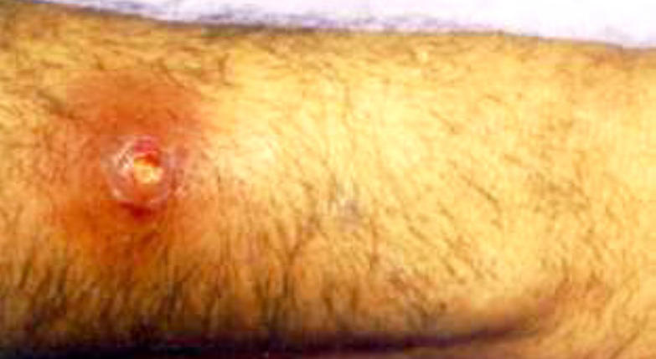
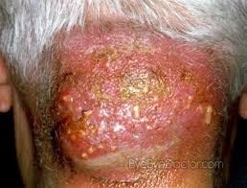
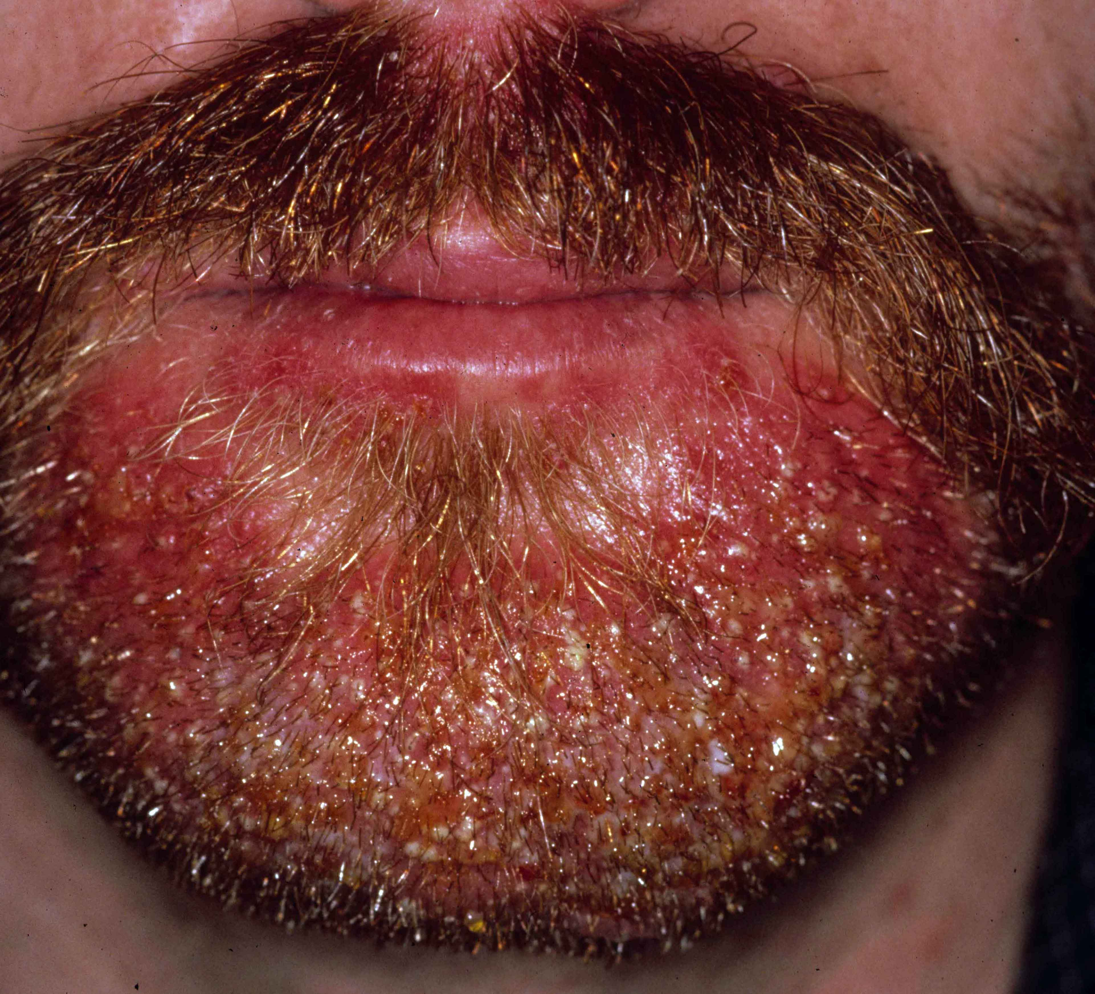

Deep Folliculitis- deeper in the hair follicle with abscess formation
Furuncle/Boil: infection of the hair follicle + the surrounding structures
Perifollicular abscesses followed by necrosis with follicular destruction.
Clinically: small inflammatory nodule, that in evolution becomes pustular and necrotic; lesions are painful and leave permanent scars.
Location sites: face, neck, wrists, buttocks or anogenital region. Those located on the upper lip, or on the face are dangerous, because cavernous sinus thrombosis may occur.
Systemically treatment with penicillinase-resistant antibiotics is necessary, also topical antibiotic agents.
Carbuncle: deep infection of a group of follicles
usually in men with diabetes, drug addiction, malnutrition, prolonged steroid therapy.
Clinically: a painful, red, hard dome-shaped lump; increases in size up to 3-10 cm diameter and suppuration occurs from multiple follicular orifices. Necrosis follows and sometimes leaves a deep purulent ulcer. Fever and malaise are present. It heals with permanent scar and in sever ill patients evolution may be fatal, because of toxaemia and systemic spread of infection.
Sycosis: deep infection of the hair follicle on the beard. Collar button/ Hourglass-shaped abscess
Lesions are oedematous, red papules/ pustules centred by hair. In evolution, lesions coalesce and form plaques. Lupoid sycosis is the term used if the follicles are destroyed and the healing is with scar.

Slide 4
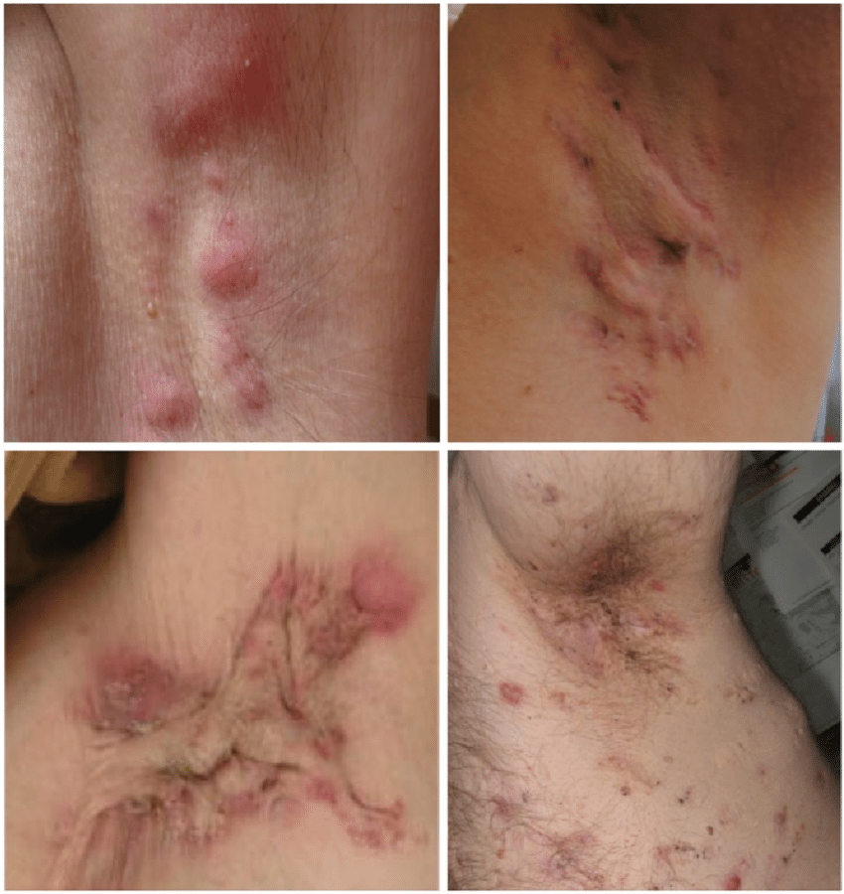
Bacterial infections of apocrine sweat glands
Staphylococcus aureus
Hidradenitis- commonly involving the axillae area.
Caused by follicular occlusion; usually occurs after puberty, more frequent in women
Clinically: painful, tense subcutaneous nodules, that in evolution can become abscesses without treatment
Verneuil disease/hidradenitis suppurativa- chronic inflammatory, extensive, debilitaiting and recurrent disease
Lesions are in axillae, pubic region, perianal, perineal area, groin and buttocks. Nodules are deep-seated and painful, with evolution to abscesses, draining sinuses and scars. Treatment: topical and general antibiotics. Surgical treatment involves incisions with drainage, curettage, limited or radical excisions.

Slide 5
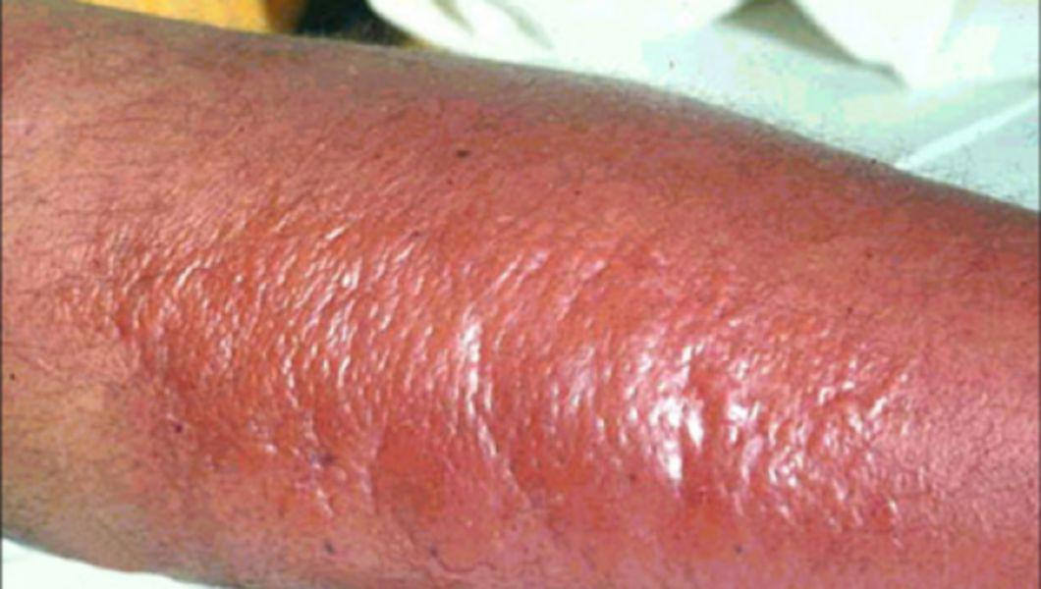
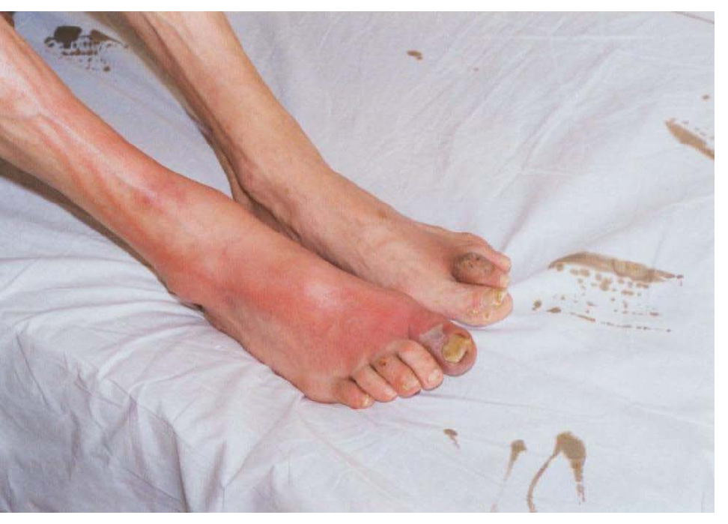
Erysipelas
Group A Streptococcus
Affects the dermis tissue + the lymphatic vessels.
The most frequent location is on the legs, but can affect also the face, the arms.
Risk factors: lymphedema, intertrigo, venous stasis, chronic legs ulcers, lower leg wounds, interdigital fungal infections.
There is an abrupt onset of fever (38-40ºC), malaise or nausea. Local lesion is a painful erythematous patch, with a well-defined and raised edge, blistering and lymphangitis.
The evolution is favourable, after 8–10 days of treatment. Without treatment, complications may develop: fasciitis, myositis, abscesses, septicaemia, nephritis.
Treatment: penicillin 10–20MU/day, intravenous or intramuscular, 10–20 days. Topical antiseptics and antibacterial agents should be applied daily.

Slide 6
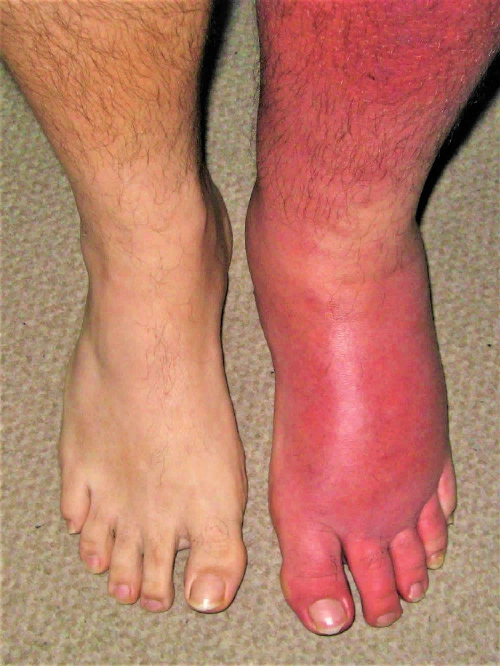
Cellullitis
Staphylococcus aureus/ group A Streptococcus (sometimes both)
Infection is deeper than in erysipelas, affects subcutaneous tissue and lymphatic vessels. Lesions and symptoms: erythema, heat, swelling, pain or tenderness. The edge of the is diffuse. Regional lymphadenopathy is associated.
Cellulitis may extend superficially and erysipelas deeply, so in many cases the two processes can coexist and it is impossible to make a clear distinction.

Slide 7
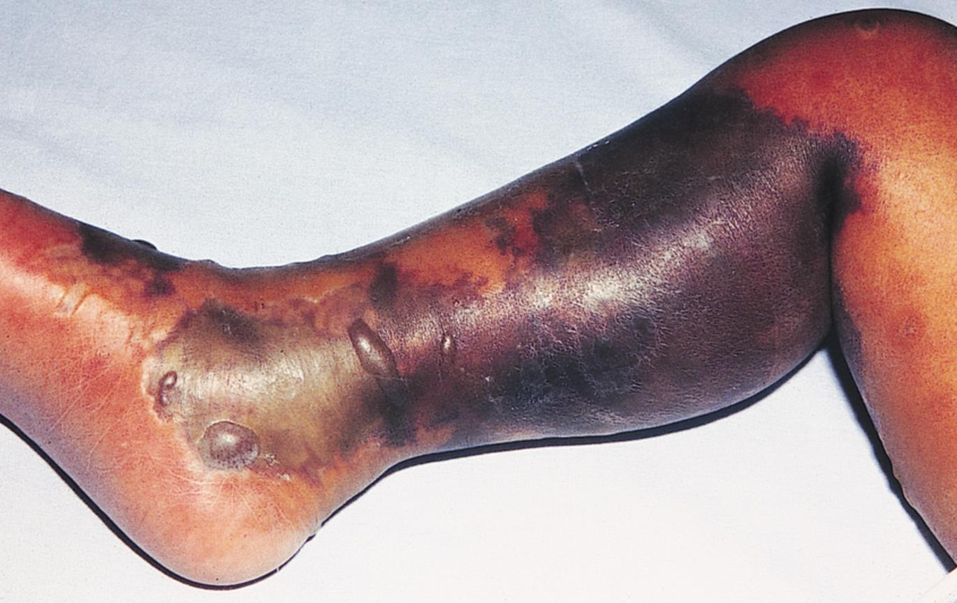
Necrotizing fasciitis
(acute dermal gangrene)
Group A Streptococcus, anaerobic organisms, Staphylococcus aureus or mixed
Risk factors: diabetes mellitus, immunosuppression, cardiac or peripheral vascular disease, renal failure, drug use.
Extremities are the site for necrotizing fasciitis, but also the trunk is often affected in children.
Clinical features: severe pain may be out of proportion to skin findings. Purple and/or hemorrhagic bullae may develop. The area may later become numb, as cutaneous nerves are destroyed. Evolution of the disease can be life-threatening with fever, malaise, leukocytosis, tachycardia and shock.
Treatment should be initiated without delay. Usually it is a team approach treatment, with surgical debridement, systemic antibiotics, daily antibiotic dressings and intravenous fluid and nutrition support.

Slide 8
Ecthyma
Group A beta-haemolytic Streptococcus / Staphylococcus aureus
Deep skin infection
Most commonly, on the lower extremities of children, or neglected elderly patients, or individuals with diabetes.
Poor hygiene and humid climates are favourable factors.
Lesions start as small bullae, or pustules on an erithematous base, followed by adherent crusts with underlying ulceration. Healing is slowly with a scar.

Slide 9
Intertrigo (intertriginous dermatitis)
Streptococcus / Staphylococcus aureus
Infection of skin folds
Commonly affects retroauricular folds, axilla, abdominal folds and perineum
Aggravated by poor hygiene, heat, friction and overweight
It presents as erythematous patches on the skin fold, with erosions, fissures, maceration and yellow crusting
Treatment is with antibacterial and topical steroid agents. Prevention is important: good hygiene, glucose control in patients with diabetes, weight loss, proper clothes for air circulation.

Slide 10
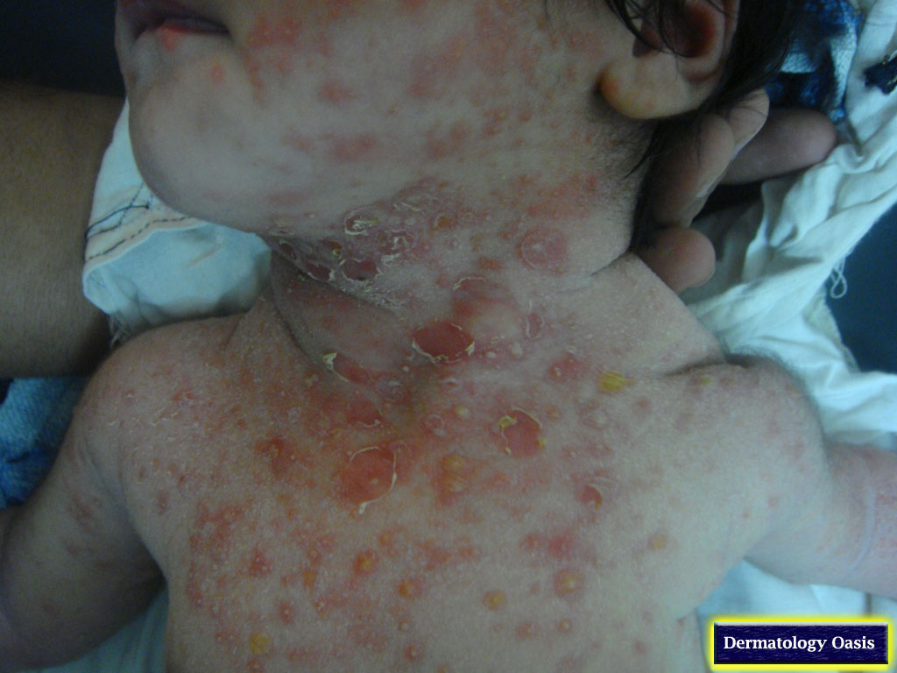
Impetigo
Staphylococcus aureus / Streptococcus pyogenes
Very contagious disease. Children are often affected. Lesions are usually on the face and limbs, on erythematous background, with exudate and classic golden crusting.
Two clinical types:
Vesicle impetigo (Tilbury–Fox impetigo): preschool and young school‐age children are most often affected (3-10 years). Although the face is often affected, the lesions may occur on the scalp and limbs. Clinically: mainly vesicles with evolution to yellow crusting
Bullous impetigo: more commonly in newborn and infants. Lesions are mainly bullae, with clear liquid and inflammatory halo. In evolution the bullae content becomes purulent, with bullae rupture and crusts formation

Slide 11
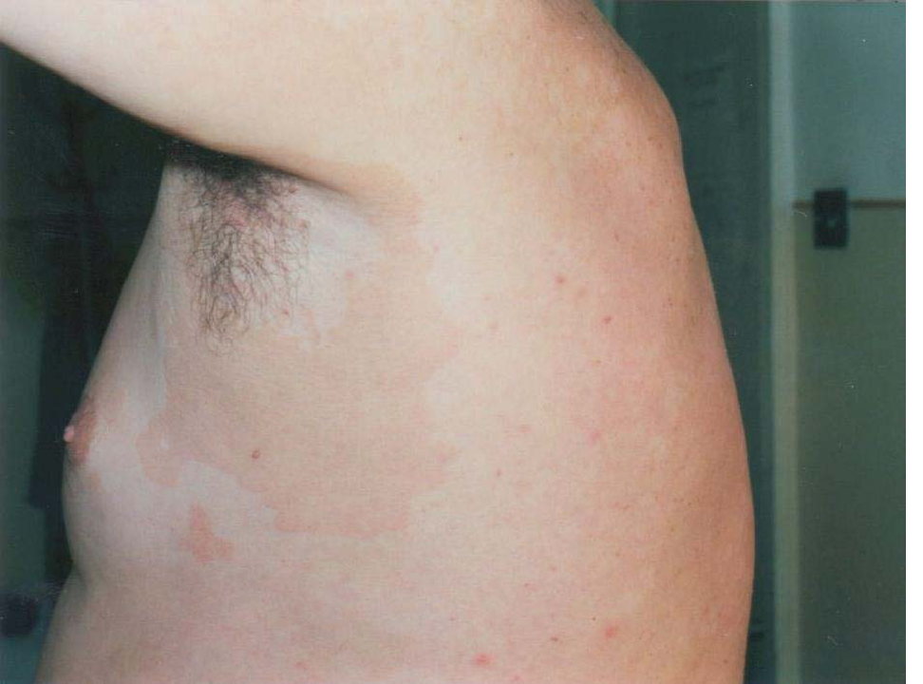
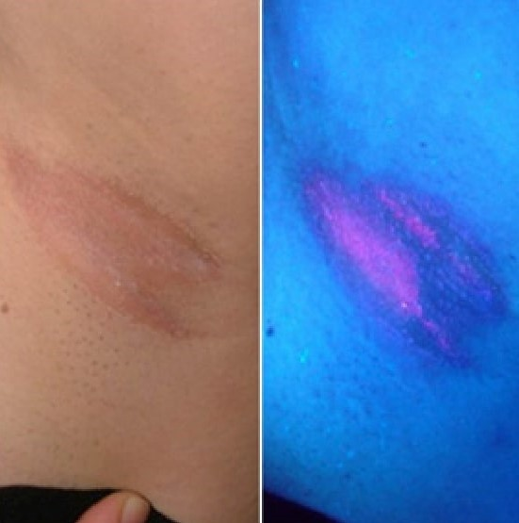
Erythrasma
Corynebacterium minutissium
Affects flexural sites, usually the axillae and groin
Wood’s lamp examination: pink fluorescence
Skin lesions are superficial scaling, on a reddish-brown patch. It can be mistaken for a fungal infection.
Treatment: topical erythromycin, neomycin or fusidic acid.

Slide 12
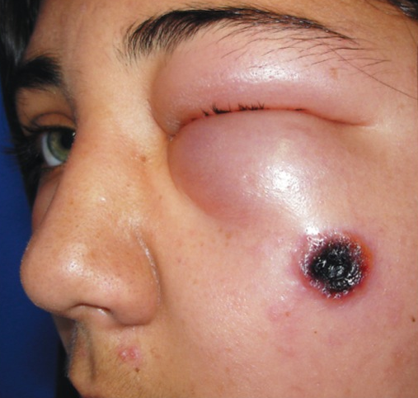
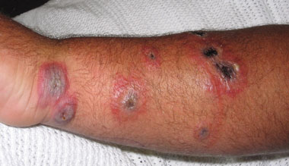
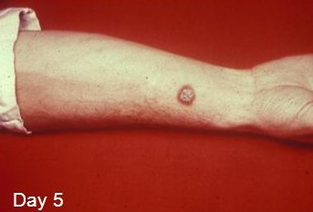
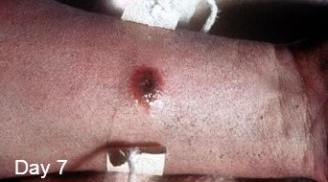
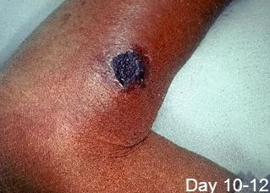
Antrax
Bacillus anthracis
Herbivorous animals are primarily infected, by ingesting spores. Humans are infected directly from animals, or animal products.
Incubation period: 1-5 days
Clinical manifestations are on the exposed skin (hands, arms, face): a papule that becomes bullae on an inflammatory patch. The bullae ruptures and is replaced by haemorrhagic crust, surrounded by oedema, erythema and vesicles. Without proper treatment, sever symptoms like fever, toxaemia, collapse and death can occur.
Treatment: iv penicillin G 4 million units, 6 hourly for 10 days.

Slide 13
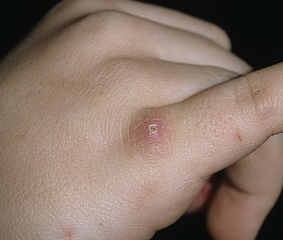
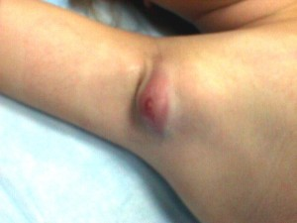
Cat-scratch disease
Bartonella henselae
Incubation period: 3-12 days
Clinical manifestation: crusted nodules develop at the site of the kitten scratch, associated with regional lymphadenophaty that develops after 1-2 month from the scratch.
Treatment: systemic antibiotics like amoxicillin, erythromycin, azithromycin. Without treatment undergoes remission within 2-3 months.

