Slide 1
Anemiile
Asis. Univ. Dr. Pătrașcu Ana-Maria

Slide 4
ERITROPOIEZA

Slide 5
Definition of Anemia
Reduction in the volume of RBC’s (hematocrit) or concentration (hemoglobin) when compared to similar values from a reference population.
  Hgb = expression of amount (g/dL).
  Hct = expression of volume (% or decimal fraction).
  RBC = expression of number (#/mm³).
Anemia is a symptom, meaning each anemia has a cause witch must(HAS TO) be found and treat if is possible

Slide 6
Initial Laboratory Evaluation
Initial Laboratory Evaluation
Complete blood count with indices:
  MCV – indication of RBC size.
  RDW – indication of RBC size variation.
Examination of the peripheral blood smear.
Reticulocyte count:
  Measurement of newly produced young RBC’s.
  Considered a measure of bone marrow responsiveness.

Slide 7
Additional Labs
Vitamin levels: iron profile, ferritin, Vitamin B12, folate.
LDH, bilirubin, haptoglobin.
Coomb’s test
Hemoglobin electrophoresis
SPEP
Creatinine
TSH
Urinalysis
Stool guaiac (fecal occult blood test)
Consider bone marrow examination

Slide 8
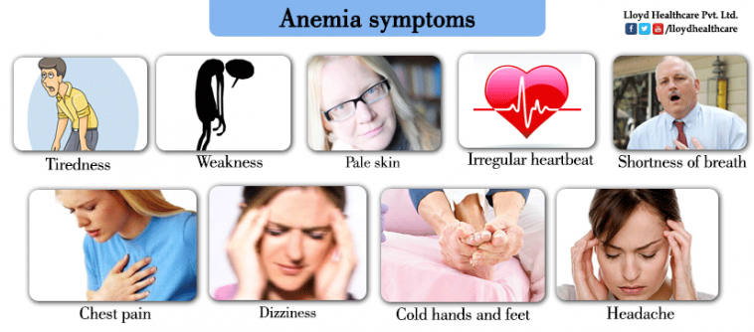
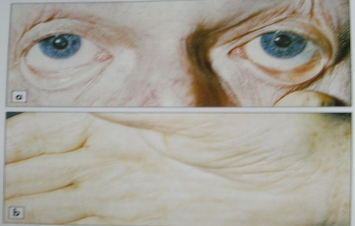
Presentation of Anemia
What are patients complaints- (Symptoms)
What are findings in patients on examination- (Signs)
In anemia, body lacks oxygen, so following signs & symptoms may be experienced:

Slide 9
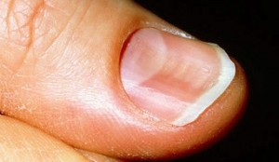
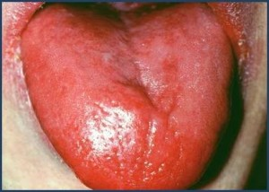
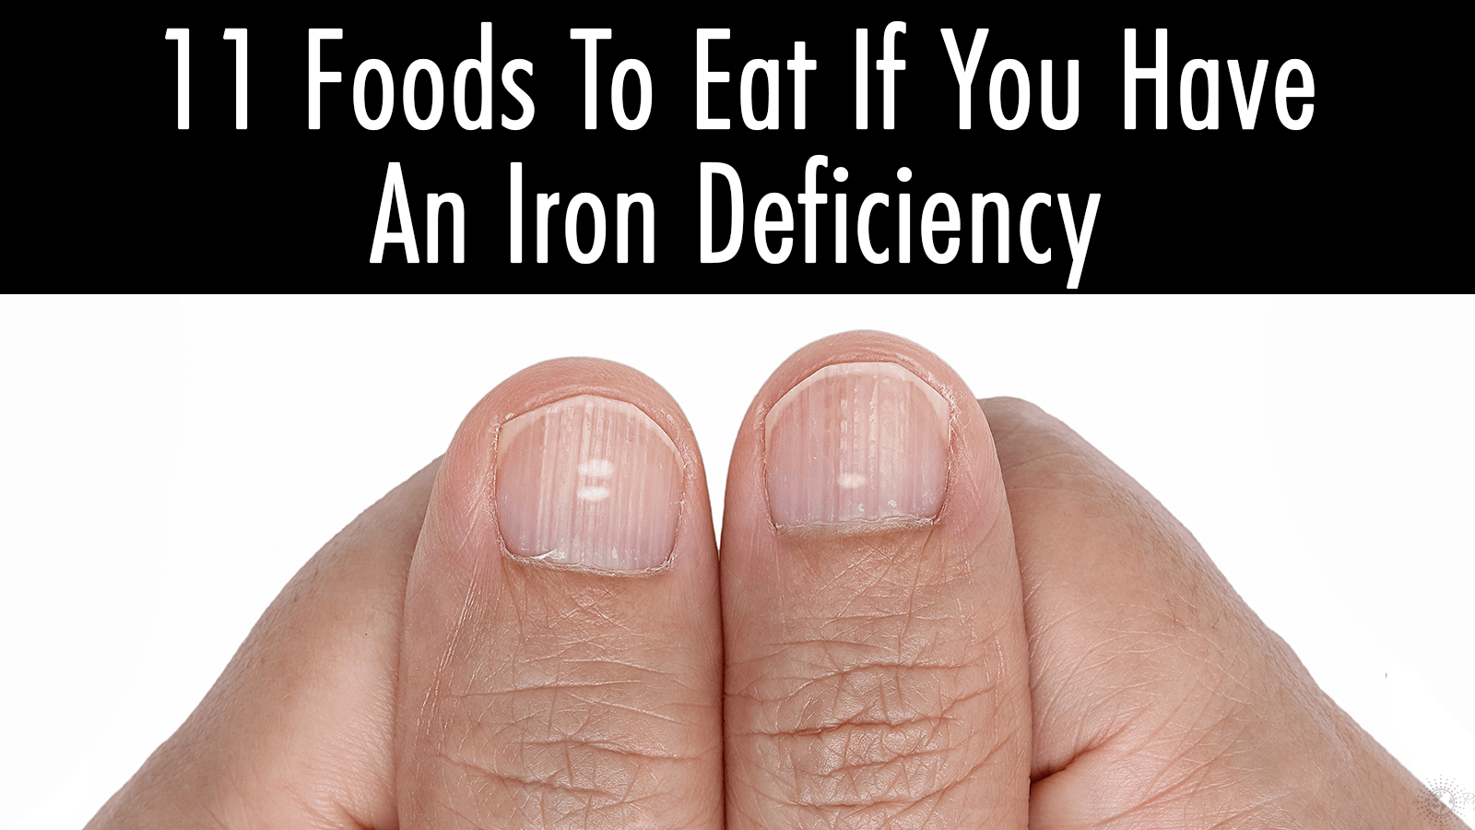
IDA

Slide 10
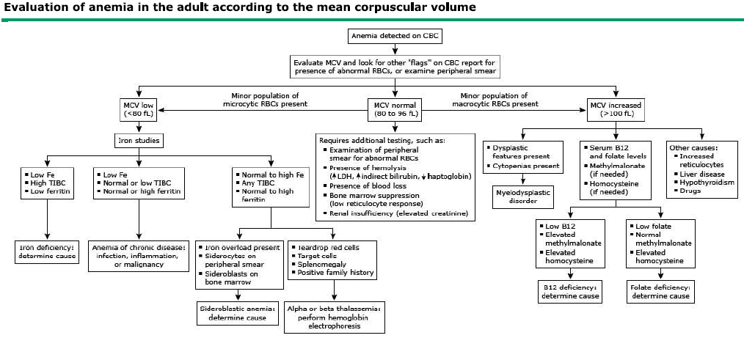

Slide 11
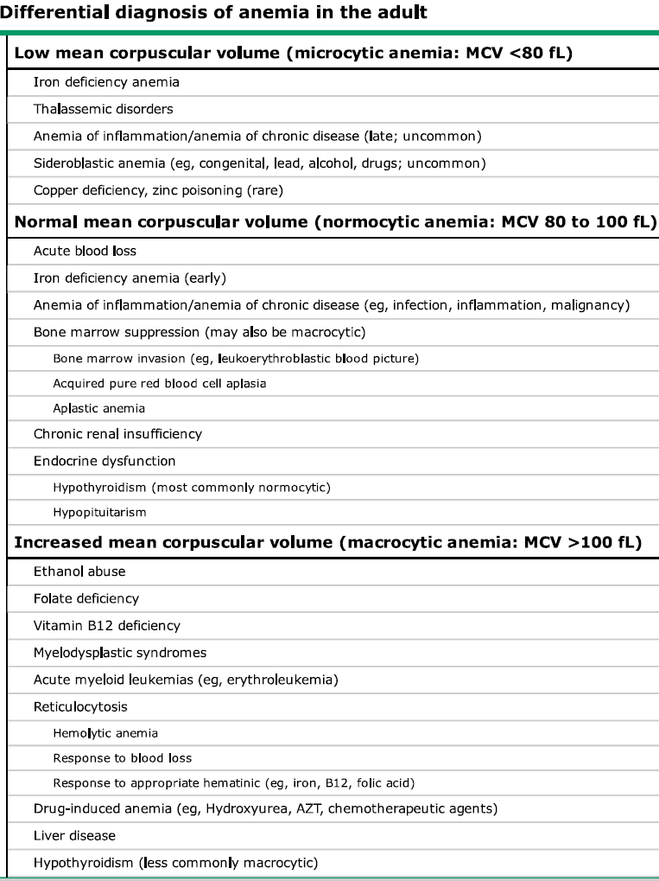

Slide 13
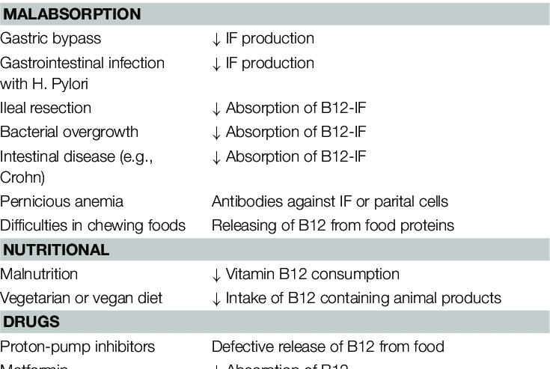
B12 deficiency causes

Slide 14
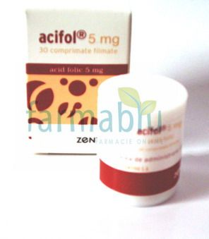
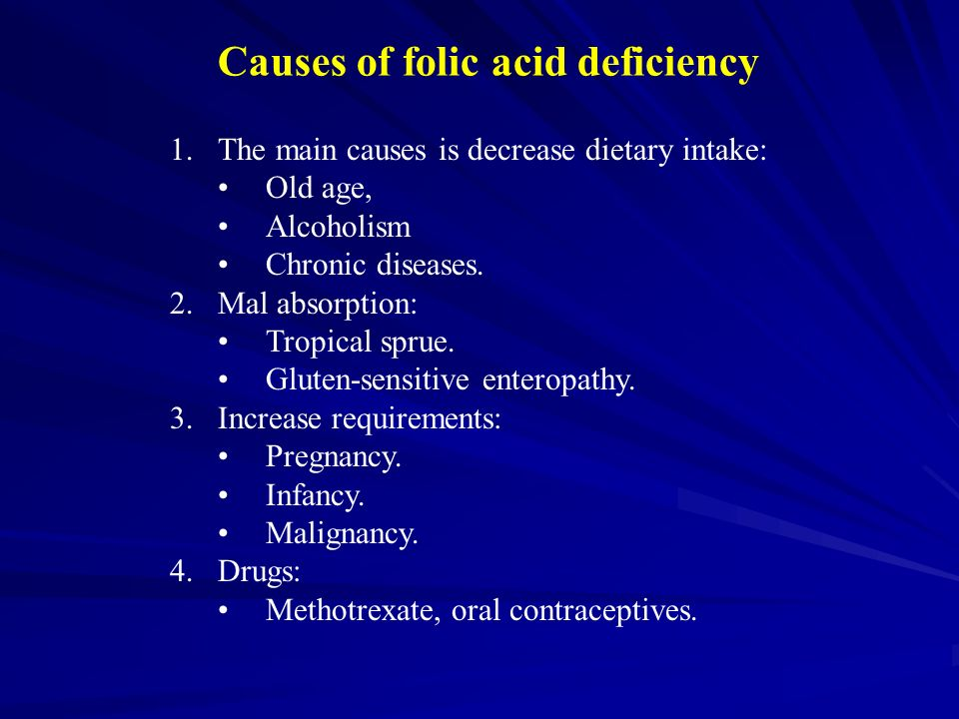

Slide 15
Diagnosticul anemiei din inflamația cronică (AIC)
Clinic:
  Anemie uşoară/moderată
  Prezenţa unei afecțiuni susceptibile să inducă AIC
Paraclinic:
Anemie hiporegenerativă,
  normocromă normocitară sau hipocroma microcitară (20-30%)
Hipoferitinemie cu depozite celulare de Fe prezente:
  Saturatia transferinei normala/redusă (20%)
  Sidermie si TIBC scazute
  Feritina normală/crescută
  Reducerea sideroblastilor
  Prezenta Fe în Mcf medulare
  IL6, proteina C, fibrinogen, VSH/crescute

Slide 16
Afectiuni asociate cu AIC
Boli infectioase:
    bacteriale,
    virale,
    micotice
Boli autoimune
    Lupus eritematos
    Poliartrita reumatoida
Alte afectiuni asociate cu status inflamator cronic/acut:
    Neoplazii
    Insuficienta renala cronica
    Insuficienta cardiaca
    Traumatisme severe
    Diabet zaharat
Imbatranirea

Slide 21
Case A
Case 2
A 45 yo white male presents to physician complaining of tiredness and fatigue over the last several months. He is otherwise healthy. His only other complaint is vague abdominal discomfort.
Medications: daily NSAIDS for a knee injury he sustained while playing tennis.
What questions should you ask in the H & P?

Slide 22
Case A
Progression of symptoms
Blood in stool
Other medications or toxins, including EToH
Prior history of anemia, prior CBC’s
Other constitutional symptoms, recent illness
Family history
Diet
Craving ice, starch, or dirt

Slide 23
Case A
The patient does note he has had black tarry stools for a few weeks prior to his visit.
We suspect GI blood loss induced by NSAID use.
What should we key in on the physical exam?

Slide 24
Case A
CBC which shows the following results:
  Hbg 8.2 gm/dL
  HCT 26%
  RBC count 3.82 million/mm3
  MCV 73 cubic microns
  Platelet count 516,000/mm3
  WBC 7,000/mm3
What is your interpretation of these values?

Slide 25
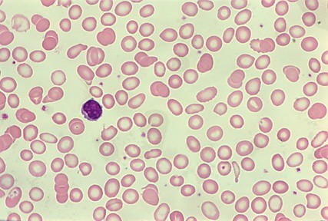

Slide 26
Case A
Iron studies:
  Fe 14 ug/dL
  TIBC 426 ug/dL
  % sat 3%
  Ferritin 10 ng/mL
Corrected reticulocyte count 1.1%
Are any other studies (bone marrow) needed?

Slide 27
Case A
We confirm iron deficiency likely secondary to NSAID use. An endoscopy confirms a H.pylori negative ulcer with chronic bleeding.
He is started on Omeprazole and his NSAID is stopped.
We prescribe oral Fe Sulfate 325 mg titrated to TID which he tolerates fairly well.
He comes back in 4 weeks.

Slide 28
Case A
He feels much better and has experienced resolution of his fatigue and lethargy.
  Hgb 12 g/dl
  HCT 35%
  MCV 82 Fl
  Retic count 4.2%
Why do you think his retic count is elevated?
Can you stop his Fe sulfate when his hgb/hct become normal?

Slide 29
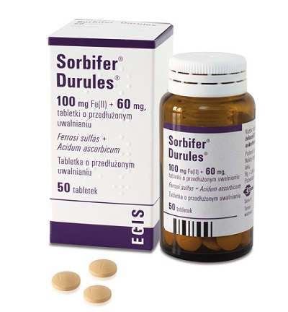
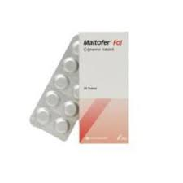
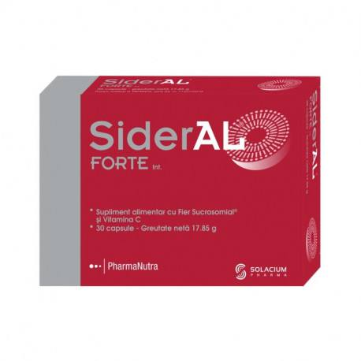
Oral Iron

Slide 30

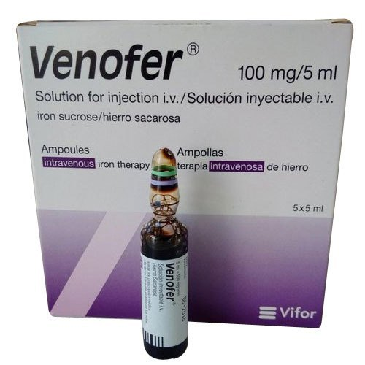
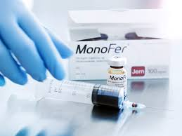
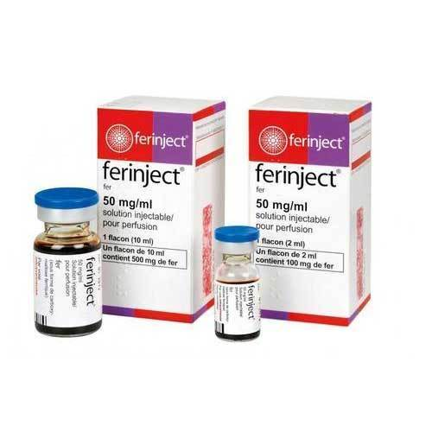
Intravenos Iron

Slide 31
Case 3
Case 3
A 67 year old woman with a history of IDDM and treated hypothyroidism is referred for evaluation of anemia. Her complaints leading to this diagnosis included weakness, fatigue, weight loss, and mild numbness in her feet bilaterally.
Physical exam was essentially normal except for mild loss of proprioception in her feet bilaterally.

Slide 32
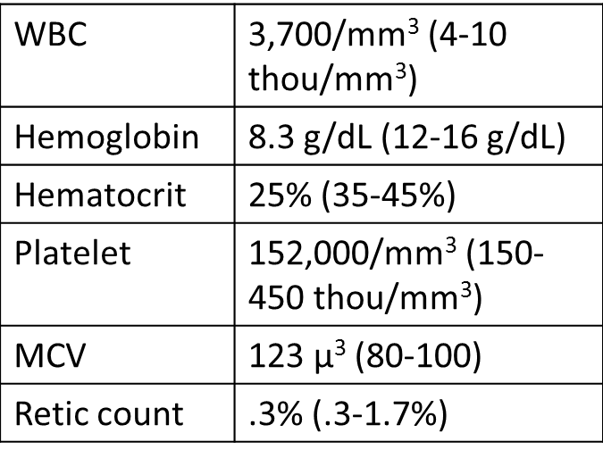
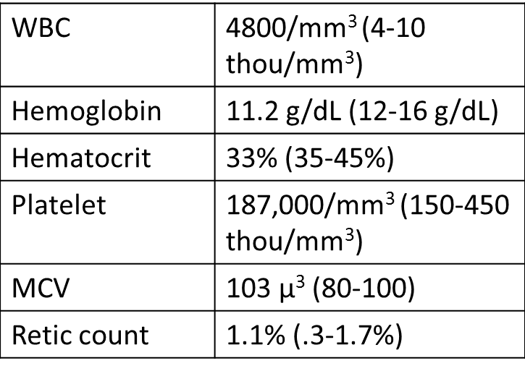
Case B
Current Labs:
2 years ago:
How do you interpret these values?

Slide 33
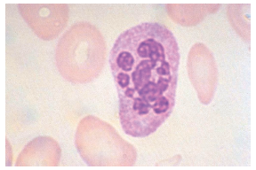

Slide 34
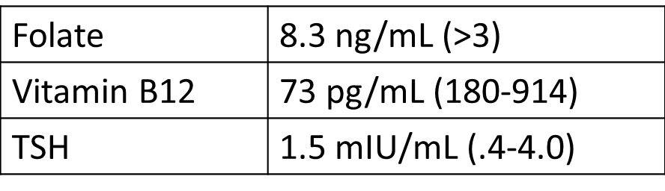
Case 3
What tests or procedures do you want to perform to further evaluate this patient?

Slide 35
Case 3
We diagnose B12 deficiency and prescribe B12 injections 1000ug weekly x4 then 1000ug a month indefinitely.
In 1 month the patient feels remarkably better and her blood counts have all improved.

Slide 36
Case B: Vitamin B12 Deficiency
Found primarily in animal meats.
Large hepatic reservoir.
Deficiency from decreased oral intake takes many years.
In the duodenum cobalamin binds to intrinsic factor produced by parietal cells of the stomach.
In the terminal ileum, cobalamin-IF complex is transported through the enterocyte into the blood.
Almost always due to malabsorption:
  Pernicious anemia, achlorhydria, IBD, celiac disease, pancreatic insufficiency, bacterial overgrowth, alcohol.

Slide 37
Case 3: Vitamin B12 Deficiency
Clinical findings:
  Insidious onset.
  Glossitis, weight loss, pale yellow skin.
  Neurologic manifestations:
    Loss of position or vibratory sense.
    Can progress to spastic ataxia.
    May occur with mild anemia and may be irreversible.
  Psychiatric disorders can occur without evidence of hematologic abnormalities.
    Hallucinations, dementia, psychosis, “megaloblastic mania”.
    May be irreversible.

Slide 38
Case 3: Vitamin B12 Deficiency
Lab findings:
  Cobalamin <200ng/L.
  If low-normal (200-350ng/L), check homocysteine and MMA.
    Both elevated in Vitamin B12 deficiency.
  Methylmalonic acid level is more sensitive than low-normal cobalamin alone.
  Pernicious anemia:
    Autoantibodies to parietal cells or intrinsic factor (50-70% sensitive, 100% specific).

Slide 39
Case 3: Vitamin B12 Deficiency
Treatment:
  Parenteral:
    1000 ug IM for 7 days followed by weekly for 4-5 weeks, then monthly.
  Oral:
    1000-2000 ug/day (in selected cases)
Reticulocytosis in 3-5 days, blood counts normalize by 2-3 months.
Folate may correct the anemia but not the neuropsychiatric manifestations, so you must check both prior to administration of folate.

Slide 40
