Slide 1

UNIVERSITY OF MEDICINE AND PHARAMCY OF CRAIOVA
Dr. PĂTRAȘCU ANA-MARIA

Slide 2
In iron deficiency anemia:
In iron deficiency anemia:
a. sideremia is low
b. the patient could present atrophic gastritis
c. the total iron binding capacity is low
d.feritin is increased
e. neuro-anemic syndrome affects 30% of patients

Slide 3
Hipocromic microcitic anemia

Slide 4
ACUTE MYELOID LEUKEMIA
Clonal hematopoietic neoplasm characterized by unregulated proliferation, arrest in maturation at the primitive blast stage and reduced apoptosis.
Blast cells comprise 20% or more of nucleated peripheral blood or bone marrow cells.
DEFINITION
Median age at diagnosis - 67 years
All ages affected
Men > Women
3.5 cases to 100.000 people per year
INCIDENCE

Slide 5
ETIOLOGY
PRIMARY AML:
HEREDITY : Down syndrome, Fanconi anemia, Bloom syndrome
CHEMICAL AND OTHER EXPOSURES : herbicides, pesticides, benzene, cigarette smoking
SECONDARY AML:
RADIATION
DRUGS: Topoisomerase II inhibitors, alkylating agents
MYELODYSPLASTIC SYNDROMES
OTHER CELL PROLIFERATION DISORDERS: CML, polycythemia vera, primary thrombocytosis

Slide 6
A.M.L. – CLASSIFICATION
FAB
WHO
FAB subtype | Name
M0 | Undifferentiated AML
M1 | AML with minimal maturation
M2 | AML with maturation
M3 | APL: Acute Promyelocytic Leukemia
M4 | Acute Myelomonocytic Leukemia
M4E0 | Acute Myelomonocytic Leukemia with eosinophilia
M5 | Acute Monocytic Leukemia
M6 | Acute Erythroid Leukemia
M7 | Acute Megakaryoblastic Leukemia
1. | AML with certain genetic abnormalities (gene or chromosome changes)
2. | AML with myelodysplasia-related changes
3. | AML related to previous chemotherapy or radiation
4. | AML not otherwise classified
5. 6. | Myeloid sarcoma Myeloid proliferations related to Down syndrome
7. | Undifferentiated and biphenotypic acute leukemias

Slide 7
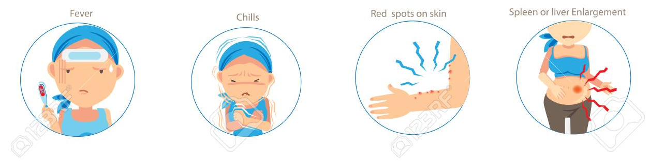
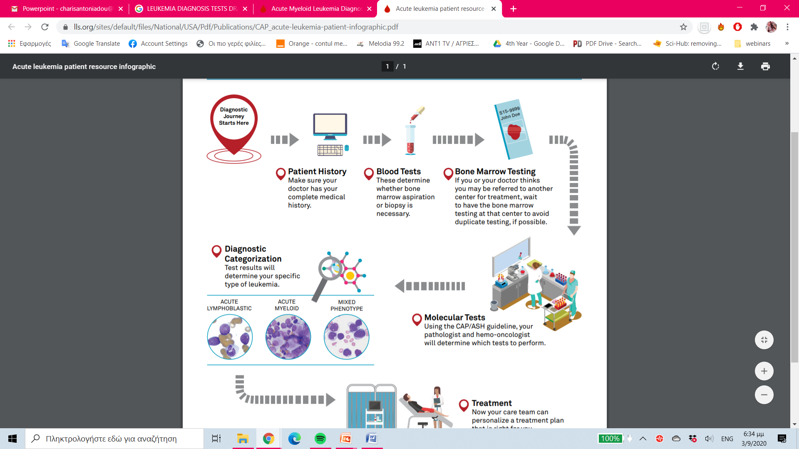

ACUTE MYELOID LEUKEMIA
ONSET: abrupt
SIGNS/SYMPTOMS:
  fever, night sweats, weight loss, infections, anemia, bruising, lymphadenopathy, splenomegaly, hepatomegaly
CLINICAL PRESENTATION
CBC
bone marrow aspiration and biopsy
immunohistochemistry
molecular and cytogenetic analysis
LABORATORY TESTS
DIAGNOSIS CRITERIA
>20% blast cells in bone marrow

Slide 8
TREATMENT PLAN
Apl
AML
INDUCTION
"7+3" regimen
CONSOLIDATION
High dose cytarabine
7 day infusion of cytarabine
3 day administration of an anthracycline (daunorubicin, idarubicin)
GOAL-Complete remission
Intensive chemotherapy and allogeneic or autologous hematopoietic stem cell transplantation (HSCT)
GOAL-destroy the remaining leukemia cells
INDUCTION
ATRA with ATO/anthracycline
CONSOLIDATION
anthracycline + ATRA
MAINTENANCE
ATRA
mercaptopurine
methotrexate

Slide 9
CLINICAL CASE 1
PATIENT DATA
PHYSICAL
EXAMINATION
      BP= 150/86mmHg
      HR=88
CBC: Hb= 5 g / dl
    platelets= 31.000/mm³
General: ECOG=1
pale
bruising on the right forearm
GENDER : Female
AGE : 63years
PATIENT HISTORY:
2nd degree hypertension
DIAGNOSTIC TESTS
Bone marrow aspirate:
76% granulocytes with 45% blasts
5-6% eosinophils
15% erythroblasts represented by rare polychromatophilic and oxyphilic erythroblasts
8-9% lymphoplasmacytoid cells
Immunophenotype: 21% myeloblasts,
39% monocytes, CD9+, CD123+
FINAL DIAGNOSIS
AML M4 FAB

Slide 10

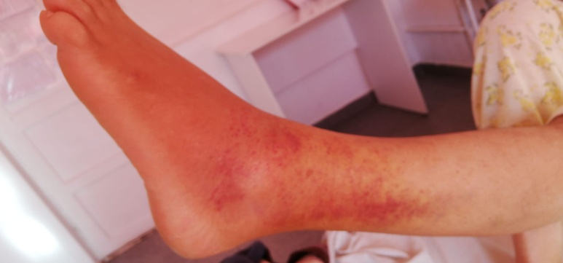
CLINICAL CASE 1
TREATMENT
COMPLICATIONS
Chemotherapy with Cytarabine 150 mg x 2/day for 5 days
Supportive therapy: Milurit, Fluconazole, Acyclovir, Silymarin, Biseptol, Adrenostazin, Etamsilate, Phytomenadione, Omeprazole, Acifol, Arginine, Vitamins B1, B6, platelet and RBC transfusions
edema on the left leg
multiple bruises
TREATMENT
Dexamethasone 16 mg i.v. with favorable evolution

Slide 11
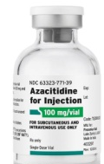
CLINICAL CASE 1- EVOLUTION
Multiple bruises and hematuria indicating treatment failure
PALLIATIVE TREATMENT:
Azacitidine (Vidaza) of 75 mg/m² for 7 days
After 3 cycles of Vidaza:
CBC: Hb= 5.8 g/dl, WBC=60.13x10³
PBS: 60% blasts
Physical exam: dyspnea, tachypnea, asthenia
TREATMENT: Hydroxyurea

Slide 12
CLINICAL CASE 2
PATIENT DATA
PHYSICAL
EXAMINATION
: Pale skin
GENDER : Male
AGE : 63 years
CBC:
Hb=11.1 g/dl
WBC= 18.000/mm3
Platelets=45.000/mm3
PATIENT HISTORY
2nd degree hypertension
DIAGNOSTIC TESTS
CHIEF COMPLAIN
Bone marrow aspirate:
90% blast cells, mainly being myeloblasts with 1-4 nucleoli and basophilic cytoplasm
Rare erythroblasts about 4%
5% granulocytes
few megakaryocytes
Immunophenotype: 82% myeloid blast cells, CD10+, CD9+,CD19+,CD123+
Asthenia
sweating of insidious onset
FINAL DIAGNOSIS
AML M0 FAB

Slide 13
CLINICAL CASE 2
TREATMENT
Severe pancytopenia
Neutropenia
Lymphopenia
COMPLICATIONS
Chemotherapy
Idarubicin 8 mg/m² i.v on days 1, 3, 5
Cytosar 100 mg/m² continuous i.v infusion in days 1-5
Supportive therapy: Cefort 1 g/12h, Gentamicin 80 mg/8h, antivirals and antifungals, red blood cell and platelet transfusions
ADDITIONAL TESTS
CBC: Hb=10 g/dl
  WBC= 480/mm3
  Platelets=4000/mm3
Physical examination: labial HSV, oral candidiasis, fever
X-ray: bacterial pneumonia
Supportive therapy
Tienam (Imipenem and Cilastatin) of with favorable evolution

Slide 14
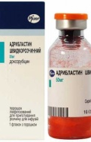
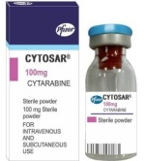
CLINICAL CASE 2- EVOLUTION
CONSOLIDATION TREATMENT: Adriblastine and Cytosar
SUPPORTIVE THERAPY:
RBC transfusions
Antifungals
Broad spectrum antibiotics
2nd round of consolidation:
-Cytosar 100 mg/12h iv or 5 days with favorable evolution
-CBC: Hb=12.3, platelets=280.000/mm3, WBC=5300/mm3

Slide 15
CLINICAL CASE 3
PATIENT DATA
pale skin, bruises on arms and anterior thorax
Dizziness
BP=130/90mmHg
HR=82
PHYSICAL
EXAMINATION
GENDER : Male
AGE : 65years
PATIENT HISTORY
Hb=10.4 g/dl
WBC= 1300/mm3
Platelets=22.000/mm3
2nd degree hypertension
biliary lithiasis
CBC:
CHIEF COMPLAIN
1-week onset fever
productive cough
sweating
DIAGNOSTIC TESTS
Bone marrow aspirate:
few nucleated cellular elements
rare lymphocytes
absent megakaryocytes
55% blasts
Immunophenotype: 58% blast cells, APL markers
FINAL DIAGNOSIS
AML M3 FAB
MOLECULAR ASSAYS:
PML-RARA mutation present

Slide 16
CLINICAL CASE 3
INDUCTION TREATMENT
-ATRA 45 mg/m²/day
-Idarubicin 12 mg/m²/day on days 2, 4, 6, 8
SUPPORTIVE THERAPY: red blood cell and platelet transfusions
RE-EVALUATION
-CR: CBC- Hb=10.6, WBC=5.2x10³ Platelets= 566.000/mm3
Bone marrow aspirate: 2-3% blasts
CONSOLIDATION TREATMENT:
-ATRA 45 mg/m²/day on days 1 to 15
-Idarubicin 5 mg/m²/day on days 1 to 4
Relapse
Multiple red-purple tumoral formations, anterior thorax, lumbosacral region and left inguinal area, diameter=0.3-1.5 cm
BONE MARROW ASPIRATION indicates residual disease with 7-8% blasts
TREATMENT:
HiDAC consisting of Cytarabine 2 g/12h
SUPPORTIVE TREATMENT: Osetron, Acyclovir, Fluconazole 100mg, Vesanoid and Tobradex, having a favorable evolution

Slide 17
CLINICAL CASE 3- EVOLUTION
COMPLICATIONS
-Fever, headache, myalgias, abdominal pain, appetite loss
-CBC: Hb=10.4 g/dl, WBC= 0.2x10³, Platelet 39.000/mm³
A FEW DAYS LATER
Cardiopulmonary arrest rescuscitation coma
CT: Hemorrhagic stroke
CBC: Severe Thrombocytopenia-Hemorrhagic stroke

Slide 18
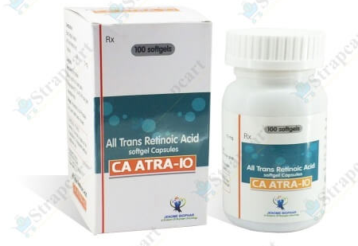
Discussion
CLINICAL CASE NR1 with AML, followed treatment with moderate-dose chemotherapy with Cytarabine, ended up having an unfavorable evolution, with complications and progression of the disease.
1
CLINICAL CASE NR2 diagnosed with AML, followed treatment with Idarubicin and Cytosar, achieved complete remission and was discharged in a stable condition.
2
CLINICAL CASE NR3 with AML, even though the patient followed conventional treatment with ATRA and Idarubicin, he ended up with relapsed disease and presented serious complications.
3
CONCLUSION: even though patient characteristics are compatible with literature, the outcome of each one is unpredictable.

Slide 19


THANK YOU
FOR YOUR ATTENTION !
“Wherever the art of Medicine is loved, there is also a love of Humanity. ”
― Hippocrates, 400 BC

