Slide 1
Hematology practical work no. 2 Asis. Univ. Dr. Pătrașcu Ana-Maria

Slide 3
Hemolytic anemia is defined as an anemic state due primarily to an increased rate of destruction of red blood cells, resulting in a RBC survival of less than 100 days.
●Intrinsic abnormalities (intracorpuscular defects):
These are usually congenital:
Hemoglobinopathies – sickle cell disease, thalassemia, and unstable hemoglobins variants. Affect the solubility of hemoglobin. When hemoglobin becomes insoluble, it can precipitate and damage the RBC membrane. Some abnormal hemoglobins are less able to recover from oxidant challenge, leading to the formation of Heinz bodies, as in Hgb Köln.
RBC membrane/cytoskeletal defects –hereditary spherocytosis (HS), hereditary elliptocytosis (HE), and hereditary stomatocytosis (HSt). Affect the structure of the RBC membrane and underlying cytoskeleton These conditions may be associated with a sub-optimal membrane surface area to volume ration (eg, HS), or a defect in a membrane protein with ion channel function such as Band 3 may alter salt and water handling, which also contributes to altered surface membrane to volume ratio.
RBC metabolic abnormalities – Metabolic abnormalities include deficiency of glucose-6-phosphate dehydrogenase (G6PD), pyruvate kinase (PK), and, in some cases, HSt. These defects affect the metabolic capacity of the RBC, which promotes solute transport and recovery from oxidant damage
Rarely be acquired: paroxysmal nocturnal hemoglobinuria.
●Extrinsic abnormalities (extracorpuscular): Immune (Coombs test) + Non-immune

Slide 4
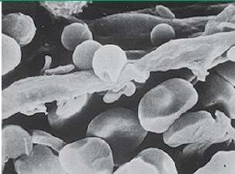
Extravascular hemolysis
-occurs primarily via macrophages of the reticuloendothelial system in the liver, spleen, bone marrow, lymph nodes.
Severely damaged RBCs, especially those coated with complement, are primarily destroyed in the liver, who receives a larger proportion of the cardiac output than the spleen.
Poorly deformable RBCs such as spherocytes or sickled cells are primarily destroyed in the spleen, in the cords of Billroth.
The only way for a RBC with a diameter of 7 to 8 microns to escape from these cords and return to the general circulation is to deform sufficiently to pass through 2 to 3 micron slits in the walls of the cords.
Senescent or damaged RBCs remain in the cords and are phagocytosed by monocytes and macrophages.
RBCs destroyed in the spleen: most of the hemoglobin is degraded to release heme,
with each molecule of heme converted to equimolar amounts of biliverdin, iron, and carbon monoxide

Slide 5
Intravascular hemolysis
occurs primarily within the vasculature.
considerable structural damage to the RBC membrane (eg, mechanical shearing, complement MAC) or when the reticuloendothelial system becomes overwhelmed. When severe, intravascular hemolysis is characterized by pink or brown serum and dark urine with free serum and urine hemoglobin. The pink color is due to oxyhemoglobin.The brownish color is due to the oxidized form, methemoglobin.
Free hemoglobin binds to haptoglobin, and the hemoglobin-haptoglobin complex is rapidly removed by the liver, leading to a reduction in plasma haptoglobin.
Dimers of alpha-beta globin that are not bound by haptoglobin are small enough (molecular weight 34,000 daltons) to be filtered by the glomerulus and appear in the urine as hemoglobinuria.
Urine hemosiderin may be seen several days after an episode of intravascular hemolysis, as renal tubular cells take up the heme, degrade it, store it as hemosiderin, and eventually are shed into the urine. Urine hemosiderin is detected using Prussian blue staining (iron stain) of the urine sediment.
●Hydration and hemodynamic support – For individuals with apparent severe intravascular hemolysis (eg, acute hemolytic transfusion reaction due to ABO incompatible transfusion), free hemoglobin in the circulation can cause renal failure, hypotension, and disseminated intravascular coagulation. Aggressive hydration
●Plasma exchange – In cases of presumed thrombotic microangiopathy (TMA; ie, microangiopathic hemolytic anemia and thrombocytopenia), diagnostic testing may take hours to days. The use of therapeutic plasma exchange for a presumptive diagnosis of thrombotic thrombocytopenic purpura (TTP) and information regarding the diagnostic evaluation are presented separately.
● Transfusion – Patients with severe anemia should be transfused with RBCs, especially if there is active bleeding, symptoms of organ ischemia, or ongoing brisk hemolysis. It may be appropriate to obtain a pre-transfusion blood sample that can be stored for later analysis, particularly if an inherited cause of hemolytic anemia is suspected. For patients with possible immune-mediated hemolysis for whom crossmatch compatible blood cannot be identified, blood designated for immediate release can be transfused

Slide 6
Diagosis of hemolytic anemia
● anemia
● reticulocytosis
● RBC destruction
Increased concentration of serum indirect bilirubin
Increased concentration of serum lactate dehydrogenase
Decreased concentration of serum haptoglobin.
● Site of RBC destruction (intravascular):
Increased concentration of free hemoglobin in the plasma
The presence of free hemoglobin in the urine (hemoglobinuria), which produces a red, heme-positive urine supernatant in association with red plasma.
The presence of hemosiderin in the urine (hemosiderinuria), which is a more chronic event.

Slide 7
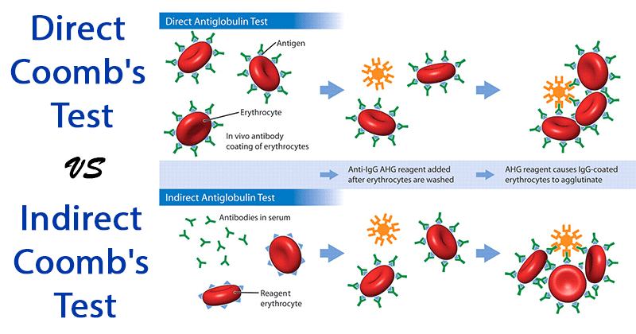

Slide 8
Hemolysis without anemia
-can be seen if the bone marrow capacity to increase RBC production is sufficient to overcome the anemia caused by the hemolysis.
Despite a normal hemoglobin and hematocrit, hemolysis can still be detected from increased reticulocytosis and serum LDH, and concentrations, and reduced serum haptoglobin.
Hypersplenism
varying, and usually mild, degrees of anemia
thrombocytopenia,
neutropenia
an enlarged spleen
Hypercelular morphologic normal bone marow
Splenectomy resolve cytopenia

Slide 9
Reticulocytosis without hemolysis
If the clinical picture is not fully consistent with hemolytic anemia or a specific cause of hemolysis cannot be identified, it may be appropriate to evaluate the patient for other causes of reticulocytosis such as:
●Recovery from an episode of bleeding or ongoing bleeding.
●Repletion of iron, vitamin B12, or folate in a patient who was deficient.
●Administration of erythropoietin.
●Recovery from a bone marrow insult such as an infection (eg, parvovirus), medication, or alcohol.

Slide 10
Hemolysis without reticulocytosis
If hemolysis is suspected or confirmed but the reticulocyte count is inappropriately low:
●Iron deficiency (absolute or functional).
●Deficiency of vitamin B12, folate, or copper.
●Anemia of chronic inflammation.
●Alcohol.
●Myelodysplasia, aplastic anemia, or other primary bone marrow disorder.
●Transient red blood cell (RBC) aplasia due to parvovirus infection, which targets erythropoietic precursor cells.
● Drug-induced bone marrow suppression such as therapy for chronic lymphocytic leukemia (CLL).
● Other settings in which the reticulocyte response may be inappropriately low include an autoimmune hemolytic anemia in which the autoantibody also targets RBC progenitor cells in the bone marrow, or a transient lag in the production of reticulocytes during the first few days of new-onset hemolysis.

Slide 11
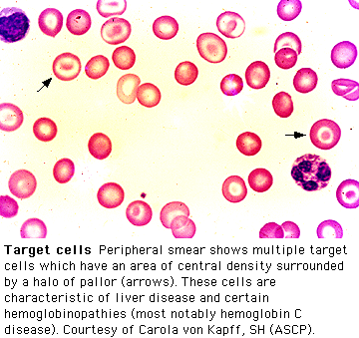

Slide 12
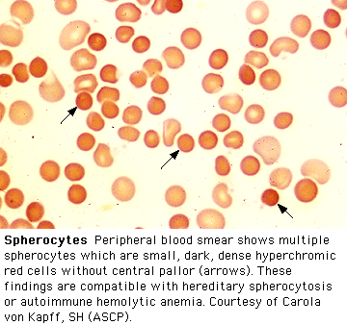

Slide 13
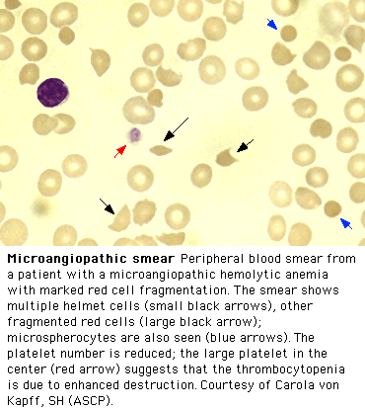

Slide 14
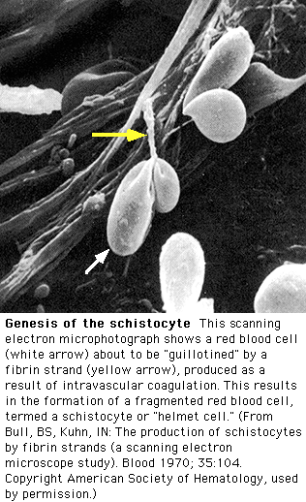

Slide 15
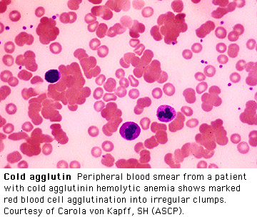

Slide 16
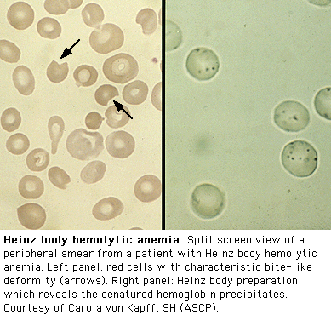

Slide 17
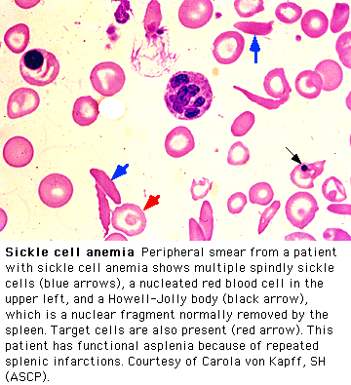

Slide 18
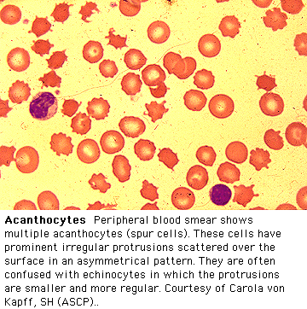

Slide 19
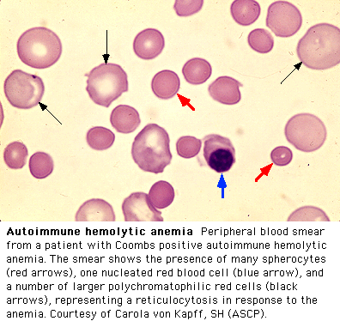

Slide 20
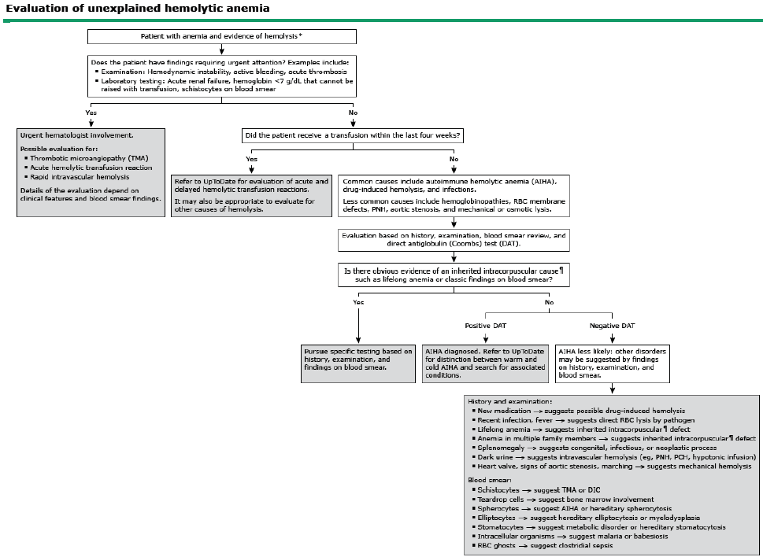

Slide 21
Case 1
A 35 year old woman has a history of pleurisy and has been told she may have SLE.
Previous CBC’s have been normal.
She presents with complaints of exertional dyspnea, fatigue, and yellowing of her eyes.
Physical exam is normal except for mild scleral icterus and moderate splenomegaly.

Slide 22
Case 1
Initial Labs:
Hemoglobin 7.9 gm/dL
HCT 23.9%
WBC 4000/mm3 with a normal differential
Platelet 138,000/mm3
What other labs would you like to see?

Slide 23
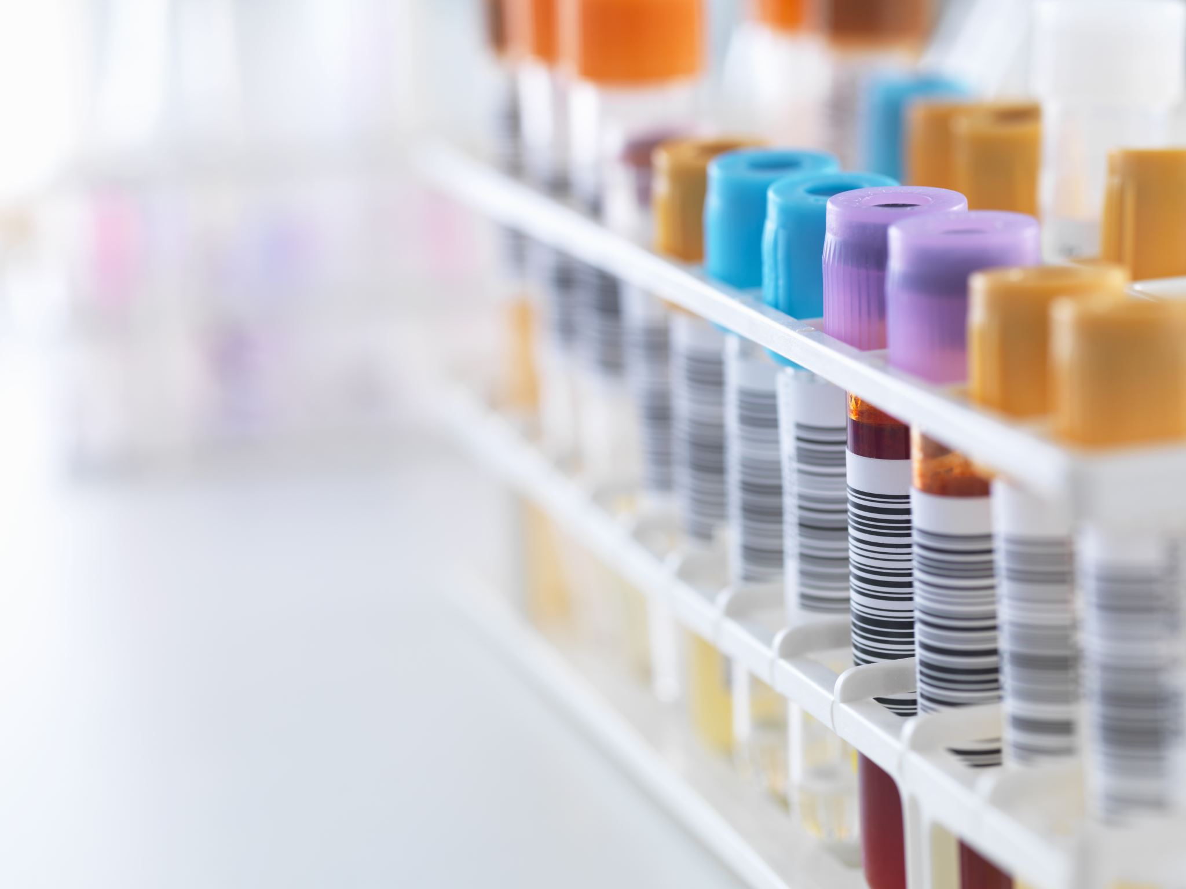
Case 1
MCV 114
Uncorrected Retic count 14.2%
LDH 2343 U/L
Bilirubin 4.3mg/dL
Direct bili .8mg/dL
The peripheral blood smear reveals macrovalocytes, polychromasia, and an occasional nucleated red blood cell.

Slide 24
Case 1
You suspect an autoimmune hemolytic anemia based on her history, physical exam, labs, and smear.
What further tests would you like to order?

Slide 25
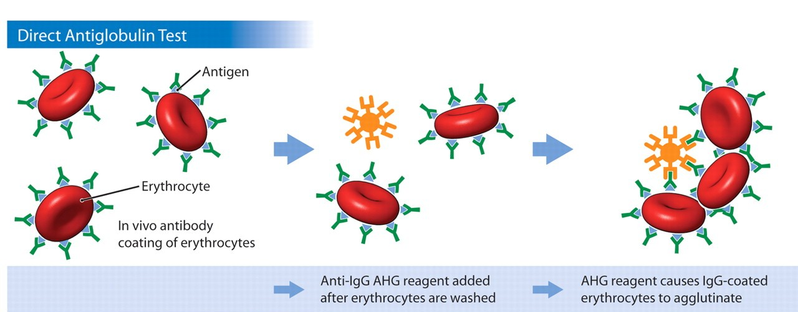
Case 1
Direct Coombs Test (direct antiglobulin test):
RBC’s are washed, removing serum and then incubated with antihuman globulin (Coombs reagent).
This binds immunoglobulin or complement factors fixed on the RBC surface, causing agglutination and therefore a positive DAT.

Slide 26
Case 1
Direct Coombs test results are as follows:
DAT: Positive 3+
IgG: Positive 3+
Complement: Negative
What type of autoantibody is this?
What conditions are typically associated with this type of antibody?

Slide 27
Case 1
We diagnose a warm-antibody hemolytic anemia and suspect an underlying autoimmune disorder.
Etiology:
Idiopathic
Autoimmune
Lymphoproliferative disorder
Viral
Immunodeficiency
Medications

Slide 28
Case 1
We decide to avoid blood transfusion because of:
The difficulties in obtaining cross match compatible blood
The expected short half life of transfused blood.
What treatment do you recommend?

Slide 29
Case 1
Treatment:
Prednisone
Splenectomy
Rituximab (monoclonal antibody)
Immunosuppressive agents
Cytoxan, imuran, cyclosporin
Danazol
Plasma exchange

Slide 30
Case 1
You begin her on 60 mg Prednisone and she has a good response. Upon several attempts at tapering the prednisone she has a relapse with worsening of the hemolytic anemia.
We are concerned about the long term side effects of Prednisone, thus you send her for a procedure.

Slide 31
Case 1
She responds well to splenectomy, but still requires very low maintenance doses of Prednisone.
Over the years she occasionally requires higher doses of Prednisone when she is ill or has a lupus flare.

Slide 32
Case 2
A pleasant 34 year old African American woman is referred, she has been known to have a mild microcytic anemia, which was picked up some years ago on routine blood work. She is entirely asymptomatic. She has been prescribed iron several times over the years without a response.
What data would you like to review?

Slide 33
Case 2
Labs:
HCT 31-34%
Hgb 10.6-11.4gm/dL
PLT 232-312K/mm3
WBC 6500-8000/mm3 with a normal differential
MCV 72-74 cubic microns
What is in your differential diagnosis?

Slide 34
Case 2
Differential Diagnosis:
Iron deficiency anemia
Noncompliance, inadequate dosing, incorrect formulation.
Beta thalassemia
Alpha thalassemia
Anemia of chronic inflammation/disease
Sideroblastic anemia
What additional lab tests would you like to order?

Slide 35
Case 2
Iron studies are normal.
Chemistries, liver function tests, thyroid studies are normal.
No history of lead exposure.
You ask to see a peripheral blood smear and one other study. What is it?

Slide 36
Case 2

Slide 37
Case 2
You also request a hemoglobin electrophoresis.
Hgb A = 97.5%
Hgb A2 = 2.1%
Hgb F = 0.6%
What is your diagnosis of exclusion?

Slide 38
Case 2
Alpha thalassemia with a double gene deletion.
No treatment is necessary.
Anemia is not progressive.
No other systemic problems.
Often mistaken for iron deficiency and treated with iron or for anemia of chronic disease.

Slide 39
Case 3
A 36 year old man with a history of progressive renal failure over the last 4 years comes to you from work up of weakness and progressive anemia. He has recently begun dialysis. His renal failure initially appeared after an acute febrile illness and the etiology was never determined.

Slide 40
Case 3
Physical exam is significant for pale sclera and an AV shunt in his left arm.
CBC:
WBC 6400/mm3
Hgb 7.6 g/dL
HCT 23.8%
Platelet 242,000/mm3
MCV 78/mm3

Slide 41
Case 3
Prior labs reveal a hematocrit that was normal 4 years ago, but has steadily declined as his renal function worsened.
Reticulocyte count corrected= 0.7%
Fe 26 mcg/dL
TIBC 224 mcg/dL
Iron saturation 11%
Ferritin 145 ng/mL
What is in your differential diagnosis?

Slide 42
Case 3
Differential Diagnosis:
Anemia of renal failure
Iron deficiency anemia
Thalassemia
Lead poisoning
Myelodysplasia
Mixed microcytic and macrocytic anemia.
You request one more study to support your suspicion?

Slide 43
Case 3
We order an erythropoietin level which returns at 12 IU ( 4.1-19.5 ) within the normal limits.
What do you make of this value?
Should you proceed to a bone marrow exam?

Slide 44
Case 3
We place the patient on 10,000 units of EPO SQ tiw with dialysis. He comes to see you in one month feeling better.
Labs:
HCT 34%
Hgb 11.2 gm/dL
MCV 83/mm3
Retic 3.2%

Slide 45
Case 3
He continues on his EPO injections for four months.
Soon after he again becomes fatigued, but otherwise doing well.
Labs reveal:
WBC 6200/mm3
Hgb 8.9 gm/dL
Platelet 234,000/mm3
MCV 76 cubic microns
Retic .6%

Slide 46
Case 3
We suspect with his increased reticulocytosis and hgb/hct over the last few months he has become iron deficient. We confirm this with lab assay.
We give him 1 gram of intravenous iron and ask him to come back in 2 weeks.

Slide 47
Case 3
He again feels much improved and is tolerating the iron fairly well. His hematocrit has increased to 33%, corrected reticulocyte count to 3.2%, and the MCV is now 80 cubic microns.
He continues on Iron and EPO injections and is considering renal transplant.

Slide 48
Case 3: Anemia of Chronic Inflammation
Mild to moderate anemia that is persistent for greater than 1-2 months in patients with infectious, inflammatory, or neoplastic diseases.
Other causes have been excluded.
Hypoproliferative, low reticulocyte count.
Normocytic-MCV 80-100:
May be microcytic in later stages.
Iron studies show low serum iron, low percent saturation, and normal to elevated ferritin.
Adequate reticuloendothelial iron stores.

Slide 49
Case 3: Pathophysiology
Epo production is inhibited or decreased, so inappropriately low levels.
Increased levels of inflammatory cytokines:
IL-1, TNF α.
IL-6 causes induction of hepcidin synthesis (decreased iron absorption).
Alterations in iron metabolism.
Suppression of erythropoiesis.
Moderate decrease in RBC survival.

Slide 50
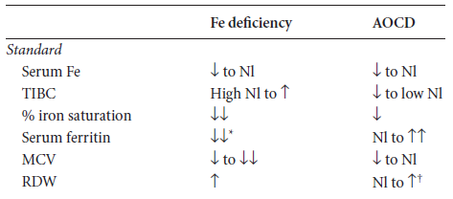
Case 3: Laboratory Abnormalities
ASH SAP 5th edition

Slide 51
Case 3
ACI does not usually require treatment.
Iron replacement is typically not necessary.
Erythrocyte-stimulating agent can be given in the setting of renal disease however caution regarding hypertension and thrombosis.
Treat the underlying cause!

Slide 52
