Slide 1
Practical work no.4

Slide 2
Hemoliza intravasculară | La nivelul splinei, ficatului Bilirubina crescută pe seama indirectei Hemoglobinemie Haptoglobina crescută Hemoglobinurie Intravascular LDH crescut Reticulocitoză Hemosiderinurie Talasemia majoră Agresivă Tulburari membranare, enzimatice Poastransfuzională Incompatibilitatea în sistemul Rh Hemoglobinuria paroxistică nocturnă | Hemoliza extravasculară
Notes:
Eu nu am facut asta cu ei

Slide 3
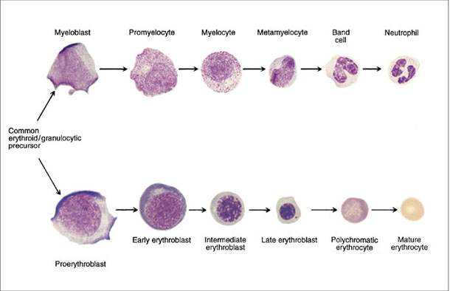
LEUKAEMIA
A disorder characterised by the accumulation of malignant white cells in the bone marrow and peripheral blood.
Chronic leukaemia
Acute leukaemia
A malignant disorder in which blasts constitute >20% of the bone marrow cells
Acute Myeloid Leukaemia (AML)
Acute Lymphoblastic Leukaemia (ALL)
Normal White Cell Development
Notes:
3

Slide 4
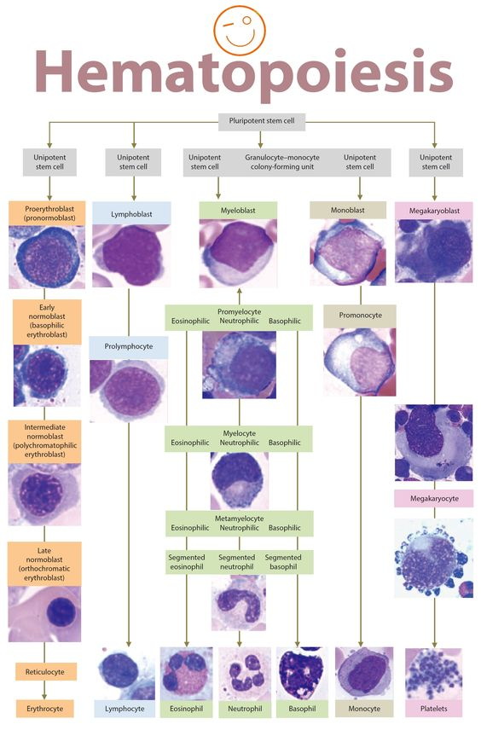

Slide 9
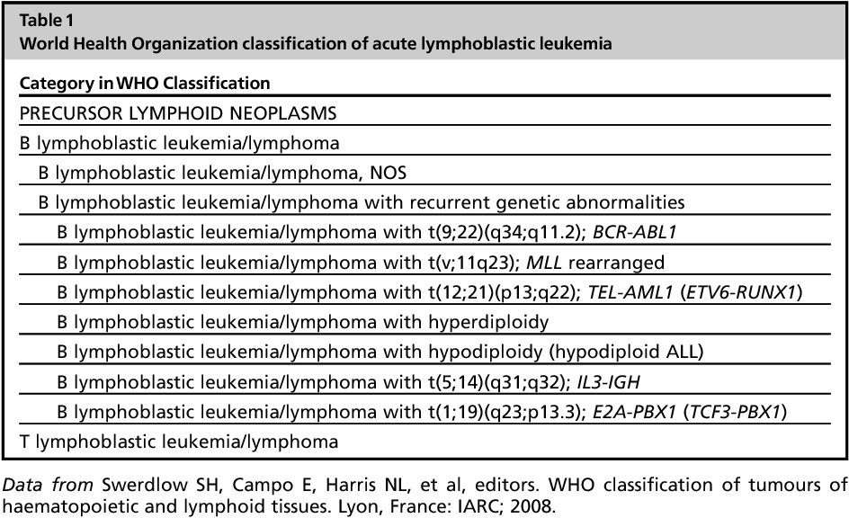

Slide 10
Epidemiology and Aetiology
ALL commoner in childhood with a peak age of 4 years
AML commoner in adults
Genetic / Constitutional
  Down’s syndrome
  Fanconi’s anaemia
Acquired
  Myelodysplasia
  Chemotherapy/radiotherapy
  Chronic myeloproliferative disorders
  Ionizing radiation exposure
  Occupational chemical exposure : benzene
Viral infection ( HTLV-1)
Immunological : hypogammaglobulinemia
Notes:
10
ALL is the commonest from of leukaemia in childhood. Its incidence is highest between 3-7 years.
There is a second peak in adults after the age of 40 years.
AML is much more common in adults. 10% of childhood leukaemia.
From an aetiological point of view there are no proven environmental factors

Slide 11
Acute Leukemias Criteria
Acute leukemias are characterized by abnormal differentiation and proliferation of malignantly transformed hematopoietic blast cells.
These cells proliferate in the bone marrow and lead to the suppression of the normal cells.
These have little or no maturation and may see mainly blast cells.
Acute Leukemias are diagnosed on the percentage of blast cells in the bone marrow (30% or more blast cells are needed to classify the disorder as acute leukemia).
These leukemias are associated with varying degrees of anemia, neutropenia, thrombocytopenia, and or infiltration of the tissues (the most common site of infiltration is lymph nodes, liver, spleen, CNS, and skin).

Slide 12
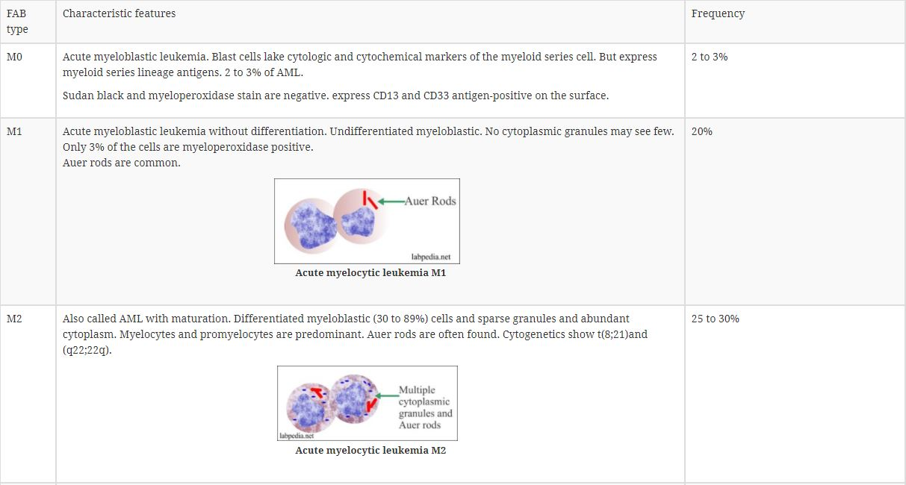
French-American-British (FAB) Classification Of Acute Myelocytic Leukemia

Slide 13
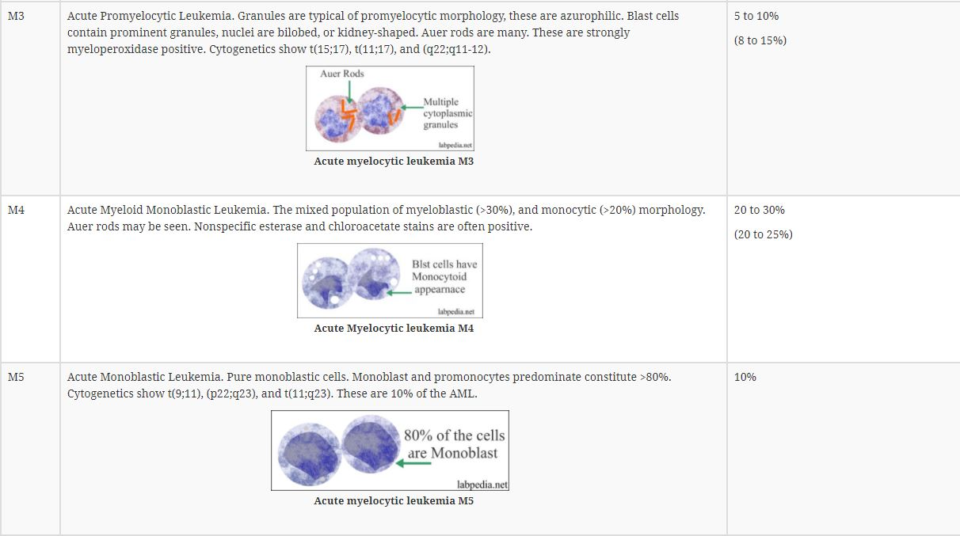

Slide 14
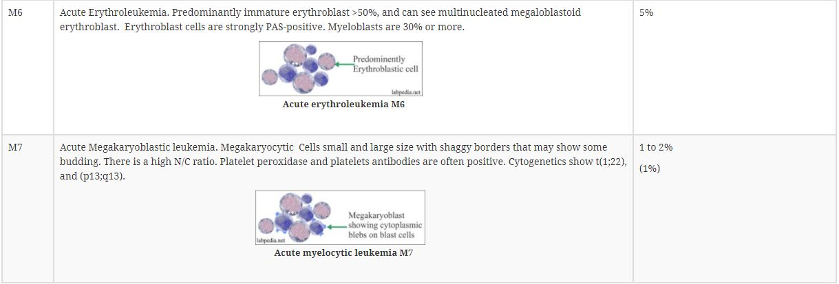

Slide 15
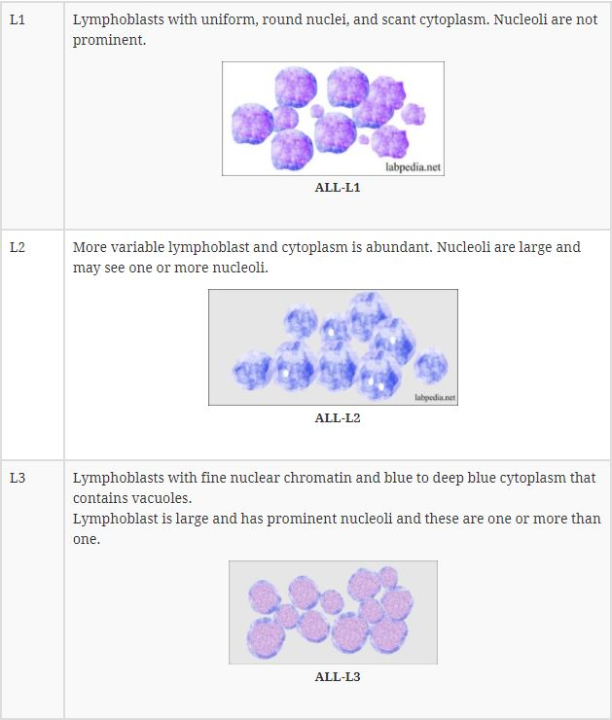
FAB (French-American-British) classification of Acute Lymphocytic Leukemia:

Slide 16
CLINICAL APPEARANCE OF ACUTE LEUKAEMIAS
Weakness - anaemia
Fever, infection - granulocytopenia
Hemorrhage - thrombocytopenia (anywhere in the body)
Bone pain, tenderness - subperiosteal leukaemic infiltration
Meningeal symptoms - CNS involvement /
(headache, nausea, vomit, subarachnoidal bleeding
cerebral palsy, intracerebral,
meningeal infiltration)
Notes:
16
7

Slide 17
Symptoms, specific to certain leukaemias
AML M3 - DIC
(promyelocytic)
AML M1-2 - soft tissue or subperiostal infiltration
AML 4-5 - skin, gum infiltration

Slide 18
Clinical Features
Bone marrow failure
  Anaemia, bruising/bleeding, DIC (M3), infection
Lymphadenopathy / hepatosplenomegaly
  Commoner in ALL
Tissue infiltration
  CNS, testes (ALL), gum hypertrophy (M4)
Increased cellular catabolism
Notes:
18

Slide 19
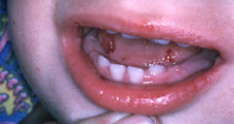
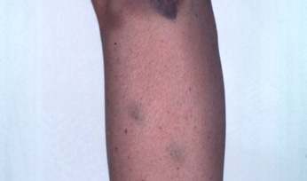
ACUTE LEUKAEMIA - HAEMORRHAGE
ACUTE LEUKAEMIA - PURPURA

Slide 20
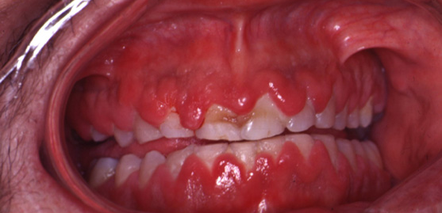
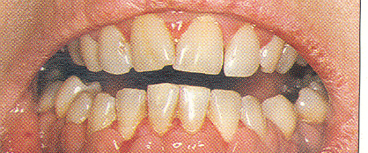
ACUTE MYELOID LEUKAEMIA – GUM HYPERTROPHY

Slide 21
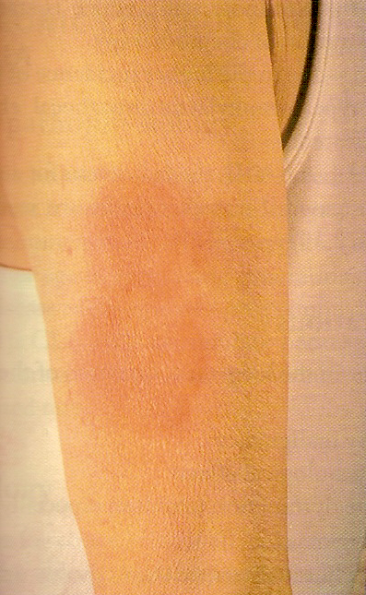
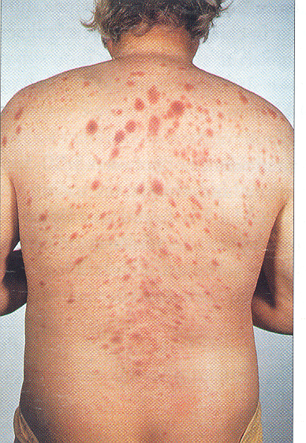
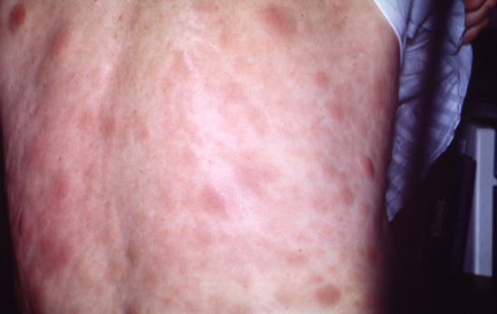
ACUTE MYELOID LEUKAEMIA – SKIN INFILTRATION

Slide 22

  WBC count is variable. 25% of the patient has >50,000/cmm, 25% has <5000/cmm and 5 to 10% has count between 5000 to 10,000/cmm.
    A count>100,000/cmm is reported in <10% of the patients but these patients have severe CNS or respiratory diseases due to leukostasis.
    In these patients, leukapheresis and chemotherapy may be life-saving.
  WBC morphology. These are morphologically abnormal and immature cells.
    20% or more of the blast cells in the bone marrow as diagnostic of AML.
    The peripheral blood smear may show blast cells in 85 to 90% of the cases.
  Uric acid in 50% of the cases is raised which indicates increased cell turnover.
  Lactate dehydrogenase (LDH) about 50% shows a raised level. This is not as common as in ALL.
  Bone marrow shows >20% blast cells. Promyelocytes are numerous particularly in M3.
    Auer rods can be seen in the cytoplasm.
    Cytochemical stains, peroxidase reaction, and Sudan black are positive.
  Nucleated RBCs may be seen.
  Platelet count may be low and may see count between 30,000 to 100,000/cmm. In some cases may be <20,000/cmm.
  Coagulation abnormalities are also seen. PT, PTT, and Thrombin time are prolonged
Lab. findings in AML

Slide 23
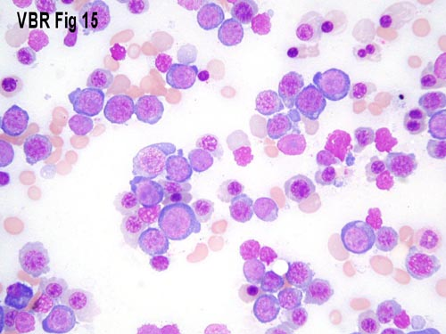
P. Smear AML

Slide 24

Lab. findings in ALL
  WBC count is variable from very high to low count.
  There are anemia and thrombocytopenia.
Bone marrow: Very few leucocytes are seen.
  Difficult to find normal WBCs or RBCs in the bone marrow.
  Characteristically there are blast cells.
  Auer rods are absent.
Flow cytometry studies (differentiation of the antigens over the surface of these abnormal cells) provide rapid diagnosis.
  80% of the ALL arises from the B-lymphocytes and will show CD molecules of CD19, CD20, or both.
  Few cases of the ALL may show CALA (common ALL antigen) which is CD10.
  Roughly 20% of the CD10-positive cases may show cµ and are called pre-B – ALL.

Slide 25
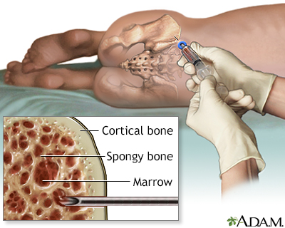
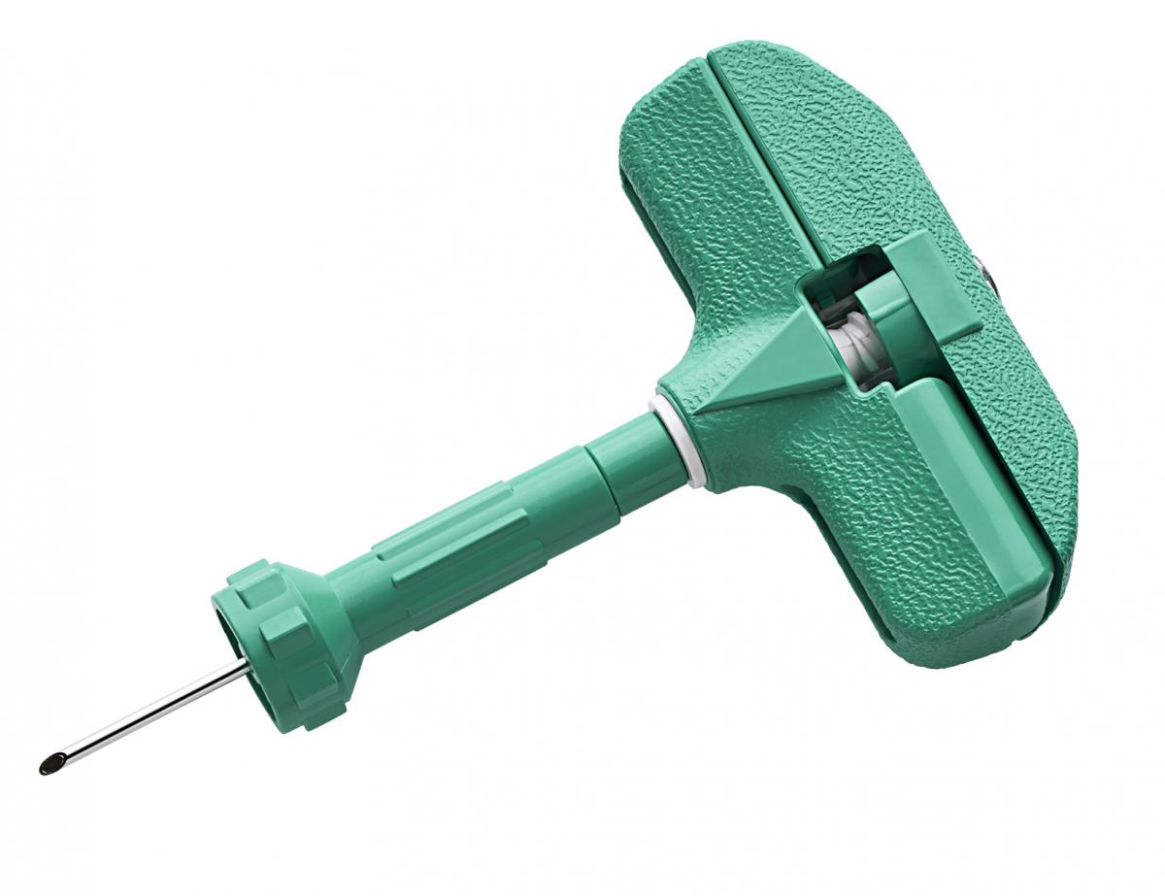
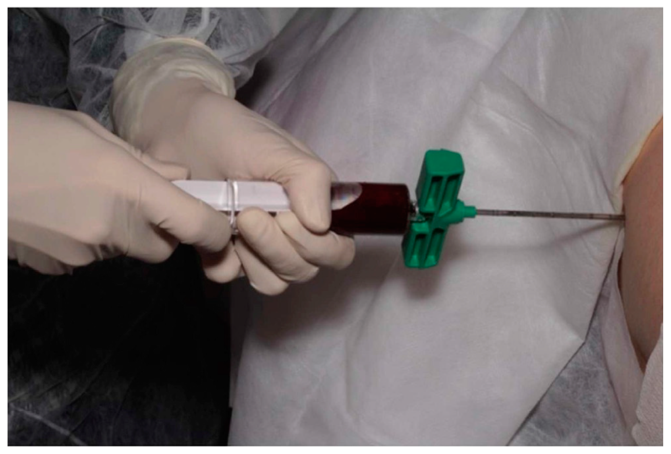

Slide 26
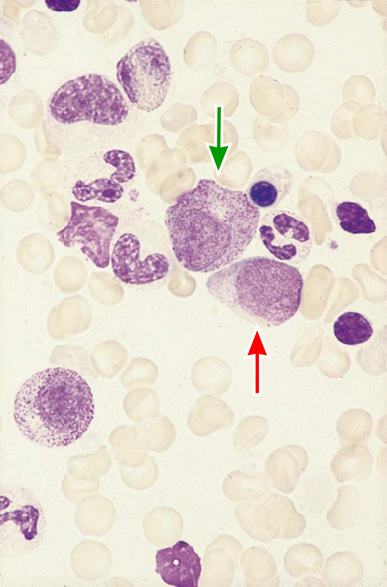
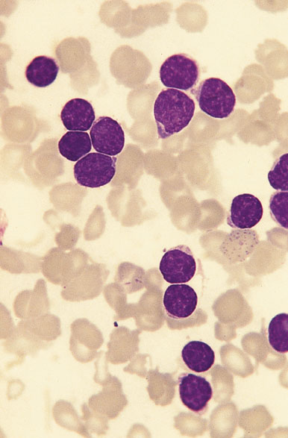
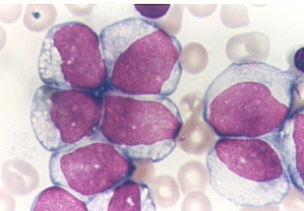
NORMAL BONE MARROW
ACUTE LYMPHOBLASTIC LEUKAEMIA
ACUTE MYELOID LEUKAEMIA

Slide 27
Cytochemistry
AML
Sudan black, Myeloperoxidase, Chloroacetate Esterase
Monoblastic – Non Specific Esterase
ALL
B lineage – PAS
T lineage – Acid Phosphatase

Slide 28
Immunophenotyping
Use of antibodies to identify cell antigens (clusters of differentiation or CD)
The pattern of antigens expressed by the cells correlates with lineage and maturity
Eg AML - CD 13, CD33 positive, CD19, CD20 negative

Slide 29

Cytogenetics
Chromosomal abnormalities are found in the blasts in 70% of cases of AML and 90% of ALL
Important in the pathogenesis of the disease
Important for diagnosis
Prognostic implications
Eg t(15;17) and M3 AML

Slide 30
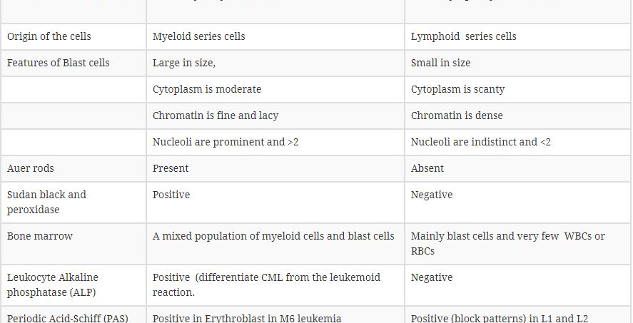

Slide 31
Clinical Management
Supportive care
Remission induction
Maintenance therapy
Bone marrow transplantation
Treatment of relapse

Slide 32
Supportive care
Anemia – red cell transfusion
Thrombocytopenia – platelet concentrates
Infection – broad spectrum IV antibiotics
Hematopoietic growth factors : GM-CSF, G-CSF
Barrier nursing
Indwelling central venous catheter

Slide 33
Treatment
AML
Remission induction + consolidation usually with 4 courses of chemotherapy
M3 – chemotherapy + ATRA
Bone Marrow or stem cell transplantation for those with poor prognosis disease who have a suitable donor
ALL
Remission induction + consolidation
CNS prophylaxis
Maintenance therapy for 2-3 years
Bone marrow or stem cell transplant for those with poor prognosis disease with a suitable donor

Slide 34
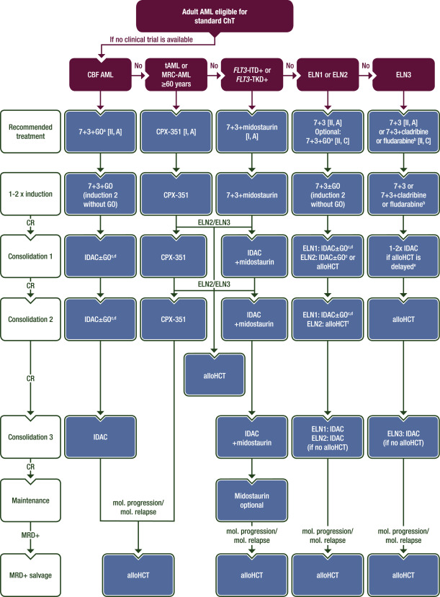
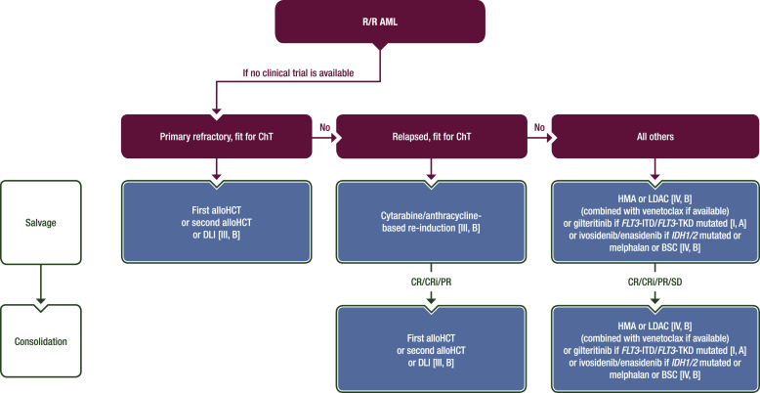

Slide 35
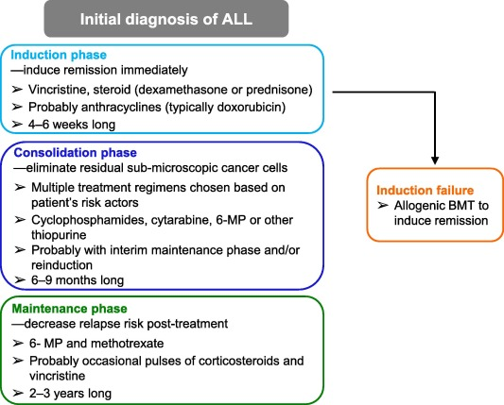

Slide 36
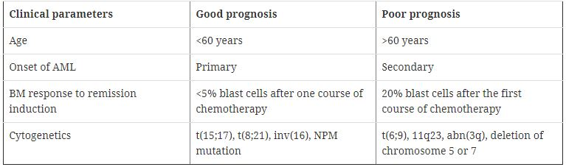
AML and prognostic factors

Slide 37
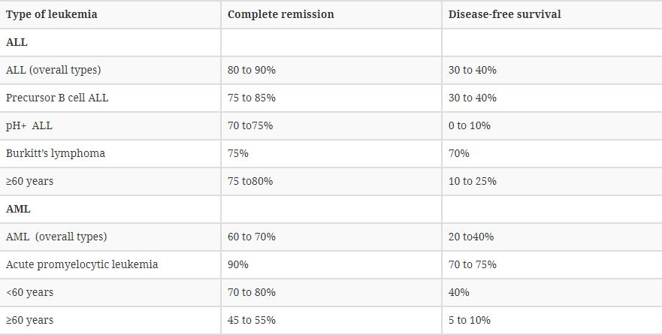
Prognosis Of The ALL and AML:

Slide 38

CLINICAL CASES

Slide 39
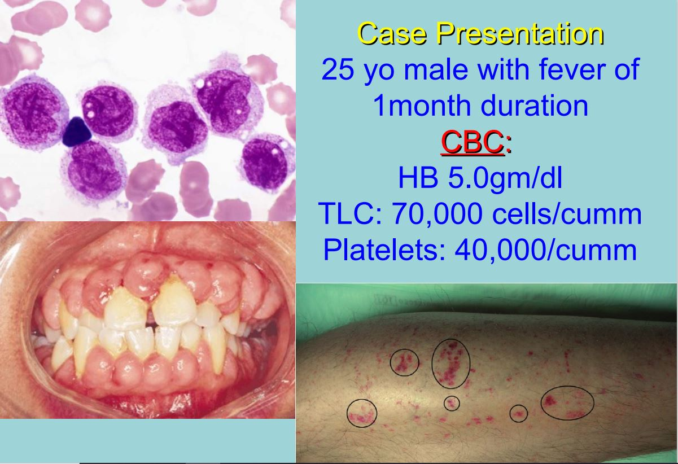
Which is the most likely diagnosis?
Why?

Slide 40
A 16 year old girl
Extreme pallor gum bleeds, Purpura,With Lymphadenopathy and Hepatosplenomegaly
Notes:
Case history

Slide 41
During a sunny spring weekend, patient would go outside to play, only to return minutes later exhausted, flopping herself onto the sofa to rest.
Notes:
Case history

Slide 42
Only a week later, the patient was ill again, with a fever, severe headache, and extreme lethargy.
Her parents decided to take her to a pediatrician who recommended for them to see an oncologist.
Notes:
Case history

Slide 43
After the oncologist performed a bone marrow aspiration, he realized that the patient had acute lymphoblastic leukemia, early pre-B cell.
Notes:
Case history

Slide 44
The white blood cell count in her peripheral blood was about 550,000.
Her bone marrow was packed with leukemia blasts.
Notes:
Case history

Slide 45
The next thing that occurred was a procedure called leukopheresis.
This procedure lasted 4 hours and cut white blood cell (WBC) count in half--to about 250,000.
Notes:
Case history

Slide 46
She was administered chemotherapy immediately following the leukopheresis procedure.
The next day chemo had produced an effect as well: The WBC -125,000.
Notes:
Case history

Slide 47
At day 29 of the induction protocol the patient was declared to be in complete remission.
Notes:
Case history

Slide 48
Step two -consolidation therapy.
This entailed multiple combinations of drugs administered on a rotational basis (on various weeks) for the next six months.
Notes:
Case history

Slide 49
For instance, she would receive an infusion of methotrexate for a couple of days and then take 6-MP by mouth for a week.
Another cycle included VM-26 (Teniposide) and Ara-C.
Notes:
Case history

Slide 50
Exactly 5 months since her diagnosis, and 16 weeks of remission… the patient has relapsed. Her white count is 27,000.
Notes:
Case history

Slide 51
The Consolidation protocol had been dropped and replaced with a new induction protocol.
After the bone marrow aspiration to determine the extent of the leukemia relapse, she was given doxirubicin, vincristine and L-asparaginase.
Notes:
Case history

Slide 52
The patient proceeds directly to the final 30 days of the chemotherapy--the bone marrow transplant.
BMT patients are in a delicate condition following discharge
Notes:
Case history

Slide 53
9 weeks after BMT the patient had relapsed. Her white count was 47,000.
Supportive therapy was required.
The patient died due to infectious complications.
Notes:
Case history

Slide 54
Caz clinic nr 2
Pacient I.M. in varsta de 32 de ani, acuza astenie fizica, satietate precoce si constipatie de aproximativ 4 luni.
Paraclinic: Hb 11g/dl, VEM 87fl, HEM 32pg, leucocite 650.000, Trombocite 530.000/mm3. FL: neutrofile 89%, Ly 12%, E 7%, B 9%. FSP: blasti 2%, promielocite 2%, mielocite 6%, metamielocite 6%, NNS 4%, NS 71%, Ly 3%, B 6%, E5%.
Completati investigatiile si stabiliti criteriile de diagnostic pozitiv

Slide 55
Caz clinic nr 3
Pacient in varsta de 27 de ani, acuza astenie fizica marcata, stare generala alterata, inapetenta, simptomatologie ce a debutat in urma cu 6 zile cu agravare progresiva. Obiectiv: tegumente si mucoase palide, echimoze si petesii la nivelul mb inferioare aparute dupa microtraumatisme.
Paraclinic: HB 4.2 g.dl, VEM 84 fl, HEM 31pg, Trombocite 12.000/mm3, leucocite 45.000/mm3, FL neutrofile 16%, Ly 5%, Mo2%, E 0%, B 0%.
FSP: blasti 77%, NS 7%, Ly 6%
MO: serie granulocitara 92%, blasti 84%
Stabiliti algoritmul de diagnostic

Slide 56
Aplazie medulară | Tromboze venoase periferice Sindrom infectios Tulburari depressive Purpura sau sindrom hemoragipar Debutul poate sa fie insidious Debut brusc Adenopatii Determinari cutanate CID Hipertrofii gingivale Hepato/splenomegalie Anemia care apare treptat si care evolueaza pana la grad sever– grav | Leucemie acuta

