Slide 1
CHRONIC LYMPHOCYTIC LEUKEMIA (CLL)

Slide 2
Case 4
Pacient I.M. in varsta de 32 de ani, acuza astenie fizica, satietate precoce si constipatie de aproximativ 4 luni.
Paraclinic: Hb 11g/dl, VEM 87fl, HEM 32pg, leucocite 650.000, Trombocite 530.000/mm3. FL: neutrofile 89%, Ly 12%, E 7%, B 9%. FSP: blasti 2%, promielocite 2%, mielocite 6%, metamielocite 6%, NNS 4%, NS 71%, Ly 3%, B 6%, E5%.
Completati investigatiile si stabiliti criteriile de diagnostic pozitiv
Notes:
Sa il rezolve ei

Slide 3
Chronic myeloid leukemia is characterized by:
a. Leukocytosis with more than 20% blasts in bone marrow in chronic phase
b. Philadelphia chromosome in 50% of cases
c. Fusion gene BCR-ABL in 20% of cases
d. BCR-ABL encodes p210 protein
e. Normal spleen size

Slide 4
WHO classification
B-Cell neoplasms
- Precursor B-cell neoplasm:
B-lymphoblastic leukemia/lymphoma
- Mature (peripheral) B-cell neoplasms:
  B-cell chronic lymphocytic leukemia/small lymphocytic lymphoma
  B-cell prolymphocytic leukemia
  Lympfoplasmacytic lymphoma
  Splenic marginal zone B-cell lymphoma (+ /- villous lymphocytes)
  Hairy cell leukemia
  Plasma cell myeloma/plasmacytoma
  Extranodal marginal zone B-cell lymphoma of MALT type
  Nodal marginal zone B-cell lymphoma (+/— monocytoid B cells)
  Follicular lymphoma
  Mantle-cell lymphoma
  Diffuse large B-cell lymphoma
Mediastinal large B-cell lymphoma
Primary effusion lymphoma
Burkitts lymphoma/Burkitt cell leukemia
T-cell and NK-cell neoplasms
- Precursor T-cell neoplasm:
T-lymphoblastic lymphoma/leukemia
- Mature (peripheral) T-cell neoplasms:
  T-cell prolymphocytic leukemia
  T-cell granular lymphocytic leukemia
  Aggressive NK-cell leukemia
  Adult T-cell lymphoma/leukemia (HTLV1 +)
  Extranodal NK/T-cell lymphoma, nasal type
  Enteropathy-type T-cell lymphoma
  Hepatosplenic gamma-delta T-cell lymphoma
  Subcutaneous panniculitis-like T-cell lymphoma
  Mycosis fungoides/Sezary syndrome
  Anaplastic large-cell lymphoma, T/null cell, primary cutaneous type
  Peripheral T-cell lymphoma, not otherwise characterized
  Angioimmunoblastic T-cell lymphoma
  Anaplastic large-cell lymphoma, T/null cell, primary systemic type

Slide 6
CLL - Definition
in 98% of patients the leukemic cells are a monoclonal population of mature B lymphocytes with low-density surface immunoglobulin
T cell CLL can occur rarely - endemic in Japan, connected with HTLV1 infection
B-CLL is a neoplastic disease characterized by proliferation and accumulation of small, mature, long-living lymphocytes in blood, marrow and lymphoid tissues (lymph nodes, spleen)
Results in prolonged cell survival despite of low proliferate index.
This lymphocytosis leads to specific clinical and laboratory symptoms of B-CLL
The neoplastic lymphocytes have on their surface the special B-cell line antigens – CD19, CD20 and also CD5, CD23, and a very weak expression of surface immunoglobulin (SIg)

Slide 7
CLL is predominently an indolent disorder of late middle-aged or elderly individuals
In its least aggressive pattern, patients die of causes unrelated to CLL at a rate that closely follows actual norms for their age.
In its most aggressive form, patients may die within 1 to 2 years after diagnosis.
When the patients come to the doctor for the first time, they are often asymptomatic.
As the disease advances, the following may appear: increasingly elevated lymphocyte counts; progressive lymphadenopathy and hepatosplenomegaly; and more severe anemia, granulocytopenia, or thrombocytopenia.

Slide 8
Late in the course of the disease, hypogammaglobulinemia and progressive splenomegaly are prevalent. Infections are common with disease progression and are the leading cause of death in patients with CLL.
Most CLL patients die of infection or illness unrelated to the leukemia.
Long-term consequences of CLL include the development of autoimmune phenomena and/or transformation.

Slide 9
CLL – Initial symptoms
Approximately 40% are asymptomatic at diagnosis – discovered by a CBC
In symptomatic cases the most common complaint is fatigue
B symptoms – fever, sweats, weight loss
Less often the initial complaint is related to enlarged nodes or the development of an infection (bacterial)

Slide 10
CLL - Clinical findings
Most symptomatic patients have enlarged lymph nodes (more commonly cervical and supraclavicular) and splenomegaly
The lymph nodes are usually discrete, freely movable, and nontender
Hepatomegaly may occur
Less common manifestation are
  infiltration of tonsils,
  mesenteric or retroperitoneal lymphadenopathy,
  skin infiltration
Patients rarely present features of anemia, and bruising or bleeding

Slide 12
Investigations
Pretreatment studies of patients with CLL should include examination of:
  complete blood count
  peripheral blood smear
  reticulocyte count
  Coomb’s test
  renal and liver function tests
  serum protein electrophoresis
  immunoglobulin levels
immunophenotyping should be carried out to confirm the diagnosis
Bone marrow biopsy and cytogenetic analysis is not routinely performed in CLL

Slide 13
CLL – Lab findings
Morphology:
  Leucocytosis with monoclonal lymphocytosis of greater than 5.000/ul.
  anemia
    Because of „displacement ”
    and/or autoimmunohemolic (10-20% of patients have a positive direct antiglobulin test; AIHA is commonly connected with the presence of warm auto- antibodies IgG class – rapidly increasing fatigue, skin getting yellow, anemia with enlarged reticulocytosis, higher level of bilirubin)
  thrombocytopenia
    Because of „displacement ”
    and/or immunologic (about 5% of B-CLL patients have anty-platelet antibodies)
protein electrophoresis – Hipogammaglobulinemia, monoclonal protein in 5% of patients

Slide 14
  Cytogenetics - clonal chromosomal abnormalities are detected in approximately 50% of CLL patients. The most common clonal abnormalities are:
    trisomy 12
    structural abnormalities of chromosomes 13, 14, 17 and 11
  patients with abnormal karyotypes have a worse prognosis
Immunoglobulin genes - monoclonal surface immunoglobulin is expressed on lymphocytes kappa/lambda restriction (60% kappa and 40% lambda light chains)
Immunologic abnormalities
  autoimmune disease (hemolytic anemia and thrombocytopenia)
  hypogammaglobulinemia
  cellular immune defects

Slide 15
CLL – Lab findings
a) Blood test lymphocytosis ≥ 5 000/mm3 (4 weeks)
b) Morphology population of small mature lymphocyte
c) B-cell CLL phenotype clonal population of lymphocyte CD
19, CD20, CD23, low SIg, CD5+
d) Markers of clonality κ/λ light chain restriction;
e) Bone marrow infiltrate > 30% ly of nuceated cells on aspirate
f) Lymph node diffuse infiltration of small lymphocyte

Slide 16
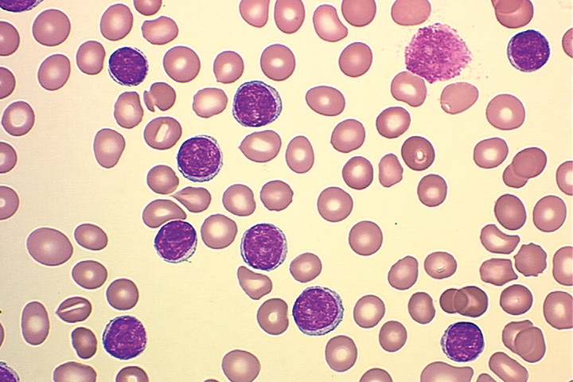
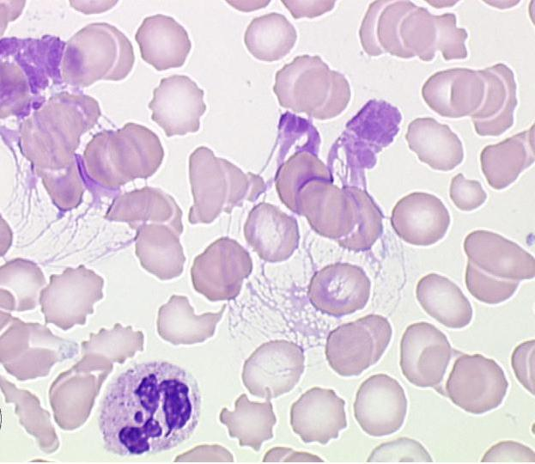
Absolute lymphocytosis
Lymphs = B cells
  Thin cytoplasm
  Dense nucleus
  Partially aggregated chromatin
  No recognizable nucleoli
Smudge cells
Gumprecht nucleus shadows

Slide 17
B-CLL
Immunophenotype:
  CD19+/CD23+/CD20+
  CD5+
  Kappa/lambda restriction
  sometimes also CD38+

Slide 18
B-CLL
Cytogenetic examinations - clonal chromosomal abnormalities are detected in approximately 50% of CLL patients
  deletion 13 (13q14.3)
  trisomy 12
  structural abnormalities of chromosomes 11 (11q-), 14, 17p-

Slide 19
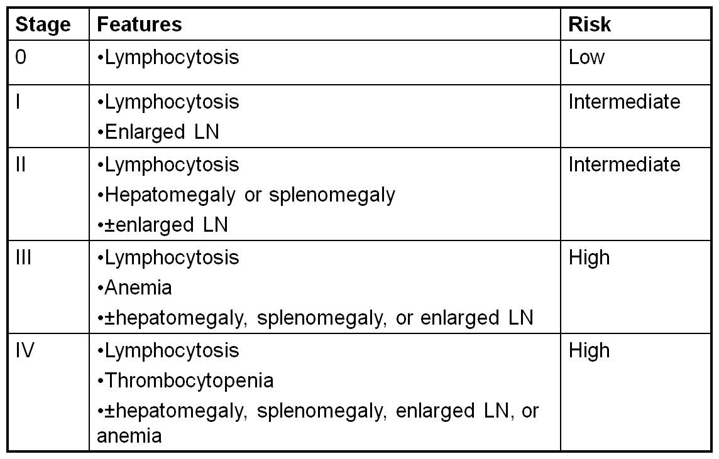
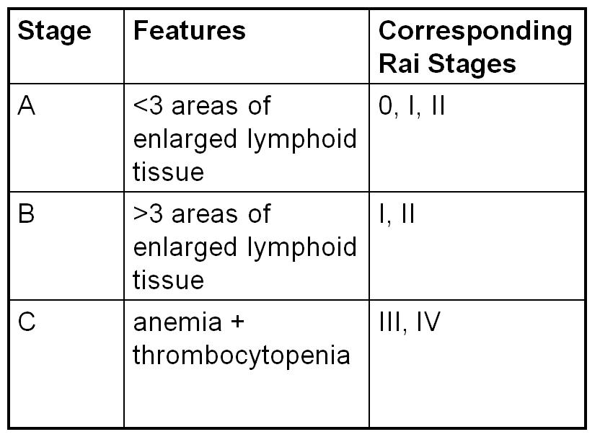
CLL – staging system RAI/Binet

Slide 20
Staging: Rai and Binet staging systems for CLL
Clinical staging systems for CLL
Stage
Value | Rai | Binet |  | Median survival
Lymphocytosis (>5,000/mm³) | 0 | - |  | 150 months (12.5 years)
Lymphocytosis plus nodal involvement | I | A | <3 node groups | 101-108 months (8.5-9 years)
Lymphocytosis plus organomegaly | II | B | >3 node groups | 60-71 months (5-6 years)
Anemia (RBCs) | III Hgb <11 g/dL | C | Hgb <10 g/dL | 19-24 months (1.5-2 years)
Lymphocytosis plus thrombocytopenia (platelets) | IV PLT <100,000/mm³ | PLT <100,000/mm³
Notes:
1. Rai KR, et al. Blood. 1975;46:219-234.
2. Binet JL, et al. Cancer. 1981;48:198-206.
3. Binet JL, et al. Cancer. 1977;40:855-864.
The clinical staging of CLL is usually done according to the staging of Rai or Binet. The Rai system is more common in the US, whereas the Binet system is prevalent in Europe.
Both systems classify the disease stages according to platelet count, hemoglobin count, and the size of lymph nodes, spleen, and liver.
The original Rai staging system included 5 stages of disease progression. However, it was modified by Rai into 3 categories: Low risk (Rai stage 0), Intermediate risk (Rai stages I and II), and High risk (Rai stages III and IV). This revision is the preferred version according to the modified NCI guidelines.
The predictive nature of both systems is limited by the wide-ranging nature of the clinical course of CLL, which can be unpredictable at the early stage of the disease.

Slide 21
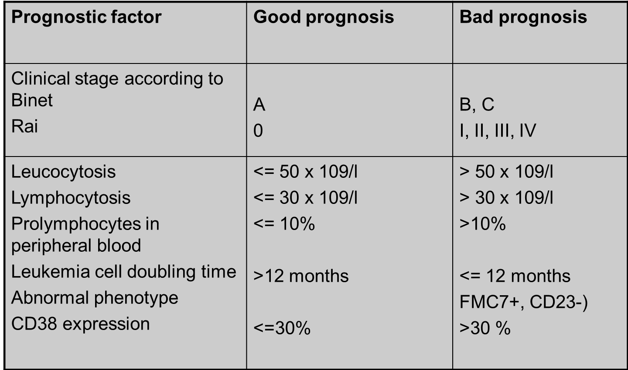

Slide 22
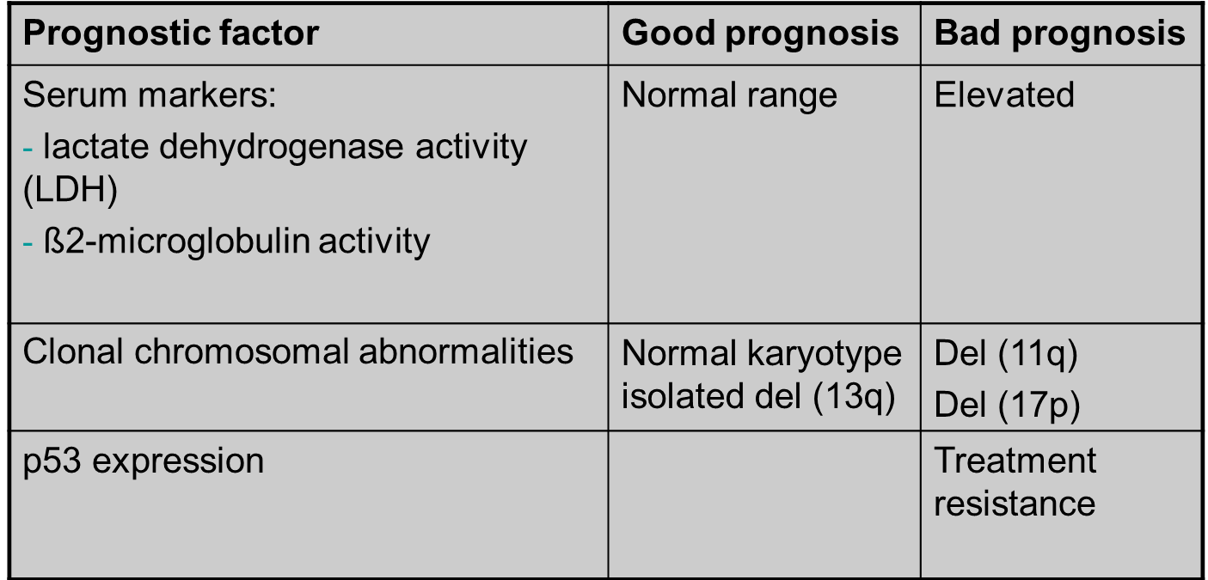

Slide 23
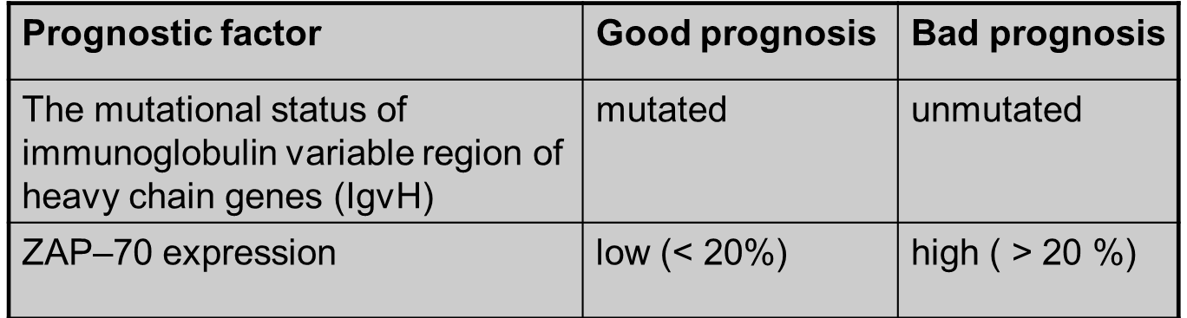

Slide 24
Complications
Infections
Autoimmune – hemolytic anemia / immune trombocytopenia
Prolymphocytic transformation
Second malignancies
  nonhematological
    Lung cancer
    Skin cancer (melanoma)
    Breast cancer
  hematological - acute leukemia
  Richter’s Syndrome
  Is transformation of CLL into an aggressive Lymphoma – diffuse large cell lymphoma (DLCL) or Hodgkin‘s lymphoma
  usually evolves after a long indolent course
  has a poor prognosis

Slide 25
Indications to Initiate Treatment for CLL
Constitutional symptoms referable to CLL (B-symptoms)
Progressive marrow failure
Autoimmune anemia and/or thrombocytopenia poorly responsive to corticosteroids
Massive or progressive splenomegaly
Massive or progressive lymphadenopathy
Rapid lymphocyte doubling time (< 6 months)
Notes:
When to begin therapy remains one of the most challenging issues confronting physicians who care for patients with CLL. Outside of clinical trials, the therapeutic goal for most patients with CLL who require treatment has been palliation of symptoms. The suggested guidelines for initiation of therapy from the NCI consensus panel on CLL are summarized on this slide.
Initiation of therapy must be individualized according to each patient’s clinical status and comorbid conditions. Although constitutional symptoms alone may be an indicator of when to begin therapy, it is important to search for other causes of weight loss or fever. Cytopenia may be caused by autoantibodies in addition to marrow impairment.
Cheson et al. Blood. 1996;87:4990-4997.
NCI-WG: Indications to Initiate Treatment for CLL

Slide 26
CLL – treatment
We have to remember:
  B-CLL – indolent lymphoma but incurable
  Outside of clinical trials, the therapeutic goal for most patients with CLL who require treatment has been palliation of symptoms
  Elderly patients – risk of additional diseases
  Course of the disease can be very long, indolent for many years, patients can die because of another reason which is not connected to B-CLL.
Decision about treatment depends on
- clinical stage
- prognostic factors
- patient’s condition

Slide 27
CLL – treatment
Watch and wait
Monotherapy
  Glucocorticoids (autoimmunological complications)
  alkylating agents (Chlorambucil, Cyclophosphamide)
  purine analogues (Fludarabine, Cladribine, Pentostatin)
Combination chemotherapy
  Chlorambucil/Cyclophosphamide + Prednisone
  purine analog (Fludarabine) + Cyclophosphamide
  CVP, CHOP (Cyclophosphamide, Doxorubicin, Vincristin, Prednisone)
Monoclonal antibodies (monotherapy and in combination)
  Rituximab (anti-CD20) = Mabthera
  Obinutuzumab
  Ofatumumab
  IBRUTINIB (Imbruvica)
  Ibrutinib is not a chemotherapy drug but one of what are termed "targeted therapies.“
  Ibrutinib inhibits the function of Bruton's tyrosine kinase (BTK). BTK is a key signaling molecule of the B-cell receptor signaling complex that plays an important role in the survival of malignant B cells. Ibrutinib blocks signals that stimulate malignant B cells to grow and divide uncontrollably.

Slide 28
CLL – treatment
Hematopoietic stem cell transplantation
  autologous - still no cure with auto-SCT
  allogeneic with reduced intensity conditioning
    Even RIC-SCT is still a risky procedure - indicated only in high-risk disease
    Can allo-SCT cure CLL? - YES
Supportive therapy (allopurinol, G-CSF, blood and platelet transfusion, immunoglobulins, antibiotics)

Slide 29
Response criteria
Complete response (for at least 2 months)
  clinical features – normal
  morphology – normal (Hb>11 g/dl; Pt>100 000 /ul, lymphocytes <4000 G/l; neutrofiles >1500 G/l))
  bone marrow - lymphocytosis less than 30%
Partial response
Stable Disease
Progressive Disease

Slide 30
A 65-year-old man pursued laboratory testing as part of health screening offered by his employer and was advised to visit his physician based on initial test results. He has not experienced any acute symptoms (fever, chills), nor weight loss, but does report feeling more tired the past few months. The patient did not have any personal or family history of cancer and is not currently taking any medications. Physical examination is unremarkable. There is no organomegaly or palpable lymphadenopathy on physical examination.

Slide 31
Test | Patient | Normal Range
WBC | 14 K/µL | 4.8-10.8 K/µL
Hemoglobin | 13.6 g/dL | 13-16.8 g/dL
Hematocrit | 41% | 40%-50%
MCV | 91 fL | 80-100 fL
Platelets | 400 K/cu mm | 150-450 K/cu mm

Slide 32
Automated Differential Count.
Differential Count | Patient Percentage | Patient Absolute (×10³/µL) | Normal Range Absolute (× 10³/µL)
Granulocytes | 20 | 2.8 | 1.4-6.5
Lymphocytes | 75 | 10.5 | 1.2-3.4
Monocytes | 5 | 0.7 | 0.1-0.6
Eosinophils | 0 | 0 | 0-0.5
Basophils | 0 | 0 | 0-0.2

Slide 33
What Is the Differential Diagnosis Based on Review of the Complete Blood Count Values? What Would Be the Next Step in the Diagnostic Evaluation?
Review of the CBC values reveals an elevated white blood cell (WBC) count (leukocytosis). The automated differential count provided by the automated hematology analyzer shows a predominance of lymphocytes among the white cells (lymphocytosis).
The differential diagnosis for lymphocytosis is quite broad and would include chronic lymphoid neoplasms as well as reactive causes such as viral infections, hepatitis, pertussis (whooping cough), autoimmune disease, and polyclonal B lymphocytosis (usually in middle-aged women with a smoking history).
The clinical history does not provide an obvious reactive explanation for the lymphocytosis, and therefore chronic lymphoid neoplasms should be strongly considered. Examples of chronic lymphoid leukemias or lymphomas which may present with leukocytosis would include chronic lymphocytic leukemia, T-cell large granular lymphocytic leukemia, hairy cell leukemia variant, prolymphocytic leukemia, adult T cell leukemia/lymphoma, Sezary syndrome, lymphoplasmacytic lymphoma, splenic marginal zone lymphoma, and mantle cell lymphoma.
An important next step would be to review the peripheral smear. Given that an automated WBC differential analysis may occasionally misclassify blasts, lymphocytes, and atypical lymphocytes, and the fact that some artifacts (platelet clumps, nucleated red blood cells [RBCs], incomplete lysis of RBCs, etc) may result in a falsely elevated WBC, review of the peripheral blood smear enables the confirmation of cell counts, as well as the assessment of the morphology of the abnormal population.¹

Slide 34
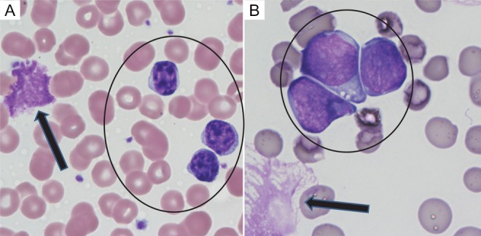
Notes:
A, Chronic lymphocytic leukemia (CLL). Note the mature, clumped chromatin and smooth nuclear contours of the CLL cells (circle) and smudge cells in the background (arrows). B, Acute lymphoblastic leukemia (ALL). Note the finely dispersed chromatin in the leukemic blast cells (circle). Note that smudge cells are not specific for CLL and can also be seen in ALL (arrow).
Images in this article

Slide 35
What Diagnostic Study Would Be Most Helpful to Confirm Your Suspicions? What Result Would You Expect to See?
In order to confirm the morphologic suspicion of a chronic lymphoid neoplasm, flow cytometry would be the preferred ancillary study and could be performed on the peripheral blood sample. In this technique, the cells are incubated with fluorescently tagged antibodies specific for hematolymphoid markers and are subsequently interrogated by a laser beam in a single cell suspension. If the marker is present, the fluorescent signal is detected, enabling the rapid characterization of the antigen profile of cells.
In this particular case, the neoplastic cells were positive for the CD19, CD20 (dim), CD5, and CD23, with monotypic expression of lambda immunoglobulin light chain. The expression of CD19 and CD20 would indicate B cell lineage, and the monotypic surface light chain expression can be used as a surrogate for clonality and aid in the establishment of a neoplastic B lymphoid process. The dim level of expression of CD20 and surface light chain, together with the coexpression of CD5 and CD23, are characteristic for chronic lymphocytic leukemia (CLL), which is the most common adult leukemia in the Western world.By definition, there must be ≥5 × 10⁹ monoclonal B CLL cells/L in the peripheral blood in order to distinguish CLL from monoclonal B lymphocytosis (MBL). This distinction is important because MBL is not considered a frank malignancy, and only a small fraction of MBL patients will develop overt CLL. When the same cells infiltrate soft tissues or lymph nodes, a diagnosis of small lymphocytic lymphoma (SLL) is rendered.
Chronic lymphocytic leukemia and SLL are now considered to be different clinical manifestations of the same disease

Slide 36
What Organ Systems Are Involved in This Disorder? How Would You Stage This Patient?
CLL/SLL may involve many organ systems, although many patients with CLL are asymptomatic when initially diagnosed. Patients with SLL present with lymphadenopathy, hepatosplenomegaly, or other symptoms of organ infiltration. CLL/SLL may be associated with neutropenia and hypogammaglobulinemia, which leads to an increased susceptibility to infections.
The Rai and Binet staging systems have been used to stage patients with CLL/SLL and take into account the degree of the cytopenias and the presence or absence of lymphadenopathy or organomegaly
This patient would be best staged as Rai stage 0 or Binet stage A due to asymptomatic lymphocytosis without anemia, thrombocytopenia, or any lymphadenopathy or organomegaly on physical examination. In patients with asymptomatic, early-stage CLL, routine surveillance with computed tomography (CT) scans is not recommended, as these studies do not improve survival and expose the patients unnecessarily to small doses of radiation

Slide 37
What Testing Could Be Performed to Help Predict the Clinical Course? What Would Be Your Treatment Recommendations?
Useful markers for risk stratification have included assessing for specific genetic abnormalities, which can be performed on the diagnostic peripheral blood sample. FISH studies evaluate for deletion (del) 11q, del 17p, trisomy 12, and del 13q, and assessment of the mutation status of the TP53 and immunoglobulin heavy chain (IGHV) genes.
In this particular patient, FISH studies only showed an isolated del 13q abnormality, and molecular studies revealed a mutated IGVH gene status.
There was no evidence of unfavorable prognostic markers such as del 11q, del 17p or TP53 mutations, or an unmutated IGHV gene status.
The clinical behavior of CLL/SLL is variable, and early treatment of asymptomatic patients does not result in improved survival. Given the overall favorable prognostic profile and lack of symptoms in this patient, observation (or “watchful waiting”) may be the best course of action. Indications for treatment include progressive cytopenias, bulky or symptomatic lymphadenopathy or splenomegaly, B symptoms, or other signs or symptoms of disease progression. In a minority of cases (5%-10%), there is transformation to a more aggressive lymphoma (“Richter syndrome”), most commonly diffuse large B cell lymphoma, often presenting as a rapidly enlarging mass.

Slide 38
Treatment
Current therapies for CLL/SLL emphasize a multimodality approach including monoclonal antibodies targeting the B cell marker CD20 (such as rituximab), combined with chemotherapeutic agents such as purine analogs (fludarabine) or alkylating agents (cyclophosphamide, bendamustine). Agents targeting B cell receptor signaling (ibrutinib, idelalisib) or expression of the anti-apoptotic protein BCL2 (venetoclax) are also increasingly being incorporated into therapeutic regimens for CLL/SLL.

Slide 39
Clinical case 2
69 yo, male
Medical history: third degree hypertension, dyslipidemia, biliary lithiasis, left gonarthrosis, lumbar discopathy,
Physical examination: good general status; afebrile, appetent; right submandibular adenopathy of 3/1.5 cm (small enlargement since previous month), mobile, firm, unpainful, blood pressure – 165/100 mmHG, liver with inferior edge at 3 cm below costal margin, impalpable spleen.

Slide 40
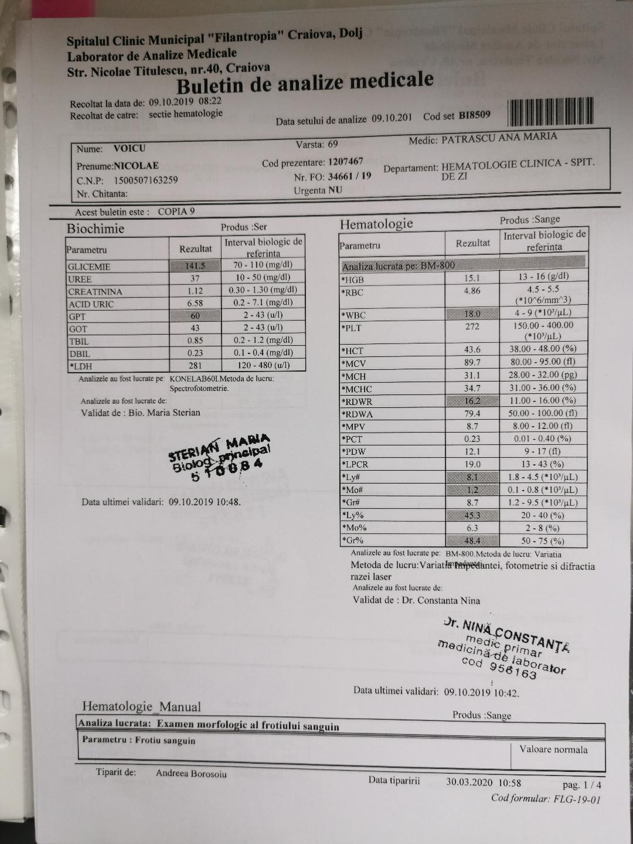
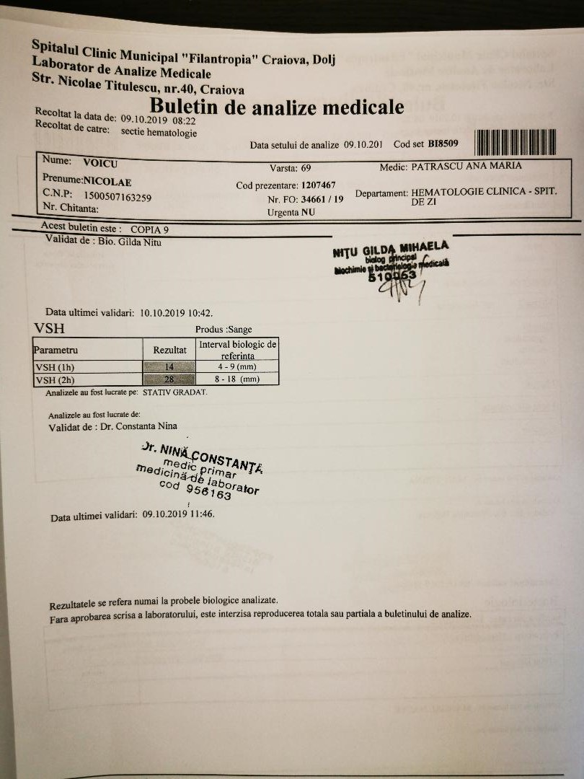
Lab findings

Slide 41
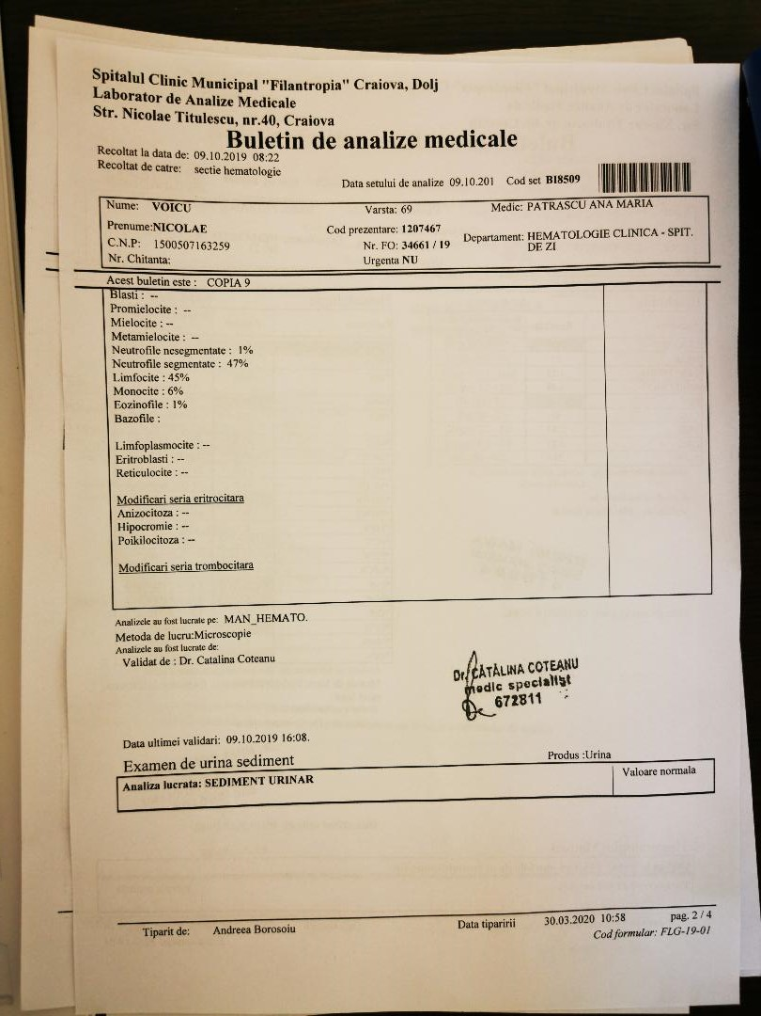
Blood smear

Slide 42
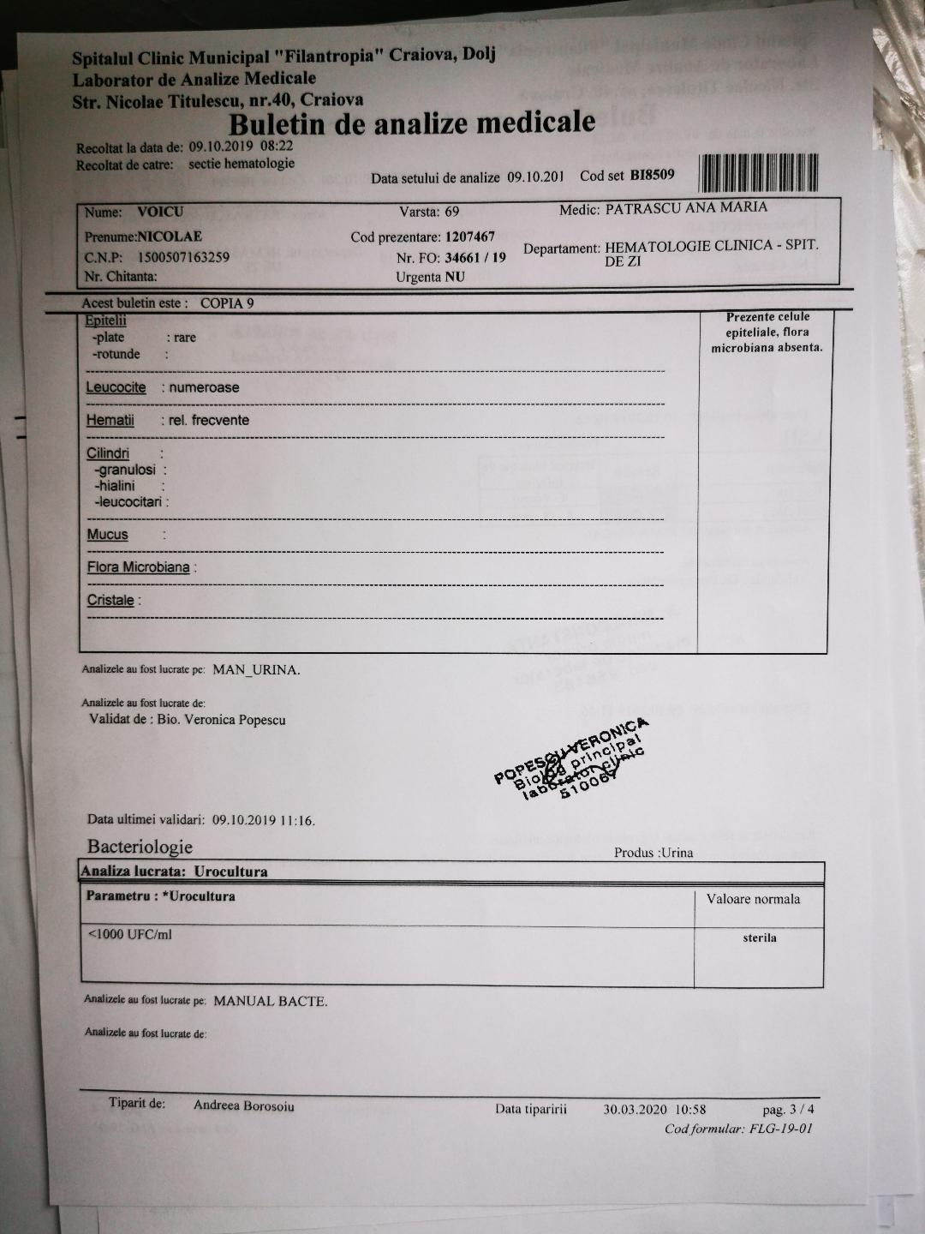
Urine exam

Slide 43

DIAGNOSIS
CHRONIC LYMPHOCYTIC LEUKEMIA
STAGE A BINETT/2 RAI

Slide 44
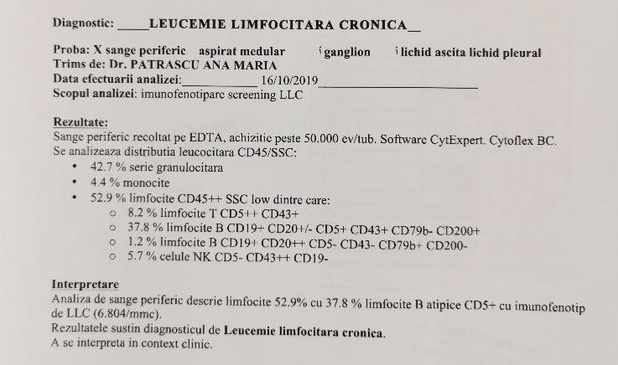
Immunophenotyping

Slide 45
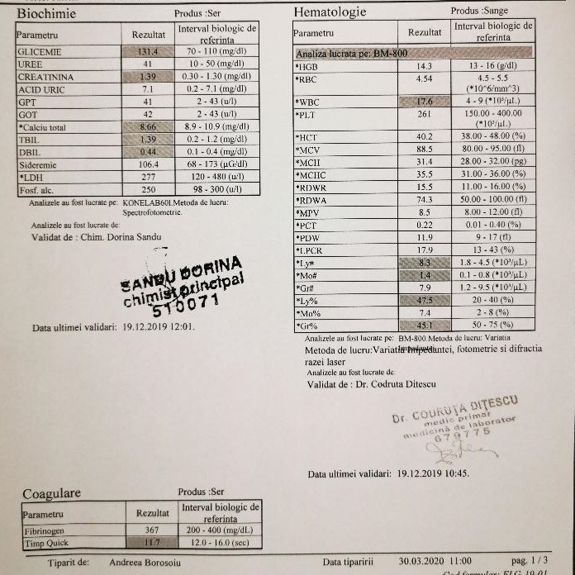
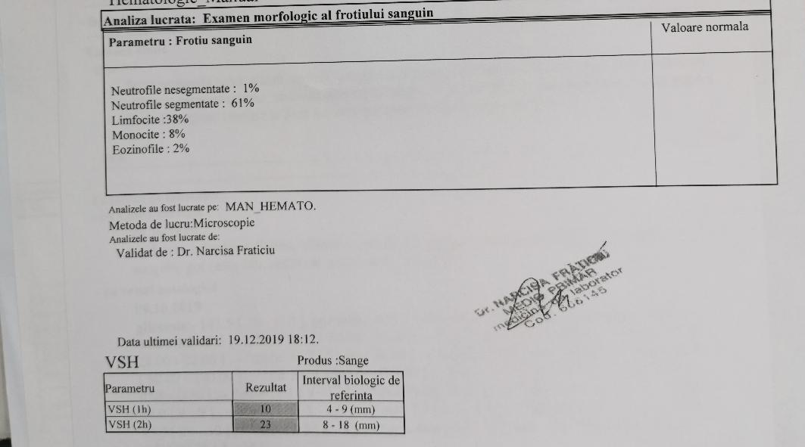
LAB FINDINGS

Slide 46
TREATMENT
The patient does not present the required criteria for treatment initiation, in his case the indication is to WATCH AND WAIT
EVOLUTION
The patient is going to have regular check-ups, every three months, and when the lab finding are going to suggest that treatment is required, he is going to be tested for 17p deletion, TP 53 mutation and for IGHV status.

Slide 47
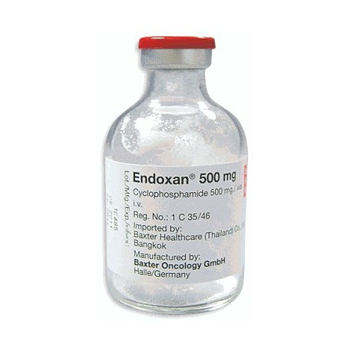
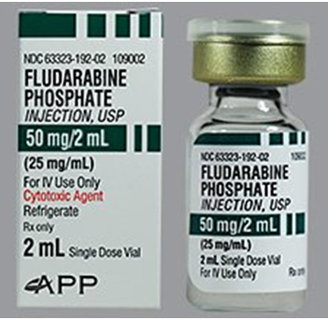
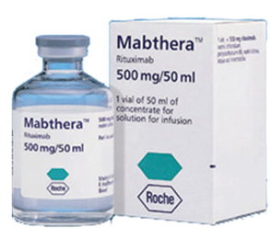
RFC combination chemotherapy is used for fit patients, without comorbidities.

Slide 48
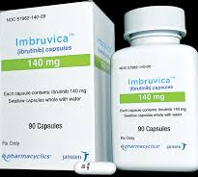
Ibrutinib is recommended for patients that already received a previous line of therapy or as first line of treatment for patients with 17p deletion or TP53 mutation.

