Slide 1
HODGKIN’S DISEAE- CLINICAL, HISTOPATHOLOGICAL AND IMMUNOHISTOCHEMICAL CHARACTERISTICS
Dr.PĂTRAȘCU ANA-MARIA
University of Medicine and Pharmacy Craiova , Faculty of Medicine
2020

Slide 2
AL | Chloroma Richter transformation Enlarged lymph nodes, liver, or spleen Clonal B cells arrested in the B-cell differentiation pathway High levels of surface membrane immunoglobulin Rituximab The most common abnormality is deletion of 13q- Onset is insidious Hematopoietic precursors are arrested in an early stage of development Immunophenotyping by flow cytometry of bone marrow or peripheral blood 3 with 7 chemotherapy (Citarabi+Idarubicin/Daunorubicin) Cells Morphology PAS+ CNS prophylaxis | CLL

Slide 3
Acute myeloblastic leukemia (AML)
a. is a chronic myeloproliferation
b. the bone marrow is infiltrated with young cells, blasts, more than 20%
c. is a curable disease
d. the bone marrow allotransplantation is indicated for patiens with favorable prognosis
e. is an incurable disease

Slide 4
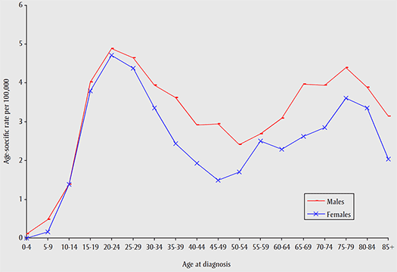
Introduction
Hodgkin Lymphoma (HL) is a B-cell derived malignancy that represents about 30% of all lymphomas, and has two major subtypes; classical (CHL) and nodular lymphocyte predominant HL (NLPHL).
HL has a unique bimodal age distribution,
with the first peak of incidence between 15-35 years old,
and the second peak after the age of 55.
Males are more frequently affected than females.
Whites have a higher incidence of the disease
than the other races.

Slide 5
Etiology
The exact etiology of the disease is unknown.
The molecular analyses of the malignant cells established that the disorder is derived from germinal center B-cells.
The survival and proliferation of RS cells is enabled through:
The Microenvironment surrounding the cells
Abnormal activation of signalling pathways
Genetic lesions in the RS cells

Slide 6
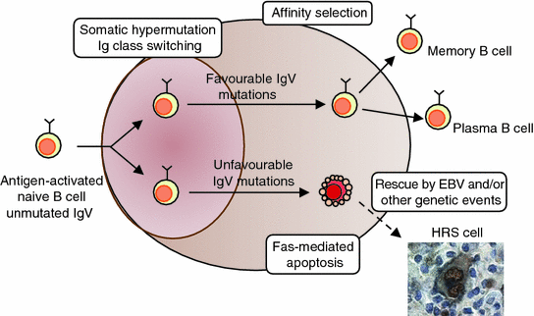
RISK FACTORS
EBV infection
Family history of HL
Low socioeconomic status
Medical history of NHL (Non-Hodgkin lymphoma)
Patients with low immunity

Slide 7
Clinical presentation
The most common presentation of HL is painless lymphadenopathy with rubbery consistency, mainly involving supradiaphragmatic lymph node groups, but can appear in any lymph node group.
About 30% of patients will present with symptoms in addition to the lymphadenopathy:
* B-symptoms (fever, night sweats and weight loss)
* Pruritus
* Fatigue
*Alcohol-induced pain in involved nodes.

Slide 8
Diagnosis
2) Physical examination: palpable nodes (number, shape, size, location, mobility, consistency) , liver and spleen palpation.
3) Lab studies: CBC with differentials, ESR, LDH, Liver Function Tests (LFTs).
4) Radiographic studies: CXR, CT (neck, thorax, abdomen, pelvis), PET-CT.
5) Lymph node biopsy.
* Bone marrow biopsy and aspirate if indicated.
1)History: family, medical and surgical history,
B-symptoms.
Due to scarcity of malignant RS cells in the tumor, an excisional lymph node is needed and not FNA.

Slide 9
CLASSIFICATION
HL has been classified into classical HL, which accounts for 95% of all HL cases, and the less common nodular lymphocyte predominant HL (NLPHL), representing less than 5% of all cases.
Classic HL is grouped into the following 4 types:
Nodular sclerosis classic HL.
Mixed cellularity classic HL.
Lymphocyte-rich classic HL.
Lymphocyte- depleted classic HL.

Slide 10
 | CHL | NLPHL
Incidence | 95% | 5%
Malignant cells | RS cells and variants | LP cells (popcorn cells)
Morphology | Diffuse, Interfollicular, nodular | Nodular or Nodular and Diffuse
Reactive background | Lymphocytes, Histiocytes, Eosinophils, Plasma cells | Mostly B-cells, T-cell rosettes
Immunophenotype | CD15+, CD30+, CD45-, CD20-/+ | CD20+, CD45+, BCL6+, CD15-, CD30-
EBER | Varies depending on subtype, positive in about 50% of cases | Absent

Slide 12
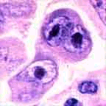
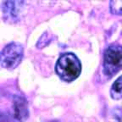
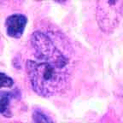
RS cell and variants
classic RS cell
lacunar cell
popcorn cell
(mixed cellularity)
(nodular sclerosis)
(lymphocyte predominance)

Slide 13
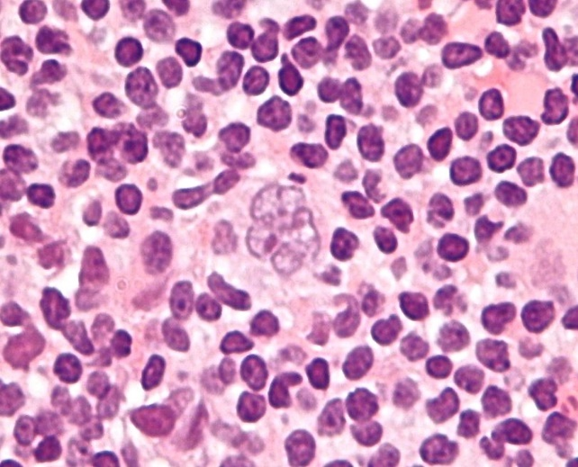
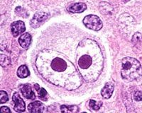
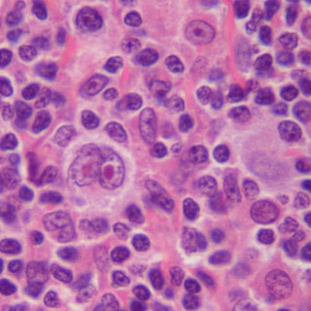
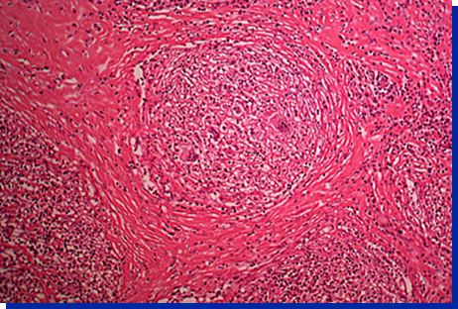
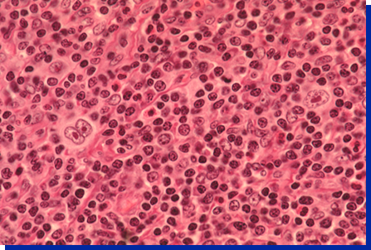
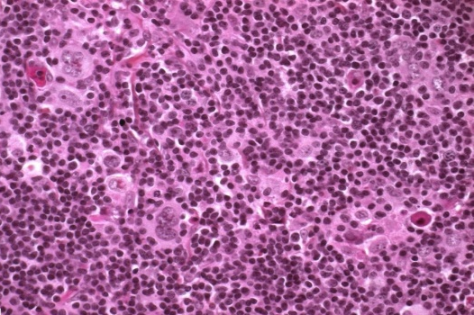
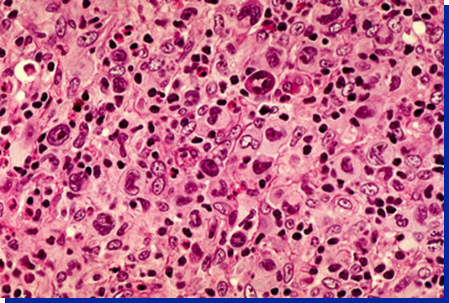
Reed –Sternberg (RS) cells in CHL
,,Popcorn Cells” in NLPHL
RS cell is the hallmark of HL, it is a large cell (15-45um) with multiple or multilobulated nuclei.
The characteristic bilobed nucleus with large nucleoli gives the classical owl eye appearance.
Large, multilobed nucleus, surrounded by small lymphocytes.
Nodular Sclerosis
Mixed Cellularity
Lymphocyte Rich
Lymphocyte Depletion

Slide 14
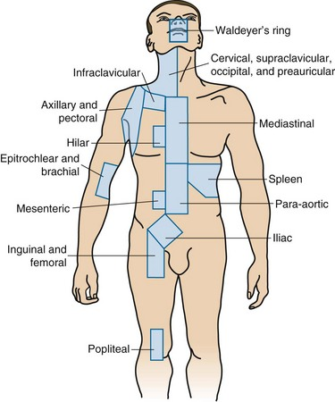
staging
(Lymph node groups and organs)
Ann Arbor classification system

Slide 15
treatment
Early Stage Favourable CHL:
The standard of care for limited HL is
2-cycles of ABVD, followed by involved-field radiotherapy (IFRT) with 20GY.
Early Stage Unfavourable CHL:
The standard of care for an intermediate stage consists of 4-cycles of ABVD, followed by involved-field radiotherapy (IFRT) with dose 30GY.
Advanced stage :
For advanced cases, a multi-agent chemotherapy regimen is used alone. The standard of care for advanced stages consists of 6-cycles of ABVD.

Slide 16
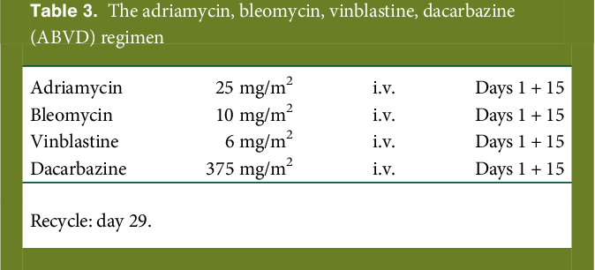
treatment

Slide 17
CASE (1)
Age : 64 yo
Gender: Male
Labs:
Moderate anemia- Hgb 10mg/dl, Hct 34.7%
Elevated ESR
leucocytosis
Chief complaint:
right inguinal lymphadenopathy
Weight loss
Night sweats
pruritus
Physical examination:
Pale
hepatosplenomegaly
Ct scan:
Multiple lymphadenopathies below diaphragm.
Lymph node biopsy:
RS cells in a polymorphic inflammatory infiltrate.
IHC: CD30+
No significant medical or family history.

Slide 18
CASE (1)
Mixed cellularity- Ann Arbor stage II B
Diagnosis
The first case represents a typical case of classical Hodgkin lymphoma, mixed cellularity in 64 years old male, with early stage unfavourable disease- Ann Arbor stage II B. He was treated with chemotherapy, achieved complete response, and during follow up for next five years, no evidence of disease was observed.
Discussion:
Treatment:
Four cycles of ABVD chemotherapy
Response:
PET-CT scan was performed to assess the response- Deauville score 2.
Patient achieved complete remission.

Slide 19
CASE (2)
CXR: left mediastinal opacity.
CT (thorax and abdomen) : mediastinal lymphadenopathies , abdominal microadenopathies.
Age: 24 yo
Gender: female
Main complain:
Left laterocervical lymphadenopathy.
Lymph node biopsy:
No RS cells, fibrosis and effacement of lymph node structure, polymorphic inflammatory infiltrate.
Bands of fibrosis, necrosis and pleomorphic infiltrate.
Effaced architecture of lymph node, RS cells, lacunar variant, frequent lymphocytes and eosinophils, and sclerosis.
IHC: CD30+, CD15+, CD20-
Medical history:
Hypothyroidism, Obesity.
Labs:
Moderate anemia
Leucocytosis
Thrombocytosis
Elevated ESR
Elevated LDH
CRP present
Physical examination:
Axillary and inguinal adenopathies
hepatomegaly

Slide 20
CASE (2)
Discussion : A case of classical HL in 24 year old female diagnosed with hypothyroidism and obesity that presented due to left laterocervical swelling without other symptoms. Chest x-ray showed left mediastinal opacity.
The diagnosis of CHL, Nodular Sclerosis subtype was made based on lymph node biopsy. Nodular Sclerosis HL commonly presents with a mediastinal mass that typically does not compress other structures or invade the anterior chest wall.
The final diagnosis was Classical Hodgkin Lymphoma, Nodular Sclerosis subtype , Ann Arbor stage IVA .
Diagnosis
Treatment:
Combined modality treatment was followed with both chemotherapy and radiation therapy.
6- cycles ABVD followed by Involved Site radiation (ISRT) with total dose of 38GY.
Response:
CT scan performed after end of treatment showed complete remission .

Slide 21
CASE (3)
Age: 22 yo
Gender: female
Main complain:
Right laterocervical lymphadenopathy
Pruritus
Headache
No abnormalities on physical examination.
CT scans of thorax and abdomen showed multiple lymphadenopathies both above and below the diaphragm.
Labs:
Moderate anemia –Hgb 10.7gr/dl, Hct 32.4%
Elevated ESR
lymphocytosis
No significant medical or family history.
Lymph node biopsy: RS cells dispersed in polymorphic cellular infiltrate of histiocytes, lymphocytes, Plasmocytes and eosinophils.
IHC: CD30+, CD15+, EBV+

Slide 22
CASE (3)
CHL, Mixed Cellularity subtype, Ann Arbor stage III A
Diagnosis
Discussion : The case represents an EBV+ mixed cellularity case, which is a common finding for this subtype.
patient continues to have complete remission on follow up.
Treatment:
Combined modality treatment- 6 cycles ABVD followed by ISRT .
Response:
At the end of Radiation therapy , PET-CT was performed and it was negative.
Patient achieved complete remission.

Slide 23
 | CASE 1 | CASE 2 | CASE 3
M/F | MALE | FEMALE | FEMALE
AGE | 64 | 24 | 22
FAMILY HISTORY | - | - | -
MEDICAL HISTORY | - | OBESITY, HYPOTHYROIDISM | -
TYPE/SUBTYPE | CHL, MC | CHL, NS | CHL, MC
STAGE | II B | IV A | III A
EBV | NEGATIVE | NEGATIVE | POSITIVE
CHEMOTHERAPY | ABVD 4 CYCLES | ABVD 6 CYCLES | ABVD 6 CYCLES
RADIATION THERAPY | NONE | ISRT | ISRT
COMPLETE REMISSION | ACHIEVED | ACHIEVED | ACHIEVED

Slide 24
DISCUSSION
The three case presentations were consistent with cases and findings described in the literature.
The efficacy of treatment regimens mentioned in literature was proved as all patients had complete response.
The treatment modality is determined according to the stage of the disease and the risk profile of the patient.
Follow-up and monitoring in HL patients who achieve complete remission is very important for avoiding severe complications and late toxicities related to treatment.

Slide 25
CONCLUSIONS
According to results of follow up of the patients, treatment of HL achieved complete remission that lasted over time without evidence of recurrence or complications.
Hodgkin Lymphoma is a curable disease with predictable response in majority of cases.
The epidemiological data, the pathologic results and the response to treatment of patients with HL are generally compatible with data from literature.

Slide 26
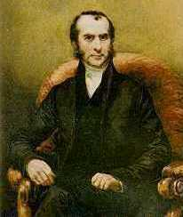
THANK YOU
THOMAS HODGKIN
(1798-1866)

