Slide 1
NonHodgkin Lymphoma

Slide 2
CML | Platelet counts normal Lacunar cells Central nervous system evaluation by lumbar puncture A reciprocal translocation of chromosomal material between chromosomes 9 and 21 Left upper quadrant abdominal pain Superior vena cava syndrome Painful lymphadenopathy Bulky disease PET scanning Increased proliferation of the granulocytic cell line Increased proliferation of the lymphocytes in the bone marrow The Reed- Sternberg cells occupy the entire node Lymph node biopsy Leukocitosis with neutrophilia | HL

Slide 3
The following statements are true regarding chronic lymphocytic leukemia:
a. the number of peripheral blood lymphocytes exceeds 5000/mm3
b. is a chronic myeloproliferation
c. the cell of origin is a B lymphocyte from the germinal center
d. the IGHV mutation status should be performed together with del 17p and the p53 mutation whenever the need to initiate therapy is established.
e. is an incurable disease

Slide 4
The lymphomas are malignant tumors of lymphoid tissue, characterized by the abnormal proliferation B or T cells in lymphoid tissue
Multicentric onset (many sites afected)
Extranodal sites involved more frequent
Adult – most frequent hematologic malignancies
Children
Acute leukemias
Brain tumors
NHL

Slide 5
Viruses | VEB (2/3 Burkitt lymphoma in patients with AIDS) HTLV-1 (T lymphoma) Helicobacter pilory MALT lymphoma C hepatitis virus (primary spleen lymphoma) herpes virus 8 ( Kaposi sarcoma)
Immunodeficiency | Inherited Ataxia telangiectazia Wischott Aldrich syndrome Aquaired Organs transplantation – chronic immunosuppresive treatment ( cardiac, BM > kidney) HIV Autoimmune diseases: Sjogreen syndrome Autoimmune thyroiditis Hashimoto – primary thyroid lymphoma
Other factors | male age History – other neoplastic diseases in relatives Hair dye

Slide 6
WHO Lymphoproliferative disorders
B-Cell Neoplasms
Precursor B-cell neoplasm
Precursor B-lymphoblastic leukemia/lymphoma
(precursor B-acute lymphoblastic leukemia)
Mature (peripheral) B-neoplasms
B-cell chronic lymphocytic leukemia / small lymphocytic lymphoma
B-cell prolymphocytic leukemia
Lymphoplasmacytic lymphoma
Splenic marginal zone B-cell lymphoma
(+ villous lymphocytes)
Hairy cell leukemia
Plasma cell myeloma/plasmacytoma
Extranodal marginal zone B-cell lymphoma of MALT type
Nodal marginal zone B-cell lymphoma
(+ monocytoid B cells)
Follicular lymphoma
Mantle cell lymphoma
Diffuse large B-cell lymphoma
Mediastinal large B-cell lymphoma
Primary effusion lymphoma
Burkitt’s lymphoma/Burkitt cell leukemia
T and NK-Cell Neoplasms
Precursor T-cell neoplasm
Precursor T-lymphoblastic leukemia/lymphoma
(precursor T-acute lymphoblastic leukemia
Mature (peripheral) T neoplasms
T-cell chronic lymphocytic leukemia / small
lymphocytic lymphoma
T-cell prolymphocytic leukemia
T-cell granular lymphocytic leukemia
Aggressive NK leukemia
Adult T-cell lymphoma/leukemia (HTLV-1+)
Extranodal NK/T-cell lymphoma, nasal type
Enteropathy-like T-cell lymphoma
Hepatosplenic γδ T-cell lymphoma
Subcutaneous panniculitis-like T-cell lymphoma
Mycosis fungoides/Sézary syndrome
Anaplastic large cell lymphoma, T/null cell,
primary cutaneous type
Peripheral T-cell lymphoma, not otherwise characterized
Angioimmunoblastic T-cell lymphoma
Anaplastic large cell lymphoma, T/null cell,
primary systemic type
Hodgkin’s Lymphoma (Hodgkin’s Disease)
Nodular lymphocyte predominance Hodgkin’s lymphoma – 5%
Classic Hodgkin’s lymphoma – 95%
Nodular sclerosis Hodgkin’s lymphoma
Lymphocyte-rich classic Hodgkin’s lymphoma
Mixed cellularity Hodgkin’s lymphoma
Lymphocyte depletion Hodgkin’s lymphoma

Slide 7
Low grade non Hodgkin's lymphomas (indolent) | Small cell lymphocytic Follicular grade 1,2 (it is the most common type of lymphoma) Mantle cell Splenic marginal zone lymphoma MALT lymphoma Lymphoplasmocytic NHL
High grade non Hodgkin's lymphomas (aggressive) | Diffuse large B cell Burkitt's lymphoma Anaplastic large cell lymphoma Follicular grade 3
Very high grade non Hodgkin’s lymphomas (high aggressive) | Lymphoblastic lymphoma ( T 95%) Burkitt lymphoma
Low grade non Hodgkin's lymphomas (indolent) with particular sites | MALT lymphoma Mycosis fungoides/Sezary syndrom

Slide 8
Low grade lymphoma | High grade lymphoma
long natural history (patients can live for many years untreated) | short natural history (patients die within months if untreated)
disease of slow cellular accumulation | disease of rapid cellular proliferation
Generally incurable with chemotherapy | Potentially curable with chemotherapy
Slow onset with slow progression of lymph nodes who can increase or decrease in time | Abrupt onset with rapid progressive lymphadenopathy
Mobile and tender lymph nodes, painless, rarely with high diameter, without trend to form conglomerates | Mobile and tender lymph nodes but often high consistence, lymph nodes conglomerates sometimes > 10 cm Waldeyer ring can be affected in the same time with stomach or small bowel

Slide 9
Low grade lymphoma | High grade lymphoma
Liver and spleen frequent affected without impairing their function | When liver is affected also the liver function is abnormal
BM is more often affected from start but with normal value of Hb, granulocytes and platelets. Secondary anemia is rare no matter what are the cause: AHAI, bone marrow infiltrate… | BM is less affected than low grade lymphoma, but can appear in evolution
Brain, kidney, testis are rare involved | Extranodal sites are frequent: lung, skin, bone, brain
Compression complication are rare | Compression complication more frequent than low grade lymphoma

Slide 10
Adenopatie laterocervicala giganta la o pacienta cu boala Hodgkin, respectiv pacient cu LMNH difuz cu celula mare B

Slide 11
Adenopatii laterocervicale multiple la un pacient cu limfom folicular

Slide 12
Mycosis fungoides

Slide 13
Mycosis fungoides

Slide 14
Mycosis fungoides

Slide 15
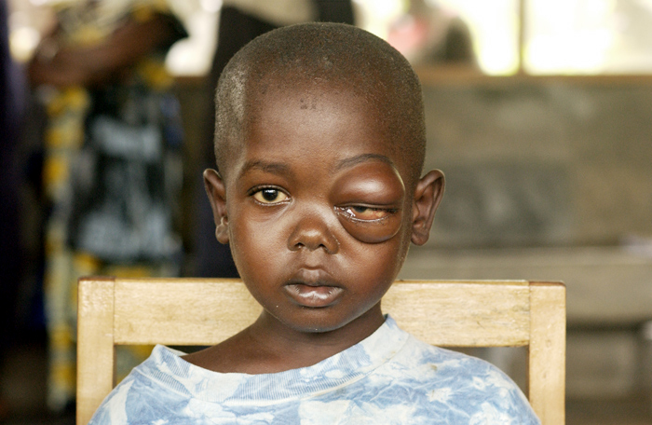
Limfom Burkitt

Slide 16
Positive diagnosis

Slide 17
History
B symptoms
* fever — >38ºC
* weight loss >10 % in last 6 months
* night sweats
Lymphadenopathy
* time to progression
* how many sites are involved
* peripheral lymphocitosis

Slide 18
Clinical
Symptoms
Clinical exam
Symptomes related to lymphadenopathy, such as:
mediastinal compression
Lymphoedema
B symptoms
Symptoms related to extranodal sites - digestive, meningitis
Rarely, accidentaly diagnosis, in asimptomatic patients who dyscover the lymph nodes enlargement
Different sizes and consistence lymphadenopathy
If in HL - common to have a “localized” presentation and spread to contiguous nodes / HNL – spread by skipping lymph nodes sites
Frequent splenomegaly şi hepatomegaly
Skin lesions
CNS involvement
Digestive symptoms
Frequent anemia
Rarely bleeding

Slide 19
Lab tests
ESR, CBC, liver and kidney function, serum uric acid…
LDH and beta 2 microglobulin
Coombs test – hemolytic anemia
Protein electrophoresis - monoclonal peak
Pulmonary X ray
ultrasonography
CT torax + abdomen
Upper endoscopy – MALT lymphoma
Examenul LCR în limfoamele de mare malignitate aflate în std IV.
Immunophenotyping – B lymphoma CD19, CD20, CD22, SIg. T lymphoma – CD2, CD3, CD7
Cytogenetic exam– ex. t(8;14) Burkitt lymphoma, t(14;18) in FL
BM biopsy
Viral tests – HIV, B and C hepatitis virus, EBV, HTLV1

Slide 20
Diagnosis criteria
Lymph node biopsy > 1cm, least 1 month, without inflamatory signs
Extralymphoid site
Histopathological exam
Immunohistochemical exam
Cytogenetic exam
Molecular biology

Slide 21
Hystopathological exam
Cell dimension
Describe the morphological features of proliferant cell
Nodular or diffuse proliferation

Slide 22
Immunophenotype
lymphoid – nonlymphoid proliferation
Which is the proliferant line – B/T
Clonal – nonclonal proliferation
Clonal proliferation – kappa/lambda restriction Ly B

Slide 23
Immunophenotyping in B-lymphomas
Type/Ag | SIg | CD5 | CD20 | CD10 | CD19 | CD23 | CD38 | CD103
CLL | +dim | + | + | - | + | + | - | -
FL | ++ | - | + | + | + | - | - | -
MCL | ++ | + | + | - | + | - | - | -
SMZL | ++ | - | + | - | + | - | - | -
HCL | +++ | - | + | - | + | - | - | +
MM | - | - | -/+ | - | - | - | + | -

Slide 24
Chromosomal Translocations Commonly Associated With Activation in B-Cell Malignancies
Oncogene |  | Protein | Translocation |  | Disease
bcl-1 | Cyclin D₁ |  |  | t(11;14) | MCL
bcl-2 | BCL2 (antiapoptosis) |  |  | t(14;18) | FL
bcl-6 | Zinc-finger transcription factor |  |  | t(3;14) | DLBCL (some follicular NHL)
Primary - initiate malignant proliferation, related to histological subtype
Secondary – progression
Notes:
Chromosomal translocations are commonly associated with activation or worse prognosis in B-cell malignancies. The table reviews some of the more common translocations associated with different B-cell malignancy histologies and the relationship of the translocation to the corresponding oncogene.
MCL frequently has chromosomal translocation t(11;14)(q13;q32). This juxtaposes the bcl1 locus with the IgG locus. Such an alteration results in deregulation of the bcl1 locus and expression of its gene product cyclin D1 which is not normally expressed in B cells. Activation of bcl1 appears to be critical in the pathogenesis of MCL. Cyclin D1 is important in cell cycle control, and bcl1 is considered a proto-oncogene.
A translocation of t(14;18) (q32;q21) is present in approximately 85% of cases FL and 15%-20% of DLBCL cases. This change results in rearrangement of the bcl2 gene, leading to activated forms of NHL.
Some translocations are very frequently and highly associated with a particular histology and prognosis; in DLBCL, which is an aggressive heterogeneous lymphoma, there are several different translocations observed, each with a different prognosis. Examples include: 30% of cases have t(14;18) with bcl2 overexpression, 35% have 3q27 rearrangements with bcl6 overexpression, and rare cases have t(8;14) with c-myc overexpression.
National Comprehensive Cancer Network, Inc. Practice Guidelines in Oncology. v.1.2005.
Skarin and Dorfman. CA Cancer J Clin. 1997;47:351.
Jennings and Foon. Blood. 1997;90:2863.

Slide 25
Staging Classification - Ann Arbor Stage I: involvement of single lymph node region or lymphoid structure +/- extranodal site, localised, by contiguity Stage II: involvement of two or more lymph node regions on same side of the diaphragm +/- extranodal site, localised, by contiguity Stage III: involvement of lymph node regions or structures on both sides of diaphragm +/- extranodal site, localised, by contiguity Stage IV: involvement of extranodal site(s), diffuse, by hematologic spread
A. Asymptomatic
B. Symptomatic (B symptoms)
X. Bulky disease :
> 1/3 widening of mediastinum,
> 10cm max.dimension of nodal mass
E. Involvement of a single, localised, extranodal site

Slide 26
Follicular Lymphoma
Most frequent indolent lymphoma
Late stage at diagnosis
asymptomatic
Origin cell: B Ly from germinal centre
t(14;18) and bcl2 overexpression with antiapoptosis effect
HPF – high power field 400X

Slide 27
Diffuse large B‐cell lymphoma
Most common type of “aggressive” lymphoma
Accounts for ~ 31% of all lymphomas
Usually symptomatic
Extranodal involvement is common
Cell of origin: germinal center B‐cell
Treatment must start from diagnosis moment should be offered
Curable if chemo‐sensitive upfront, not so if chemo‐refractory or relapses within 6 months

Slide 28
Mantle zone lymphoma
The most aggressive indolent lymphoma
Hp:
classic
blastic
IF: B Ly markers, CD5, Ciclina D1
Origin cell: B Ly from mantle zone
T(11;14)

Slide 29
IPI - International Prognostic Index – agressive lymphoma
Age >60
Serum LDH
ECOG performance status 2, 3, 4
Ann Arbor clinical stage III or IV
Number of involved extranodal disease sites >1

Slide 30
ECOG Performance Status
Performance Status Definition
0 Fully active; no performance restrictions
Strenuous physical activity restricted; fully ambulatory and
able to carry out light work
Capable of all selfcare but unable to carry out any work
activities, Up and about 50 percent of waking hours
Capable of only limited selfcare; confined to bed or chair,
less than 50% of waking hours
Completely disabled; cannot carry out any selfcare; totally
confined to bed or chair

Slide 32
Indolent NHL: guiding treatment principle
Incurable
OS - years
Despite indolent course – high morbidity and mortality
Can evolve to aggressive form: FL grade 3 or DLBCL
Early treatment does not prolong overall survival
When we have to treat?
constitutional symptoms
compromise of a vital organ by compression or infiltration, particularly the bone marrow
bulky adenopathy
rapid progression
evidence of transformation

Slide 33
Indolent NHL: treatment options
watch and wait
radiation to involved fields / single agent chemotherapy
chlorambucil + prednisone, fludarabine
combination chemotherapy CVP, FC, CHOP
chemotherapy + monoclonal antibodies
monoclonal antibodies
stem cell transplantation - MCL

Slide 34
Aggressive NHL: treatment approach
Curable
Patients have the potential to be cured
Administer most effective therapy at diagnosis
If not cured, patients typically die within a few years of diagnosis
Stage I‐II: combined modality therapy - cure rate around 70%
CHOP chemotherapy x 3 + IF radiotherapy
Stage III‐IV (also bulky stage II) - cure rate around 40%
(R)CHOP chemotherapy x 6‐8 cycles

Slide 35
CLINICAL CASE
E. M 50 years, urban environment
APP: Depressive Syndrome, Mallory-Weiss Syndrome,
Clinical exam: ECOG performance status = 1, SC 1.7 m2, relatively good general condition, afebrile, discreetly pale skin and mucous membranes;
1 lymph node (LN) to the cervical left zone of 1 cm,
2 submandibular lymph nodes of 3.5 cm left, respectively 3 cm right,
1 LN- left inguinal region of approx. 3 cm,
2-3 LN of approx. 1 cm right inguinal region, mobile, firm, painless;
A firm, painless palpable tumor of more than 10 cm at the level of the epigastric and mesogastric regions
spenomegaly grade III.

Slide 36
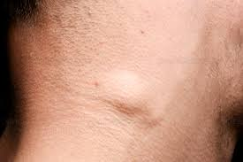

Slide 37
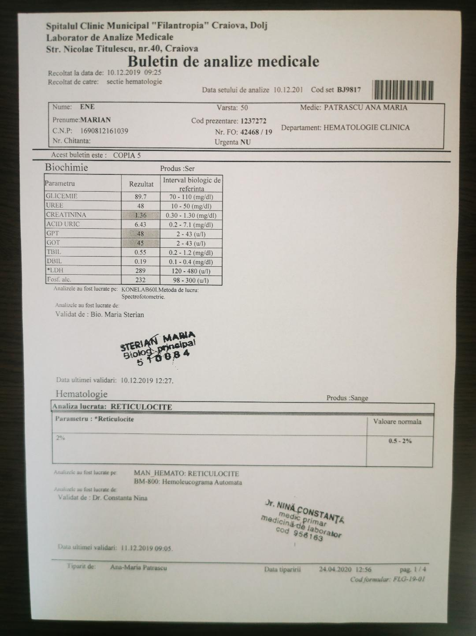

Slide 38
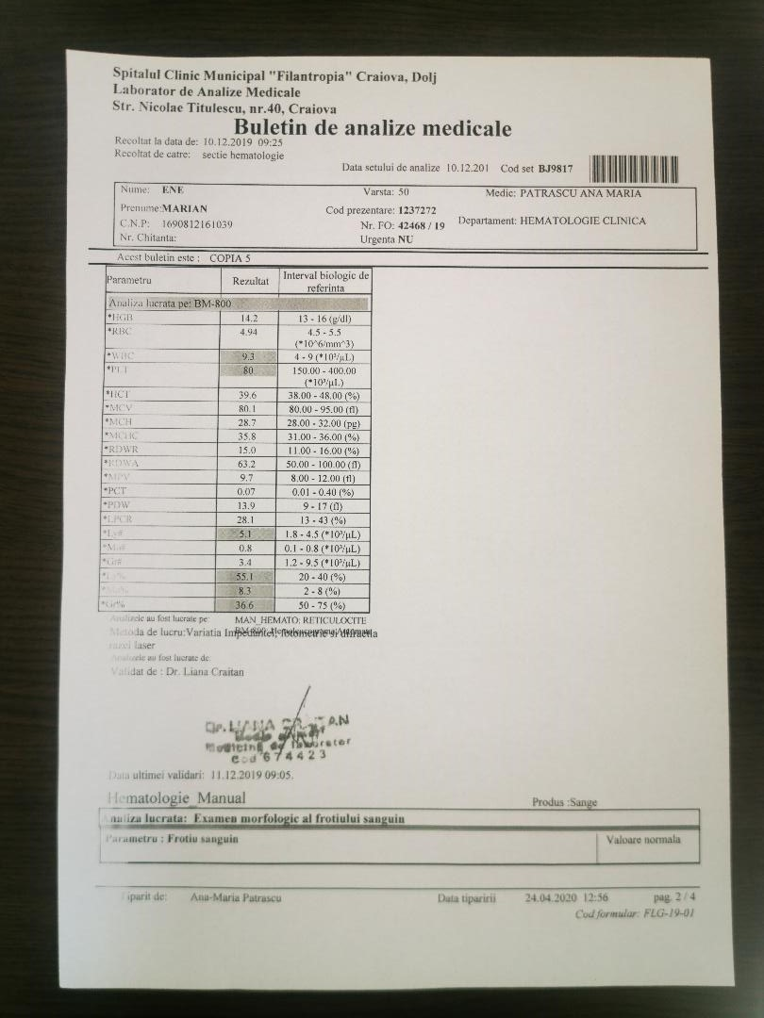

Slide 39
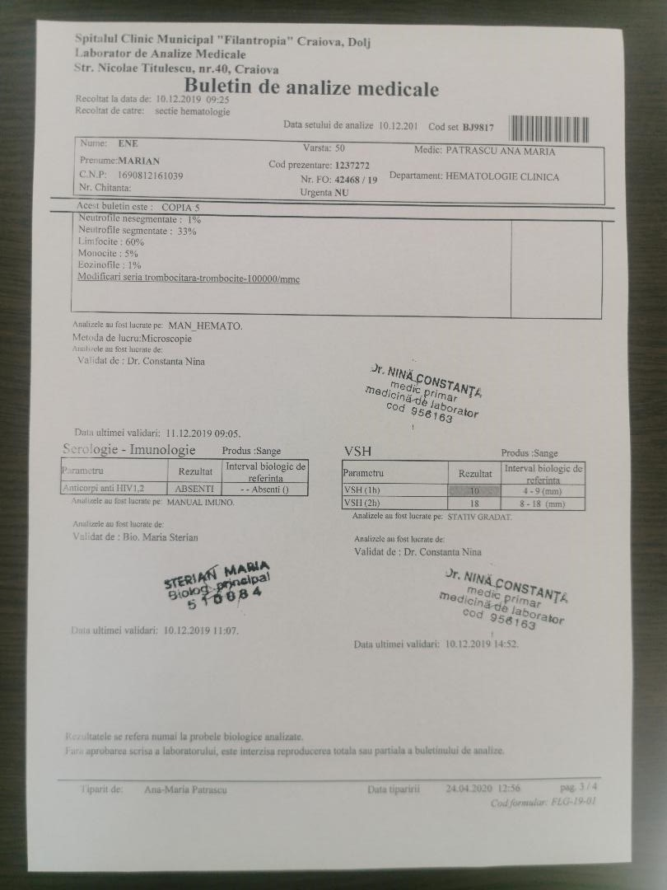

Slide 40
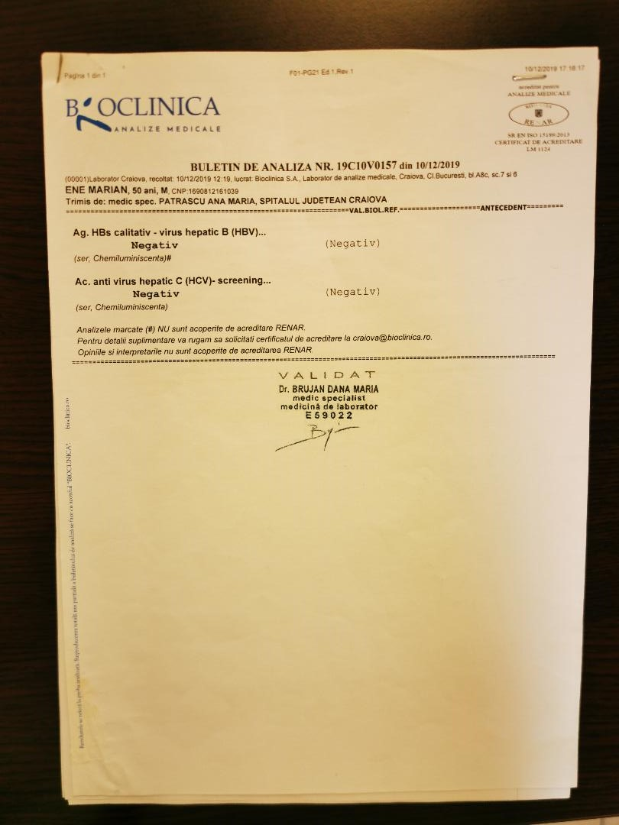

Slide 41
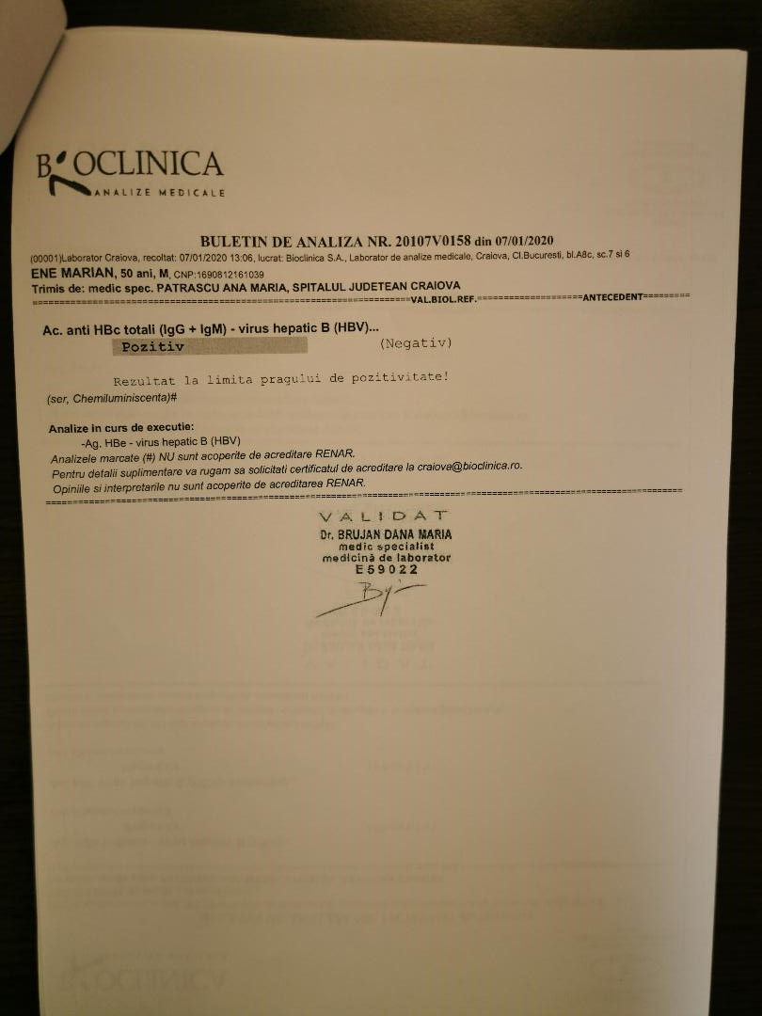

Slide 42
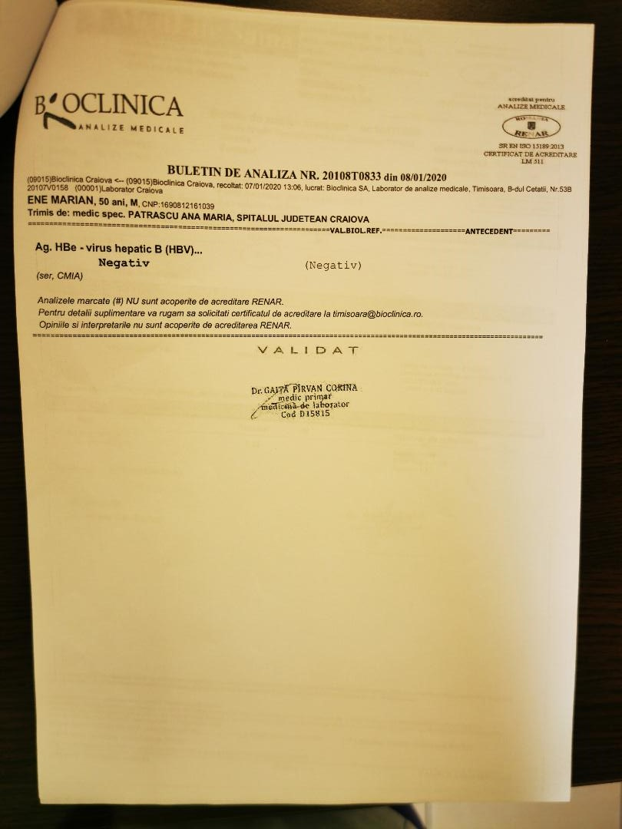

Slide 43
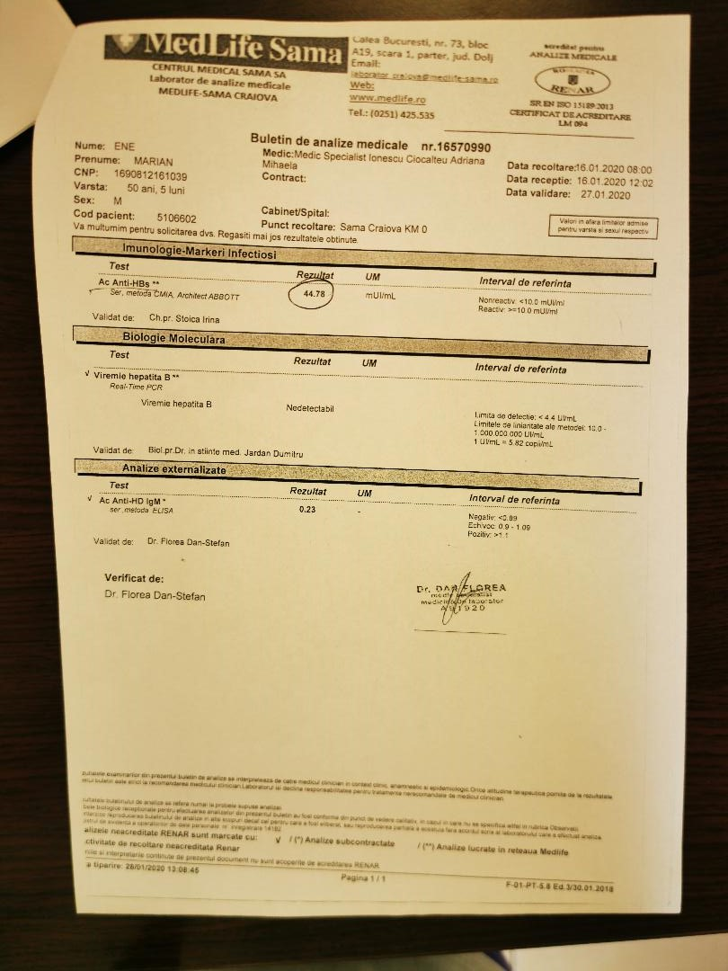

Slide 44
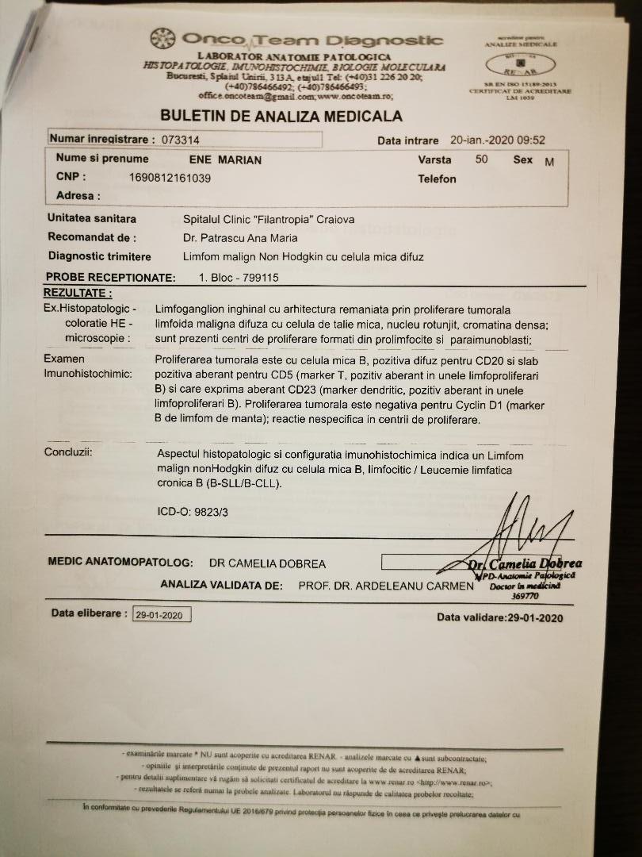

Slide 45
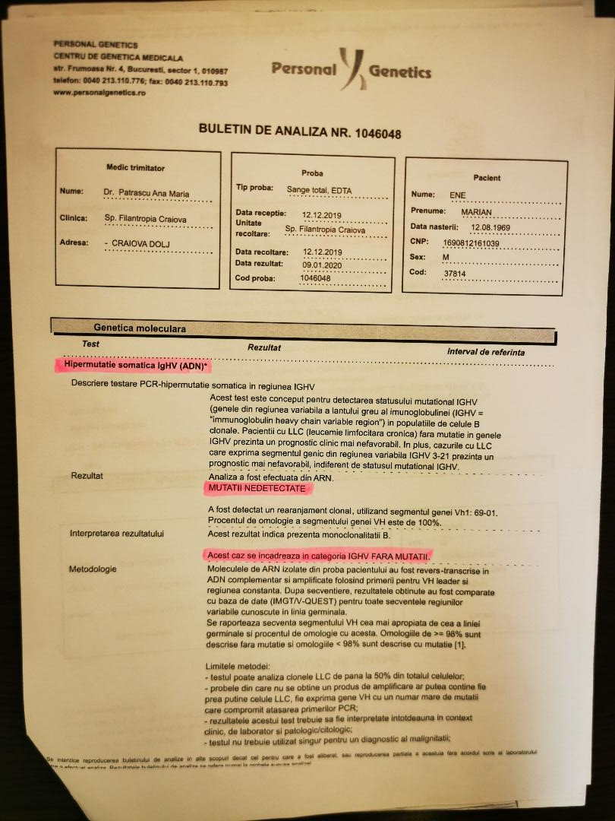

Slide 46
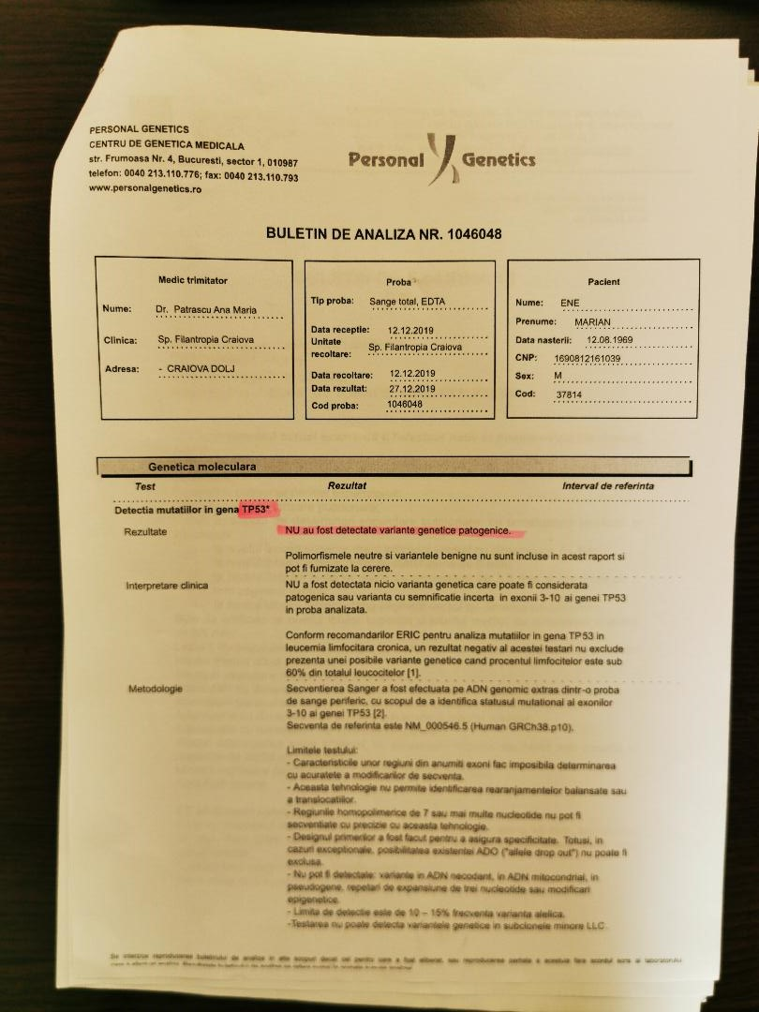

Slide 47
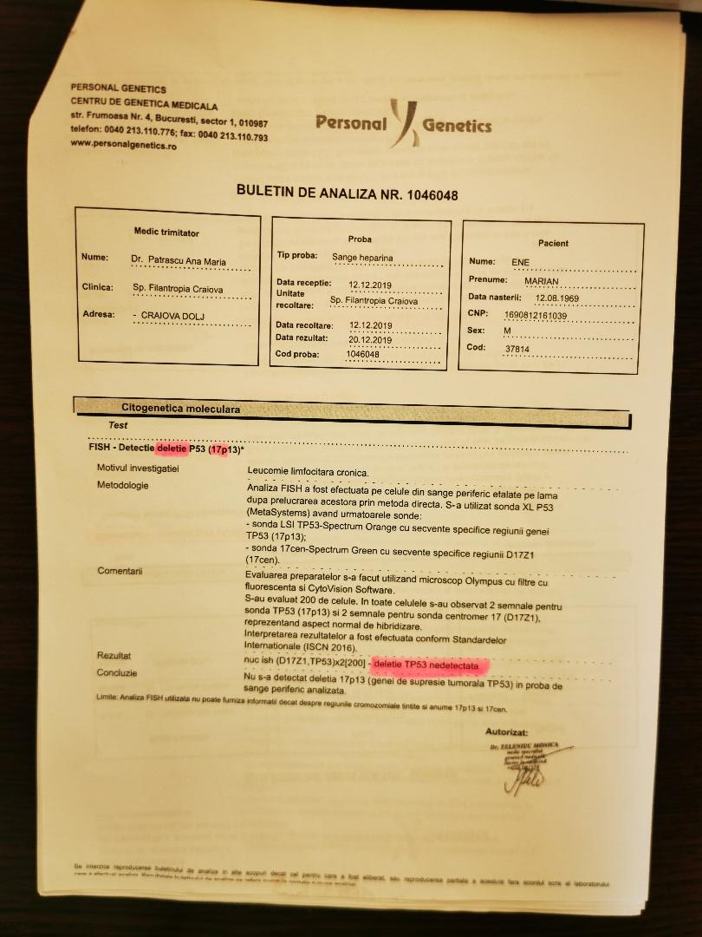

Slide 48
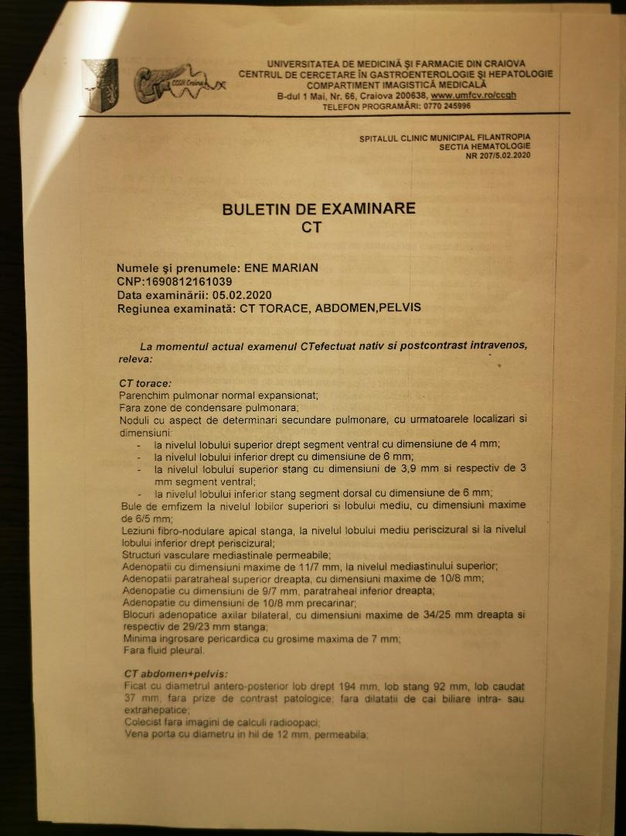
STD IV

Slide 49
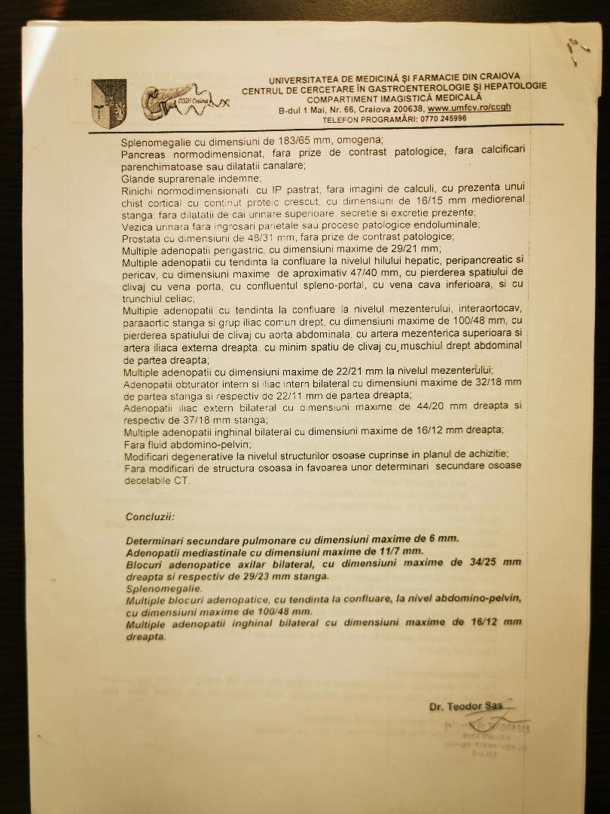

Slide 50
DIAGNOSIS: SMALL LYMPHOCYTIC LYMPHOMA STAGE IV B
TREATMENT:
Prophylactic therapy with Entecavir for Mabthera administration in combination with chemotherapy.
In January, the first R-CVP treatment is administered, which is repeated every 21 days. To date, the patient has followed 6 RCVP treatments with a favorable evolution, with importnt reduction of the lymphadenopathy and spleen, but without complete remision.

