Slide 1
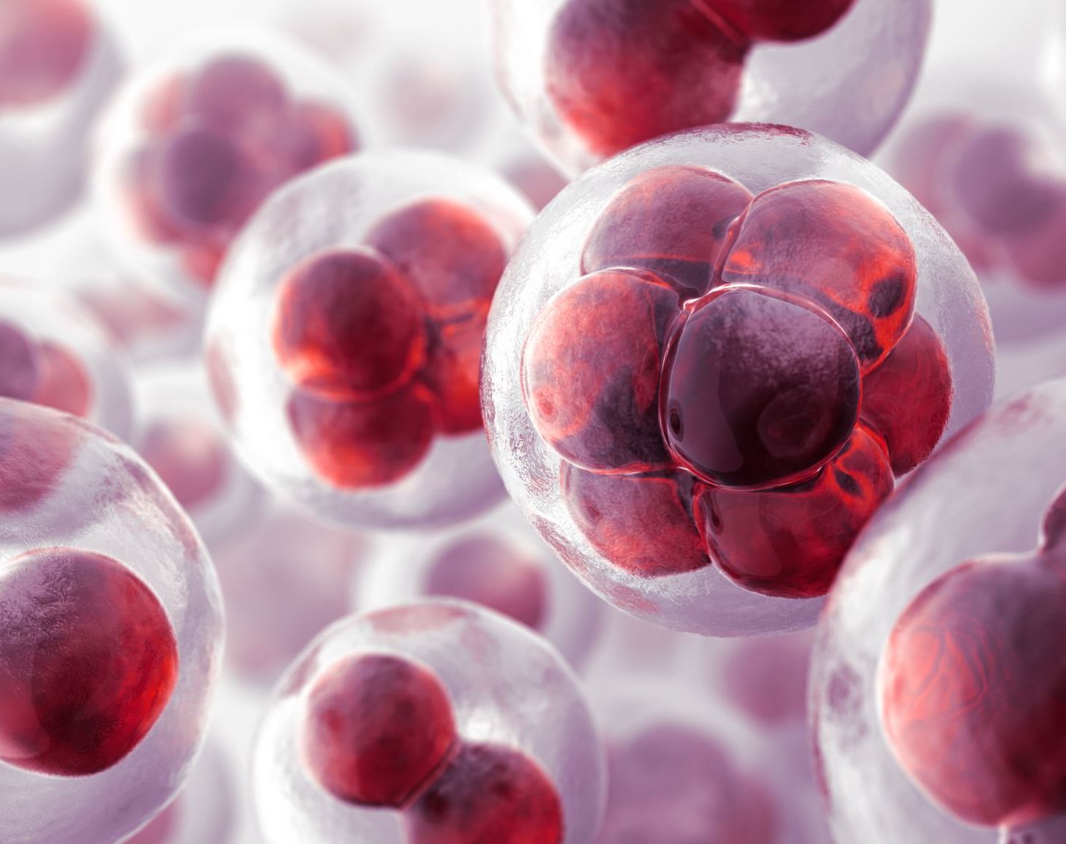
Multiple myeloma
Dr. Patrascu Ana-Maria

Slide 2
Hodgkin's lymphoma:
a. is more common in patients in their 40s and 50s
b. is included into acute lymphoproliferative syndrome
c. it is curable only by bone marrow allotransplantation
d. the patient in stage IV of disease receives 6 cycles and radiotherapy located on the largest tumor that he presented at the time of diagnosis
e. stage III of disease means lymph node involvement on the both sides of the diaphragm

Slide 3
The positive diagnosis in non-Hodgkin's lymphomas implies:
a. performing chest and abdomen CT
b. lymph node biopsy
c. abdominal ultrasound, left ventricular ejection fraction, bone marrow biopsy
d.histopathological, immunohistochemical, cytogenetic and molecular biology exams of lymph node or extralymphatic structures, samples obtained by biopsy
e. lymph node puncture biopsy

Slide 4
Definition
Multiple myeloma (MM) is a malignancy of the plasma cells, which are a type of white blood cell arising from B-cells or B-lymphocytes.
Healthy plasma cells are produced in the bone marrow and play an important role in the immune system.
Multiple myeloma is a plasma cell dyscrasia, which is a disorder that causes an overproduction of abnormal plasma cells.

Slide 5
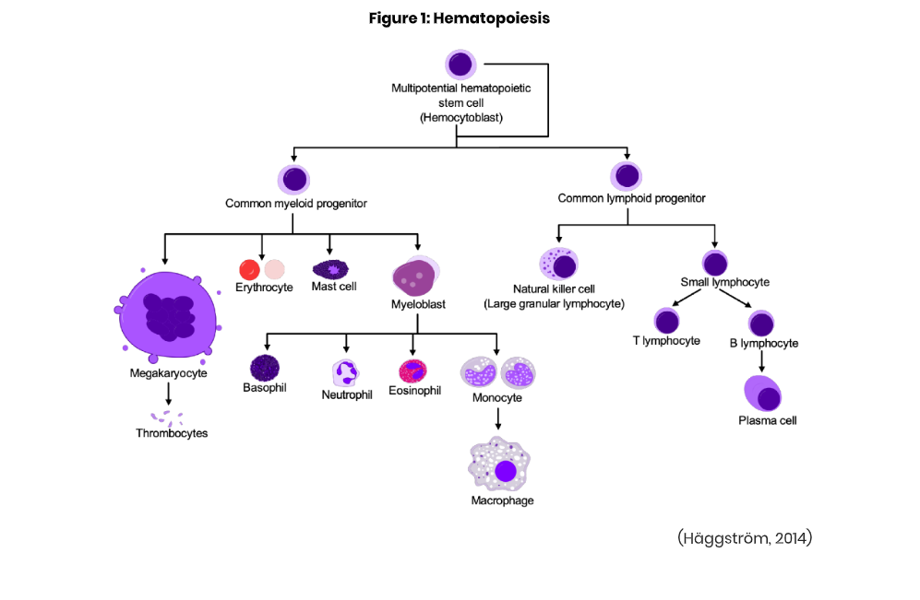

Slide 6
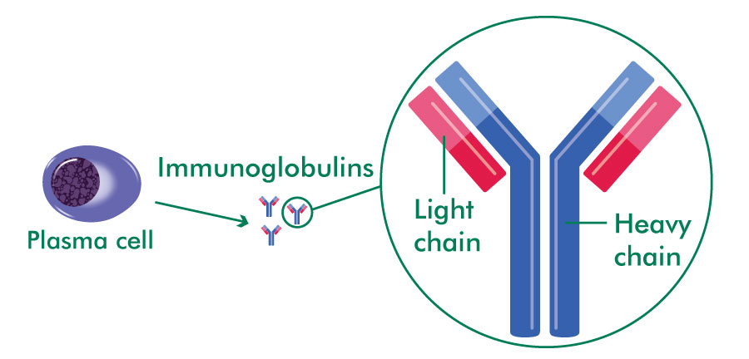

Slide 7
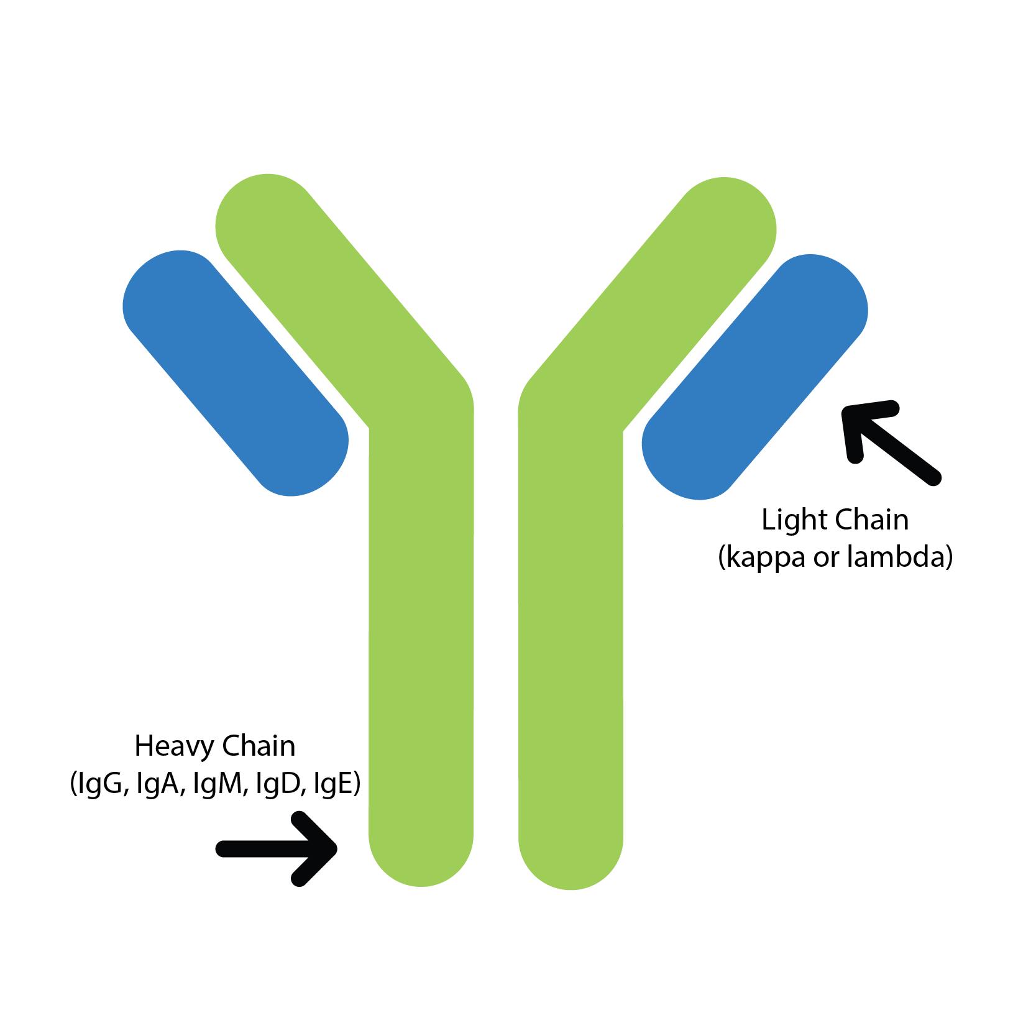
Multiple myeloma = monoclonal gammopathy = increase of a single immunoglobulin (M,G,A,D,E) and its corresponding light chain (kappa and lambda chains)
All the other plasma cells are suppressed => patients with MM are immunologically suppressed
The excess light chains are secreted in urine as Bence Jones proteins

Slide 8
Classification of monoclonal gammopathies
MGUS
Multiple Myeloma
Light chain amyloidosis
Solitary plasmacytoma
Walderstorm macroglobulinemia
Heavy chain disease

Slide 9
Epidemiology
10% of all hematological malignancies
More common in African Americans
More common in men than women
Appears > 40 years (median age of onset = 70 yo)
Most common subtype is IgG kappa, followed by IgA and pure light chain myeloma (kappa or lambda)
Unknown etiology (higher risk with benzene and pesticide exposure)

Slide 10
Pathology
Bone marrow fibroblasts and macrophages
Myeloma cells
IL6, IL1, IL3, IL5
Secrete an inhibitor of osteoblasts differentiation (DKK1)
Increases myeloma cells
Increases RANK-ligand => activates osteoclasts => osteolytic lesions
Decreases erythrocytes

Slide 11
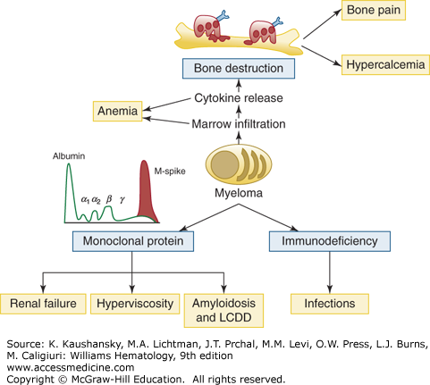
Clinical manifestations

Slide 12
Skeletal system
The most common symptom in MM is bone pain (vertebrae, skull, ribs)
Lytic bone lesion
Pathological fractures
Hypercalcemia

Slide 13
Hematology Neurology
Normochromic, normocytic anemia (MCV – 80-100)
Rouleaux formation => elevated ESR
Increased bleeding time
Radiculopathy – due to vertebral fractures and compressions
Neuropathy – “carpal tunnel syndrome ” – amyloid deposits infiltrate soft tissues around the median nerve
Lethargy, confusion, weakness due to Calcium accumulation
Dyspnea, headache, fatigue due to hyper viscosity syndrome

Slide 14
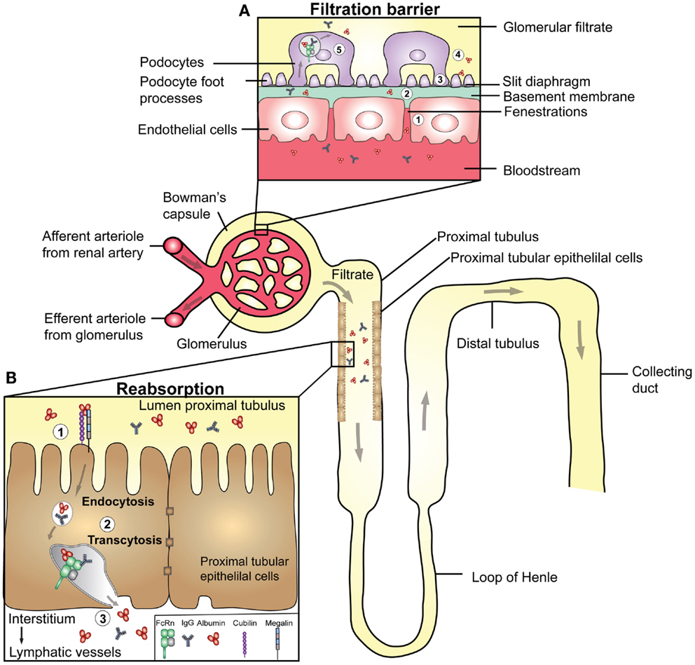
Kidney failure
Hypercalcemia => kidney stones, dehydration, increased risk of infection
Amyloid deposition
Tubular obstruction by Bence Jones proteins
Direct toxicity of paraproteins
Use of NSAIDs for pain

Slide 15
Recurrent infections
Local tumors
Plamacytomas – may produce different symptoms and complications according to their location
Abnormal B-ly => low humoral immunity (despite the overall high level of immunoglobulins) => high risk of bacterial infections and sepsis
(T cells are functional therefore viral infections are not common)

Slide 17
Diagnosis – blood tests
The complete blood count (CBC) counts the number and types of blood cells in a blood sample.
The serum protein electrophoresis (SPEP) finds and measure M proteins.
Immunofixation or immunoelectrophoresis finds the exact type of abnormal M protein antibody.
A blood calcium tests the level of calcium in your blood (a sign of bone loss)
Beta 2-microglobulin (ß2M) level tests how much ß2M is in your blood or urine.
The serum free light chain (SFLC) assay test looks for excess amounts of proteins called light chains.

Slide 18
Protein electrophoresis

Slide 19
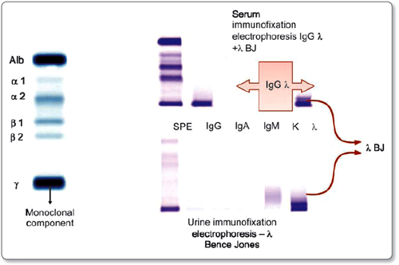
Immunofixation

Slide 20
Urine tests
24-hour urine test looks for the Bence Jones protein (parts of M protein) and other abnormal immunoglobulins (signs of kidney damage).
Chemistry profile tests, also called metabolic panel tests, measure how well the kidneys and liver are functioning.

Slide 21
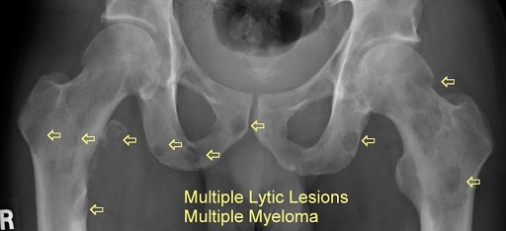
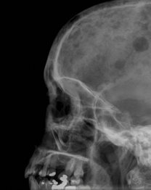
Scans
Such as a skeletal survey, x-rays, MRI, CT, or a PET scan, to look for bone damage and lytic lesions (spots where bone tissue damaged) caused by multiple myeloma.

Slide 22
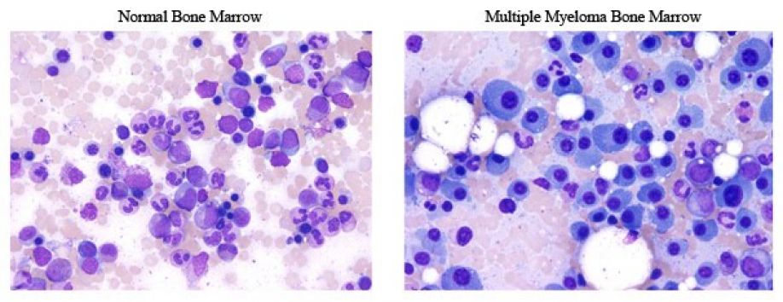
Bone marrow biopsy
Looks at the cells in bone marrow.
It confirms if cancer cells are present, and what type.

Slide 23
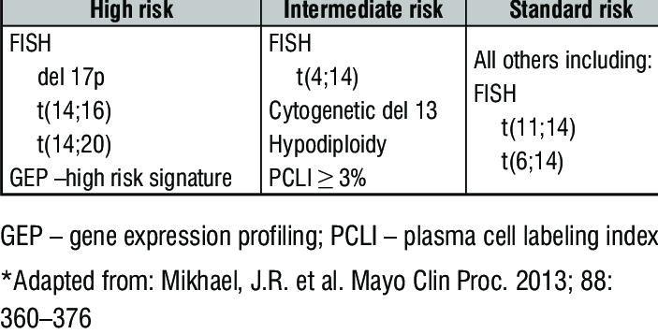
Biomarker tests
Biomarker tests look for changes in the DNA of cells. Types of tests include:
Fluorescence in situ hybridization (FISH)
Immunohistochemistry and Flow cytometry
Cytogenetics and Karyotyping
DNA Sequencing

Slide 24
Salmon Durie staging system

Slide 26
Criteria of diagnosis

Slide 27
Treatment

Slide 28
Multiple myeloma is an incurable disease!

Slide 29
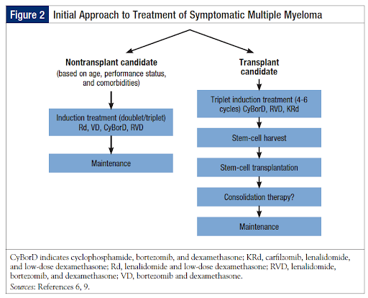
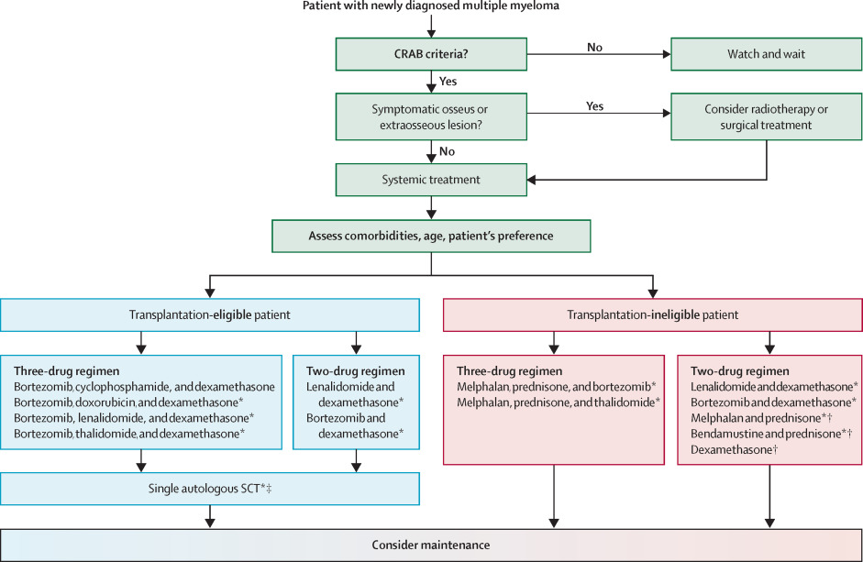
Treatment

Slide 30
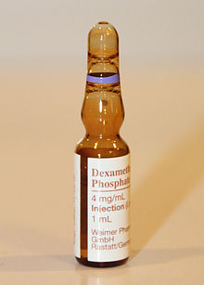
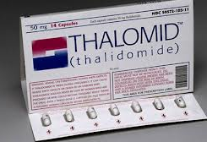
VTD regimen

Slide 31
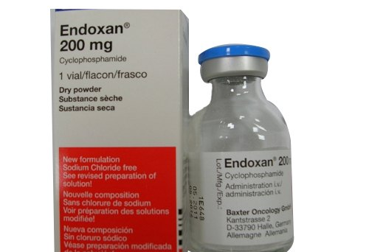
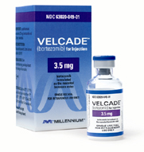
VCD regimen

Slide 32
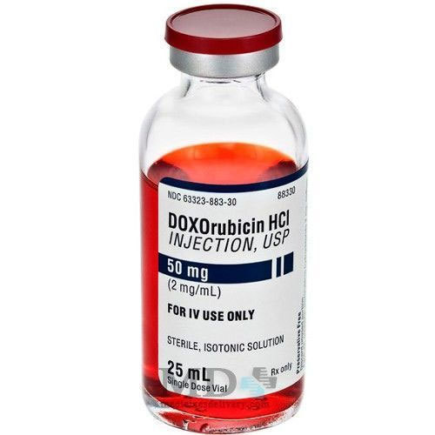
PAD regimen

Slide 33
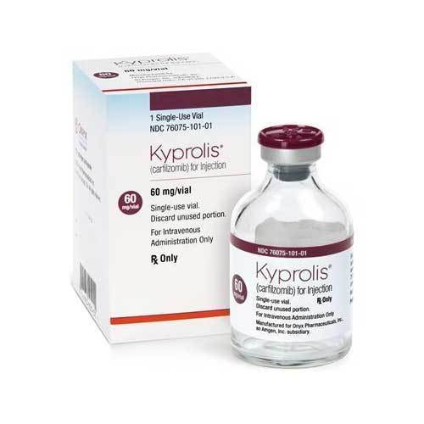
Proteosomes inhibitors
Monoclonal antibodies

Slide 34
Caz clinic

Slide 35
R.V., female, 75 years old,
Addresses the hematology clinic in nov. 2018, with suspicion of multiple myeloma, sent by the Internal Medicine clinic of CFR Hospital Craiova, where he was hospitalized for:
polyarthralgias
myalgia
disability, more pronounced in the lower limbs

Slide 36
At admission:
the same symptomatology with onset of 5-6 months is retained from the anamnesis, in a patient with IInd degree hypertension and CICD controlled therapeutically by administration of:
beta blockers
ACE
calcium channel blockers
diuretics

Slide 37
Physical exam:
pain and limitation of movements in the lumbar spine
Difficult, sustained walk
sclero-tegumentary pallor
pain on percussion of the sacro-lumbar region.

Slide 38
Lab tests
Hb =10,4 g/dl
ESR = 55 mm/h
PCR = 96mg/dl
glucose 106 mg/dl
Creatinin - 1,63-1,42-1,44 mg/dl.
the rest of the biochemical parameters had normal values

Slide 39
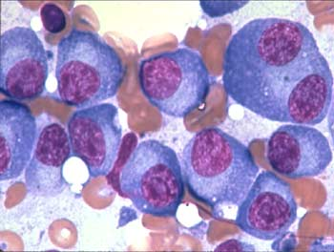
Bone marrow smear:
infiltrated with 10-12% plasma cells
some binucleate plasma cells

Slide 40
Serum protein electrophoresis and immunoelectrophoresis:
peak monoclonal in gamma band range of 41.3%
at a value of 8.9 g / dl of total proteins
Ig G of 3.6 g / dl

Slide 41
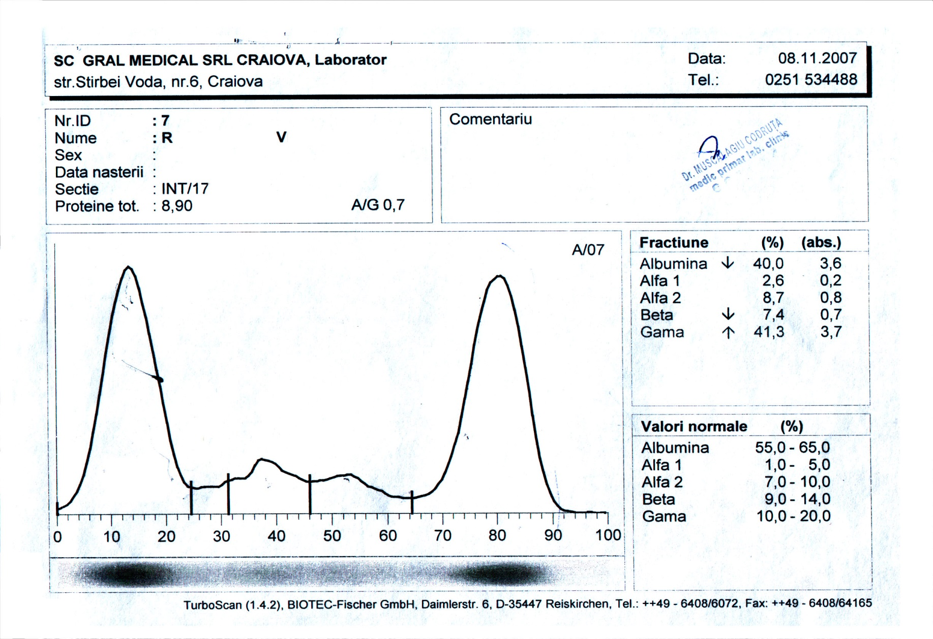
Aspect of serum electrophoresis at diagnosis:

Slide 42
Radiological and MRI changes:
Skull region front and profile:
several images of oval osteolysis of 7/10 mm, well outlined
Spine MRI shows:
impairment at L5 and at the level of the sacrum with local extension in the form of a tumor of 8.5 / 7 cm with hyposignal with presacral development with mass effect on vascular structures and posterior development in contact with nerve roots;
contrast of the thoracic dural sheaths with the appearance of possible meningeal determinations.

Slide 43
Diagnostic:
1.Multiple myeloma Ig G stage IIIA
2. Plasmocytoma with root compression at the level of the sacred roots
3. Acute renal injury
3. Mild anemia
4. CICD
5. HTA std. II
6. Altered glucose tolerance

Slide 44
Treatment:
It was initiated terapy with DEX 40mg/day days 1-4, 9 -13, 17-21 and:
radiotherapy of high voltage on the lombosacrate area of 40Gy. (07-11-2018- 15-12-2018)
adjuvant treatment: Milurit 300 mg/zi, Bonefos, hydrate in order to maintain diuresis 2,5l/day
continue with 5 bortezomib + DEX sequences

Slide 45
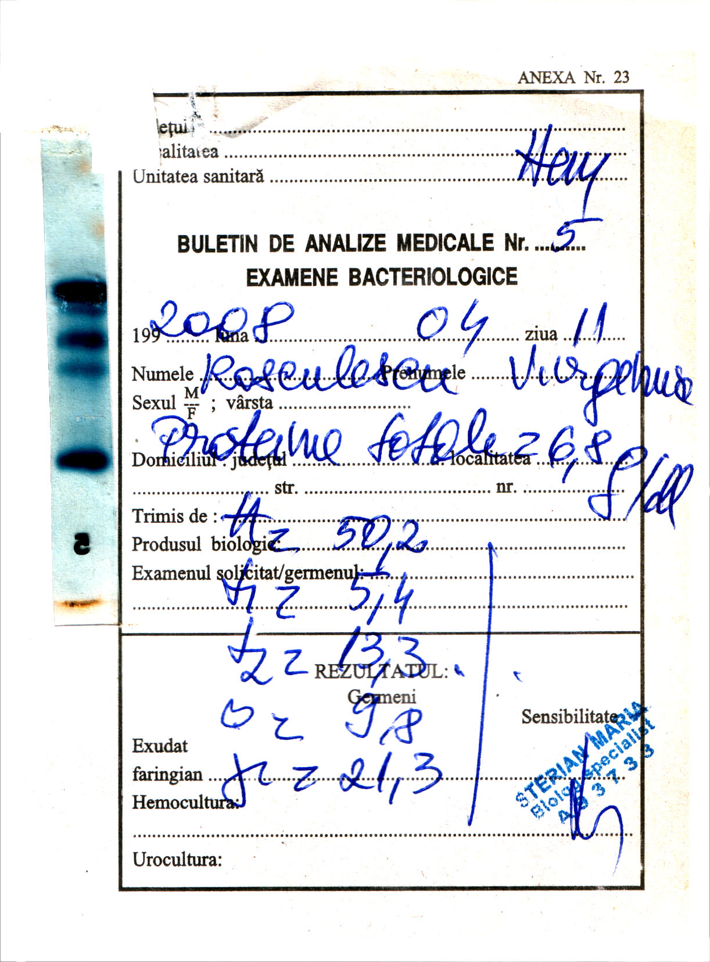
The evolution was favorable
with the reduction of CM to
(PT = 6.8g / dl, γ = 21.3%)
(11.04.2008) and
amelioration of symptoms

Slide 46
In July 2019 it is presented with:
Symptoms: headache (right hemicrania) dyspnea, chest pain in the form of pressure.
Objective: skin pallor, presternal formation of 4/3 / 1.5 cm sensitive, firm consistency.
Puncture in tumor: plasma infiltration 75-80% of which 25-30% plasmablastic character).

Slide 47
CT bulky tumor, pre and retro sternal
9.65 / 9.68 cm in coronary plan, 7.4 cm AP diameter and 8.33 cm cranio-caudal, spontaneous heterodense and inhomogeneous iodophilia. exerts a compressive effect on the subclavian arterial branches, brachio-cephalic arterial trunk, brachio-cephalic veins and superior vena cava, displaced posteriorly and laterally.
It is administered 3 applications Daratumumab + Bortezomib + DEX and blood substitution.
The evolution seems favorable with the decrease until the disappearance of the prestenal formation, but it deteriorates after the third therapeutic sequence, the patient refusing to be hospitalized.

Slide 48
Discussion
The positive MM diagnosis was established by meeting the diagnostic criteria:
CM IgG = 3.6 g / dl
medullary plasmacytosis 10-12%
osteolytic lesions of the skull cap
large presacral tumor mass
Staging Salmon - Duria - std.IIIA by:
Presence of multiple osteolytic lesions,
Creatinine <2mg / dl (after hydration reached 0.94 mg / dl)

Slide 49
Particularity of the case:
Relatively rapid evolution under treatment and the ability of bone lesions to generate bulky extraosseous local tumor invasions

